Slide 1
EELE 461/561 – Digital System Design
Module #3 – Interconnect Modeling with Distributed Elements
Topics
Impedance of Transmission Lines
Textbook Reading Assignments
7.4-7.5, 7.10-7.15, 7.18 8.1-8.2, 8.9-8.10, 8.13-8.19
What you should be able to do after this module
Know when to use lumped vs. distributed modeling
Calculate the reflections off of an impedance discontinuity
Draw the timing diagram of a transmission line with reflections
Draw a bounce diagram

Slide 2
Impedance (T)
Transmission Lines - Transmission Lines are “Distributed” elements - This means that there is propagation delay from the beginning of the line to the end of the line - In reality, all “wires” are Distributed. However, sometimes they are so short the propagation delay can be ignored. - We do this to simplify the circuit analysis: “Lumped System” - the dependant variables (V & I) are only a function of time. “Distributed System” - the dependant variables (V & I) are a function of time AND space. - We say that any conductor that has Length, needs to be treated as a distributed system. - When we use a Transmission Line element, we always specify two parameters: 1) Impedance (Z₀) 2) Prop Delay (T_{D})

Slide 3
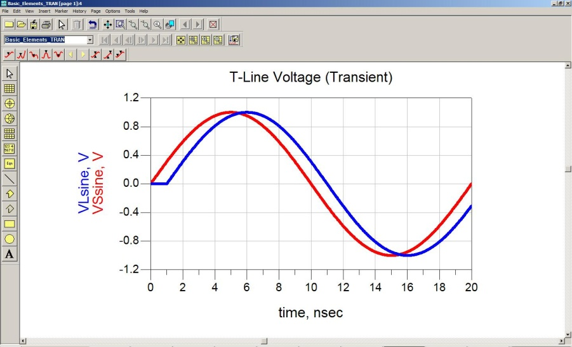
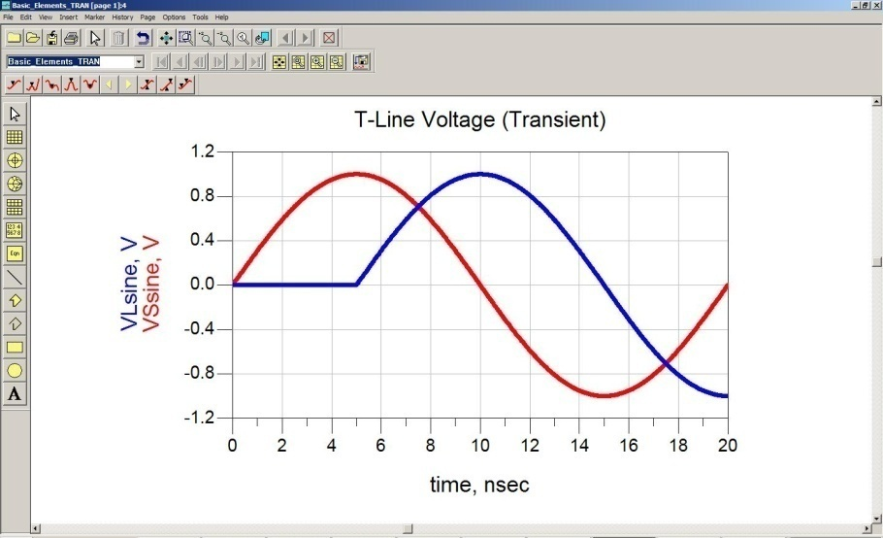
Transmission Lines
Lumped vs. Distributed - The first question we always ask when looking at a system is whether it needs to be treated as “Lumped” or “Distributed”. - We need to treat a conductor as “Distributed” when: “the length of the interconnect is comparable to the wavelength present in the signal” “Delay is not large relative to λ” “Delay is large relative to λ”

Slide 4
Transmission Lines
Lumped vs. Distributed - In a vacuum, the following expression relates frequency and wavelength: ex) if we have a GHz sine wave in a vacuum: and you drive a 12” length of perfect interconnect (i.e., in a vacuum) a full cycle of the sine wave occurs at the source before the energy is seen at the end of the line. This illustrates that the voltage on the line is definitely dependant on time AND space. Or said another way, the voltage in the line is NOT the same at all parts, so its distributed effect cannot be ignored.

Slide 5
Transmission Lines
Lumped vs. Distributed - A more precise description for when to use distributed modeling is: “when the time to change voltage on the signal is comparable to the time it takes to propagate down the line” - We can use the rule of thumb that we use distributed modeling when: NOTE: some people use λ/4, or a quarter wavelength. We’ll use λ/10 for this class
- To put in terms of digital risetimes and prop delay, the rule of thumb is: Use Distributed When: Use Lumped When:

Slide 6
Transmission Line Parameters
Propagation Delay - If our interconnect resides in a vacuum, it will travel at the speed of light: - This is equivalent to: - If it travels in a medium that is NOT a vacuum, the velocity is given by: and

Slide 7
Transmission Line Parameters
Propagation Delay - Most microelectronic dielectrics have relative permittivity (a.k.a., D_{k} or Dielectric Constant) between 2-10 ex) what is the wave velocity if ε_{r}=4?

Slide 8
Transmission Line Parameters
Propagation Delay - Risetimes of modern off-chip digital drivers are anywhere from 100ps to 1ns ex) if t_{rise}=1ns and ε_{r}=4, when do we need to consider the interconnect distributed? We consider the distributed nature when the delay of the interconnect is 1/10 of the source risetime (1n/10 or 100ps) Since ε_{r}=4, the speed of the interconnect is 167ps/in That means that we consider distributed at (100/167): 0.6” ex) if t_{rise}=100ps and ε_{r}=4, when do we need to consider the interconnect distributed? (10/167) = 0.06” ex) if t_{rise}=10ns and ε_{r}=4, when do we need to consider the interconnect distributed? (10000/167) = 6” NOTE: 6” is pretty large. That’s why 10 years ago digital designers didn’t use transmission lines.

Slide 9
Transmission Line Parameters
Propagation Delay - Today, risetimes are consistently below 1ns. That means EVERYTHING in a system is treated as a transmission line. NOTE: When we say system, we are typically talking about chip-to-chip communication using a combination of PCB’s, cables, and connectors. On-Chip interconnect is still small enough to be treated as a lumped element.
Physical Construction of a T-Line - A T-line is simply a conductor. This means that at DC, if its resistance is negligible, the wire is transparent. - So we only consider the impedance and prop delay of the T-line when the wave is traveling. - This allows us to quickly analyze a circuit at AC and then again at DC (i.e., steady state) to get a feel for the behavior at the beginning and end of the edge transition. We can then perform a deeper analysis to understand the transient behavior.

Slide 10
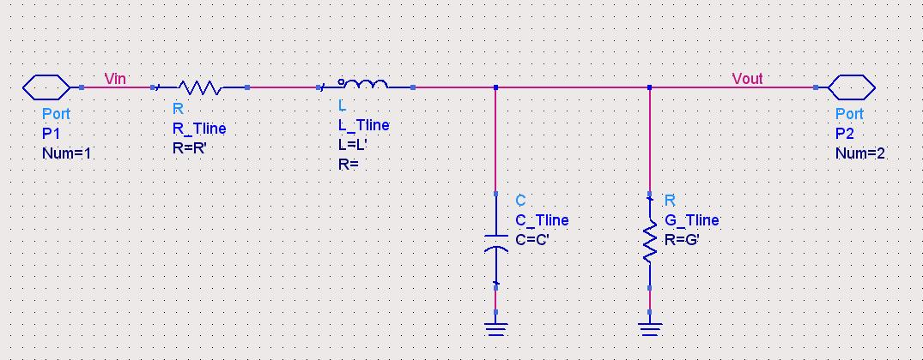
Transmission Line Parameters
Circuit Model - A T-line is a distributed element in which voltage and current depend on both time and space. - A property of a distributed system is that waves can travel both in a forward and reverse direction. - The voltage at any given point is the superposition of the forward and reverse traveling waves. - We can create a circuit model of a transmission line using RLCG’s that will allow us to better understand the voltage and current on the T-line. R' = Resistance per Unit Length L' = Inductance per Unit Length C' = Capacitance per Unit Length G' = Conductance per Unit Length

Slide 11
Transmission Line Parameters
Circuit Model - This segment will model the voltage and current dependency on time and space. - Using this basic RLCG segment, we can create a Transmission Line model that contains an infinite series of these elements. - As we add more and more segments, the amount of "Length" that the RLCG model represents will shrink to 0. R' = Resistance per Unit Length L' = Inductance per Unit Length C' = Capacitance per Unit Length G' = Conductance per Unit Length

Slide 12
Transmission Line Parameters
Circuit Model - The R in this element represents the "conductor loss" (mainly due to skin effect, more on this later…) - The G in this element represents the "dielectric loss" (due to loss in the insulator, more on this later…) - When we include the R and G in our model, we have a "Lossy Transmission Line" - If we assume there is no loss, we can reduce our model to an ideal "Lossless Transmission Line" consisting of only Inductance and Capacitance.

Slide 13
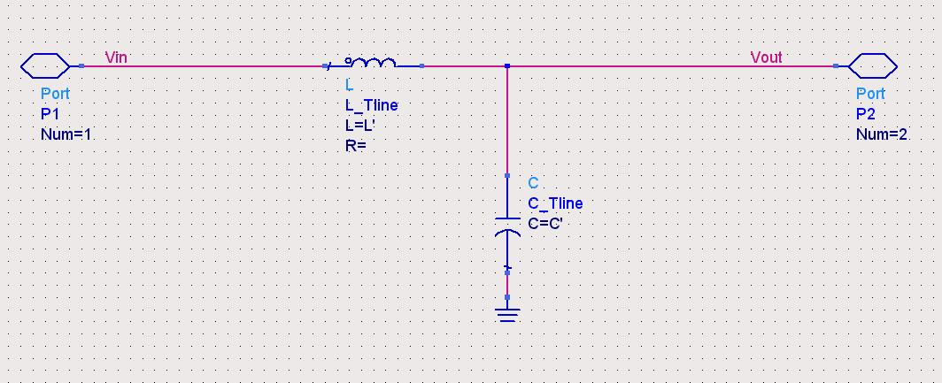
Transmission Line Parameters
Circuit Model - Let's derive the relationship between Voltage & Current to time and space. - We first define the length of the wire using dx. - Since our electrical components are defined in unit length, the total values can be found by multiplying the unit length value by dx. L_{seg} = L'·dx C_{seg} = C'·dx
dx

Slide 14
Transmission Line Parameters
Circuit Model - We enter the segment at (x) and we exit the line at (x+dx)
dx

Slide 15
Transmission Line Parameters
Circuit Model - The input voltage can be described as: V(x,t) - The input current can be described as: I(x,t) - The output voltage can be described as: V(x+dx,t) - The output current can be described as: I(x+dx,t)
I(x, t)
I(x+dx, t)
+
V(x, t)
-
+
V(x+dx, t)
-
dx

Slide 16
Transmission Line Parameters
Circuit Model - We can write an expression for the voltage drop across the inductor using our expression for the voltage on an inductor (V_{L}=Ldi/dt): - If we let dx→0, we are left with:
I(x, t)
I(x+dx, t)
+
V(x, t)
-
+
V(x+dx, t)
-
dx

Slide 17
Transmission Line Parameters
Circuit Model - Now we can write an expression for the current using our expression for the current in a capacitor (i_{C}=Cdv/dt): - If we let dx→0, we are left with:
I(x, t)
I(x+dx, t)
+
V(x, t)
-
+
V(x+dx, t)
-
dx

Slide 18
Transmission Line Parameters
Circuit Model - These two 1st order differential equations describe the interaction of V and I on a T-line. - These are known as the "Telegrapher's Equations" or more formally:

Slide 19
Transmission Line Parameters
Telegrapher's Equations - We can separate these coupled equations by differentiating each to get their 2nd derivative differentiate with respect to x differentiate with respect to t

Slide 20
Transmission Line Parameters
Telegrapher's Equations - We can now substitute into each other using (^{d2I}/_{dxdt}) to form one, 2nd order differential equation
- This is known as the "Wave Equation" - You may have seen the Wave Equation is this form:

Slide 21
Transmission Line Parameters
Wave Propagation - The Wave Equation has a couple of known solutions that are helpful to us. The first is for the velocity of the wave. - The L and C in this expression can describe a particular segment, or the total L and C of the line. Both will result in the same velocity.

Slide 22
Transmission Line Parameters
Propagation Delay - We can manipulate this equation to put it in a more useful form by rearranging and putting it in terms of "Prop Delay for a given length" - This says that the prop delay for a transmission line length with a total L and C is:

Slide 23
Transmission Line Parameters
Characteristic Impedance - Let's go back and look at Telegrapher's Equations in the Frequency Domain. The Frequency Domain allows us to convert the dependency on time to a dependency on frequency: - Let's now differentiate the frequency domain solutions with respect to x to get two, uncoupled, 2nd order differential equations:

Slide 24
Transmission Line Parameters
Characteristic Impedance - We can now substitute in our 1st order differential equations into our 2nd order differential equations to get a solution:

Slide 25
Transmission Line Parameters
Characteristic Impedance - The general solution for the Voltage and Current is: Forward Reverse Traveling Traveling Wave Wave - where we define the β as the Wave Propagation Constant:

Slide 26
Transmission Line Parameters
Characteristic Impedance - If we differentiate the voltage solution, we can get the solution for current by plugging it back into our original Telegrapher's Equation: - Rearranging for I, we get:

Slide 27
Transmission Line Parameters
Characteristic Impedance - Notice that this is in a form to give us Impedance (Z=V/I): - where Z₀ is:

Slide 28
Transmission Line Parameters
Characteristic Impedance - Finally, we can plug back in our expression for the Wave Propagation Constant to get a value for the impedance in terms of L and C:

Slide 29
Transmission Line Parameters
Characteristic Impedance - This is called the Characteristic Impedance of the transmission line - things to notice about a Lossless T-line: - Z₀ does not depend on length - the value of Z₀ does not vary with frequency - the value of Z₀ depends on only L and C, which depend on the T-line geometry and materials - the characteristic impedance only has meaning if waves are traveling i.e., If you put an Ohm meter across a Transmission line, you'll see 0 ohms. However, if you send in an AC signal, the signal will see Z₀

Slide 30
Transmission Line Parameters
Characteristic Impedance - If we have a Lossy Transmission Line, the Characteristic Impedance of the transmission becomes: - things to notice about a Lossy T-line line: - it is Complex!

Slide 31
Transmission Line Parameters
Basic T-Line Equations - The two main equations we use for T-lines are: - So for a given length of Transmission line, if we can find the total capacitance and total inductance, we can derive the prop delay and characteristic impedance:

Slide 32
Transmission Line Parameters
Basic T-Line Equations - Notice that these are related using L and C:

Slide 33
Transmission Line Parameters
Basic T-Line Equations - These expressions say that if we can know the Z₀ and T_{D} of a transmission line, we can determine the total capacitance and inductance of the line:

Slide 34
Transmission Line Parameters
Summary of Transmission Line Parameters Characteristic Impedance: Prop Delay: T-Line Capacitance: T-Line Inductance:

Slide 35
Transmission Line Reflections
Reflection Coefficient - We derived the Characteristic Impedance of a transmission line as: Lossless Lossy - We also described the electrical quantities on a transmission line consisting of both Forward and Reverse Traveling waves using:

Slide 36
Transmission Line Reflections
Reflection Coefficient - As the waves travel down the T-line, reflections may occur that cause “opposite traveling waves” - The ratio of the reflected wave to the incident wave is defined as the Reflection Coefficient: - This is dependant on two things: 1) The impedance that the wave is currently in (i.e., Z₀) 2) The impedance that the wave sees directly in front of it (i.e., Z_{Load} or Z_{L})

Slide 37
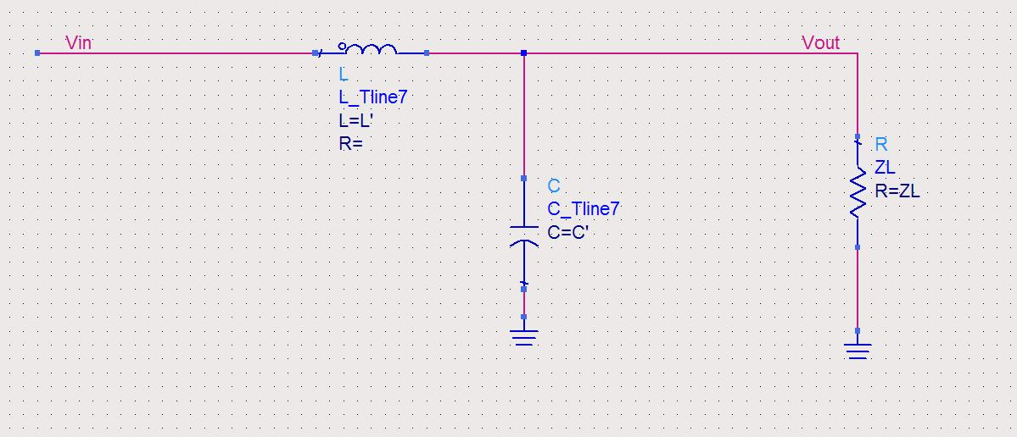
Transmission Line Reflections
Reflection Coefficient - We can derive Γ using our LC T-line segment model by placing a load impedance at the end of the circuit. - We also define the spatial location on the T-line just as before. Except this time, it makes the math easier if we define (x=0) as the location of Z_{L}, and (x-dx) as the location of Z₀
Z₀
(x=-dx)
(x=0)
dx

Slide 38
Transmission Line Reflections
Reflection Coefficient - Across the load impedance, we have: - And we describe the voltage and current as: - Substituting into the expression for Z_{L}, we have:
Z₀
(x=-dx)
(x=0)
dx

Slide 39
Transmission Line Reflections
Reflection Coefficient - Now we can rearrange to get in the form V⁻/V⁺:

Slide 40
Transmission Line Reflections
Reflection Coefficient - The result is the definition of the Reflection Coefficient (Γ) in terms of Z₀ and Z_{L}:

Slide 41
Transmission Line Reflections
Reflection Coefficient - We can use this to describe the percentage of the incident voltage (V_{inc}) that is reflected (V_{refl}) and the percentage that is transmitted (V_{trans}) - As the wave travels down the T-line, the incident wave is continuously evaluating Γ considering the impedance it is currently in, and the impedance directly in front of it. - If the impedance of the load matches the impedance that the wave is traveling in, there will be no reflected energy. Or said another way, 100% of the incident wave will continue down the line.

Slide 42
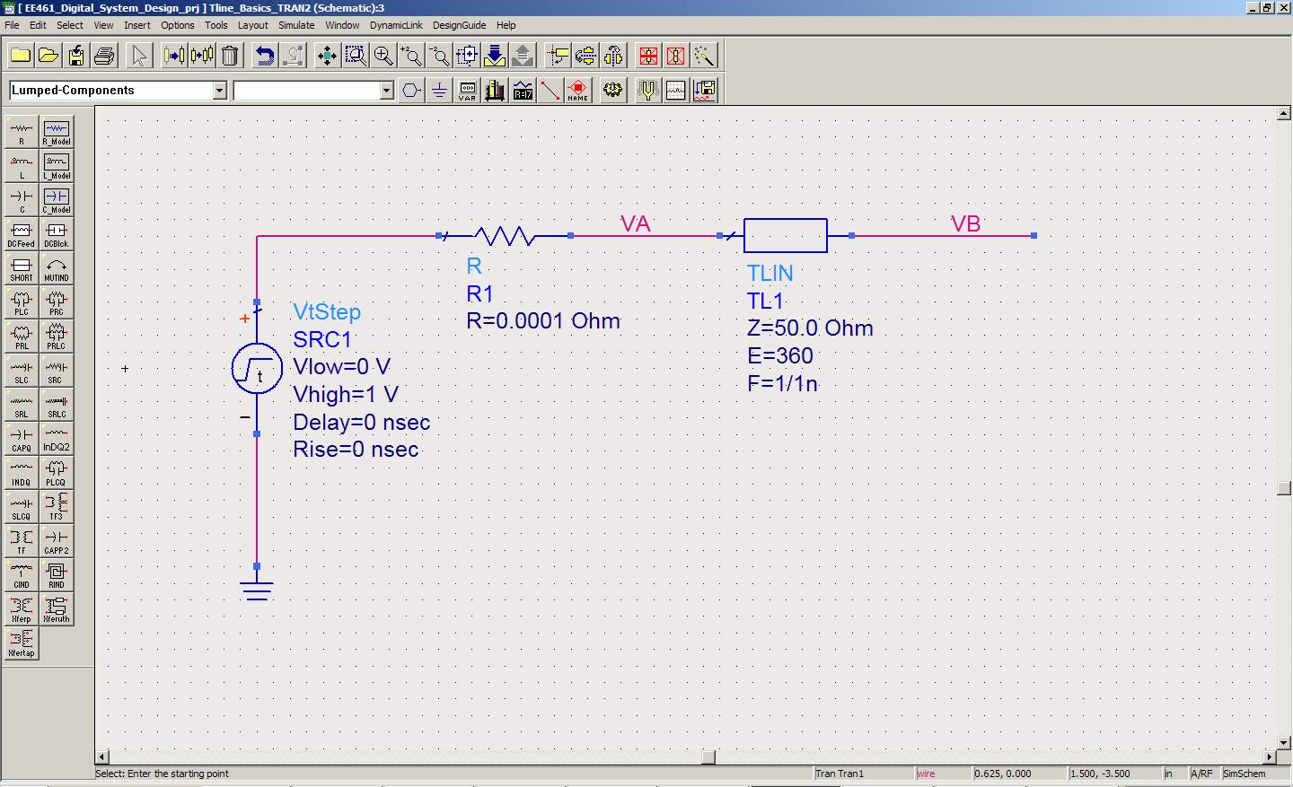
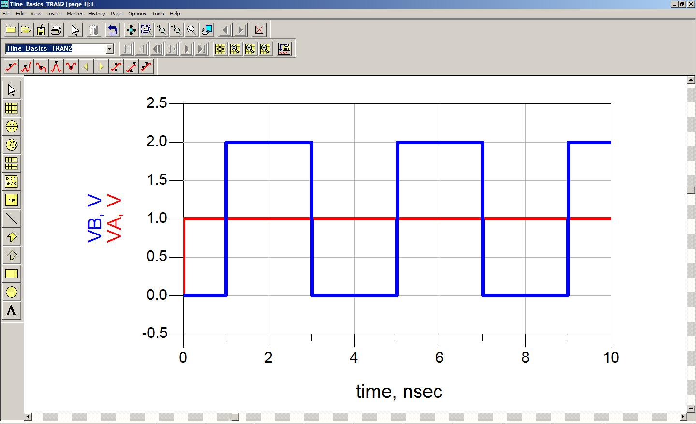
Transmission Line Reflections
Reflections on a T-line (example #1, step 1)
1) The voltage arrives at the end of the T-line (VB) 1ns after the driver (VA) sends it.
2) The voltage at VB is the instantaneous superposition of the incident wave (1v) and any reflected voltage. Since Z_{L}=infinity, then Γ is found using: This results in 1v of reflected voltage. 3) The total voltage observed at VB @ 1ns is 1v+1v=2v.

Slide 43
Transmission Line Reflections
Reflections on a T-line (example #1 , step 2)
1) The reflected voltage (1v) travels backwards down the line and arrives 1ns later at VA (t=2ns).
2) This reflected wave evaluates Γ at VA. Since ZL=0 (now ZL is the source), then Γ is found using: 3) The reflected voltage observed at VB @ 2ns is 1v+(-1v)=0v, so we don’t see any net change at VB. NOTE: A reflection still occurred at VA which travels back down the line with a magnitude of -1v.

Slide 44
Transmission Line Reflections
Reflections on a T-line (example #1, , step 3)
1) The 2nd reflection (-1v) arrives at the end of the T-line (VB) 1ns later (t=3ns)
2) Again Γ is calculated: 3) This means that 100% of the -1v is reflected, so the net voltage at VB = (-1v) + (-1v)=-2v. This -2v is superimposed on the existing voltage, which was +2. The total result is +2 + (-2) = 0v.

Slide 45
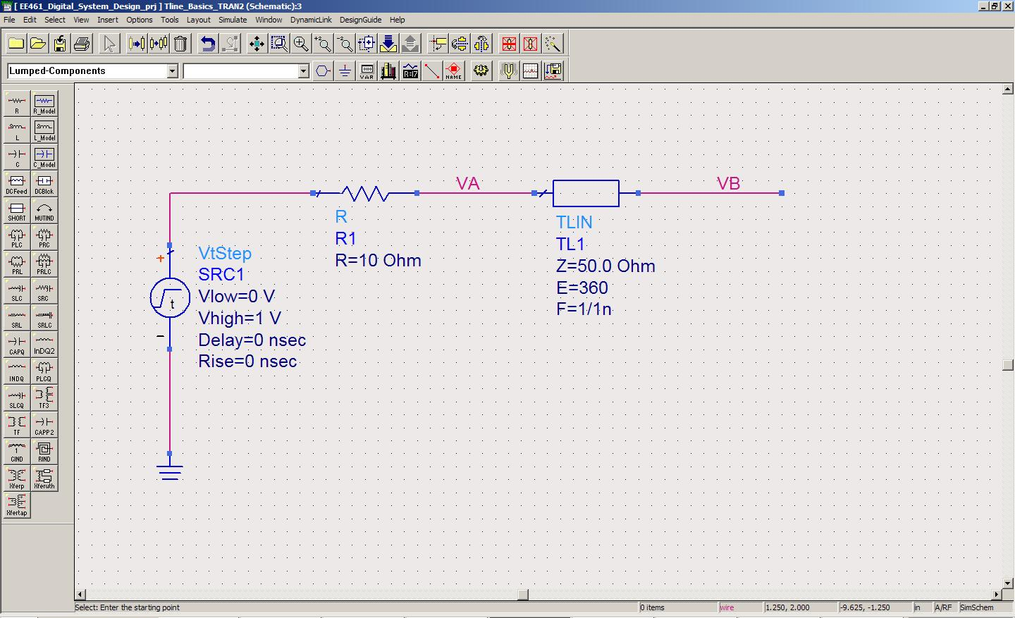
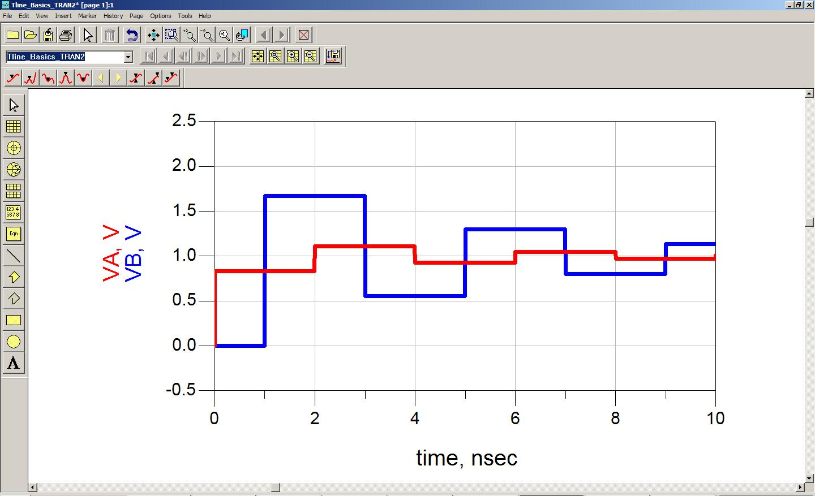
Transmission Line Reflections
Reflections on a T-line (example #2, step 1)
1) Initially, the voltage at VA will be dictated by the resistive divider network formed by R_{s} and Z₀: This is the magnitude of the wave that will be initially launched down the T-line

Slide 46
Transmission Line Reflections
Reflections on a T-line (example #2, step 2)
1) The voltage (0.833v) arrives at the end of the T-line (VB) 1ns after the driver (VA) sends it.
2) The voltage at VB is the instantaneous superposition of the incident wave (0.833v) and any reflected voltage. Since Z_{L}=infinity, then Γ is found using: 3) 100% of the 0.833v incident wave is reflected so the observed at VB @ 1ns is 0.833v+0.833v=1.667v.

Slide 47
Transmission Line Reflections
Reflections on a T-line (example #2, step 3)
1) The reflected voltage (0.833v) travels backwards down the line and arrives 1ns later at VA (t=2ns).
2) This wave evaluates Γ at the source using: 3) The reflected voltage (-0.667*0.833v=-0.556v) is superimposed on top of the incidence wave (0.883v) which yields a net addition of 0.833v+(-0.556v)=+0.278v on top of the initial 0.833v that the driver put on the line. This yields a total voltage at VA of: 0.833v + 0.278v = 1.111v.
NOTE: The reflection of -0.556v occurred at VA and now travels back down the line toward VB

Slide 48
Transmission Line Reflections
Reflections on a T-line (example #2, step 4)
1) The 2nd reflection (-0.556v) arrives at the end of the T-line (VB) 1ns later (t=3ns)
2) Again Γ is calculated: 3) This means that 100% of the -0.556v is reflected, so (-0.556v) + (-0.556v)=-1.111v is superimposed on the existing voltage at VB (1.667v) which yields a total voltage of +1.667+(-1.111v)= +0.555v.

Slide 49
Transmission Line Terminations
Terminations - We know that reflections occur on a transmission line any time there is an impedance discontinuity. - We describe the percentage of the incident wave that is reflected using the reflection coefficient: where the amplitude of the reflected and transmitted voltage is related to Γ by:

Slide 50
Transmission Line Terminations
Terminations - We can place resistors in our circuit in order to create an impedance match and reduce reflections. - Remember a Resistor has an impedance that is constant over all frequencies so it is an ideal component to use for impedance matching. - When we use resistors to reduce reflections, this is called "terminating the transmission line". - We call the component the termination resistor or termination impedance. - There are a variety of terminations techniques, each with advantages and disadvantages.

Slide 51
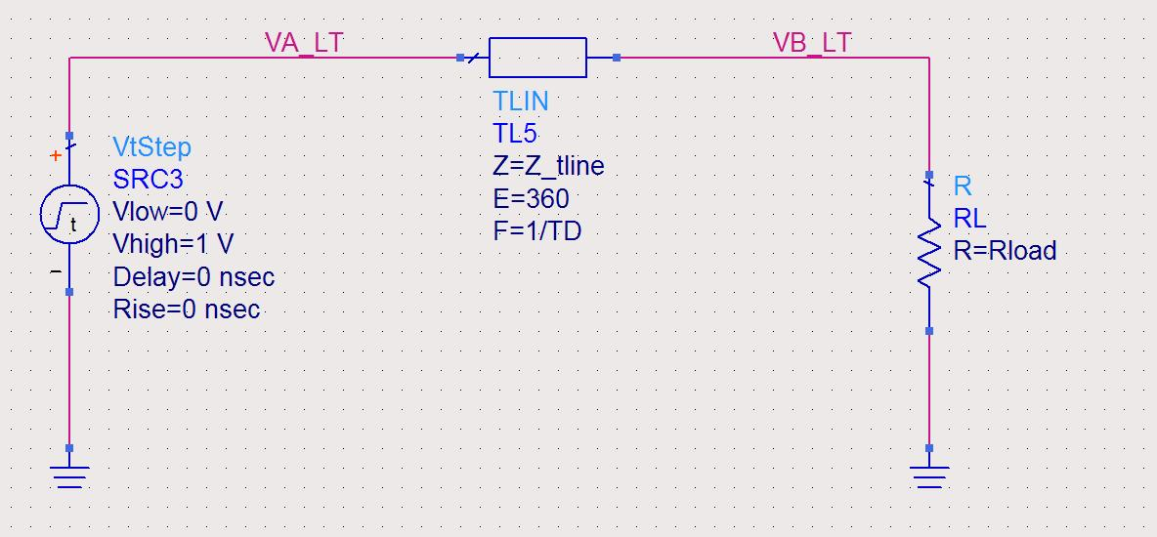
Transmission Line Terminations
Technique #1: Load Termination - Let's see what happens if we place a termination resistor at the end of the transmission line. - We will choose a resistance that is equal to the characteristic impedance of the transmission line. - We assume that the source impedance of the driver is 0 and the characteristic impedance of the transmission line is 50ohms.

Slide 52
Transmission Line Terminations
Technique #1: Load Termination 1) Initially, the full voltage step develops at the beginning of the transmission line since the source impedance is 0. 2) The wave travels down the transmission line in a constant impedance and arrives at the load one prop delay (T_{D}) later. 3) The wave sees the termination resistance and evaluates Γ: 4) Since there are no reflections, there are no more transients on the transmission line and we are done. Since we are now at DC (i.e., no transients), the driver only sees the resistance of the termination resistor as its load.

Slide 53
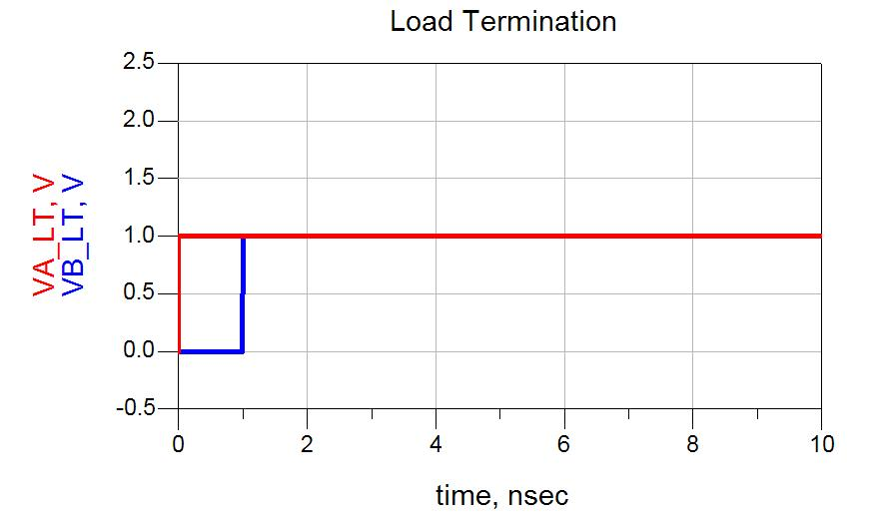
Transmission Line Terminations
Technique #1: Load Termination

Slide 54
Transmission Line Terminations
Technique #1: Load Termination Advantages: 1) Simple 2) If the receiver is capacitive (which it is), the termination resistor will reduce the effective time constant of the load. (more on this later…) 3) The full driver voltage is delivered to the receiver Disadvantages: 1) When the transients have ended, the driver now has a DC load that it is driving. This increases DC power consumption. 2) We assumed an ideal source impedance (Rs=0), but in reality the source has output impedance so after the transients have ended, there will be a resistive divider between R_{S} and R_{L}. This means that the full voltage of the driver will not be seen at the receiver.

Slide 55
Transmission Line Terminations
Technique #1: Load Termination Termination Voltage - The voltage that we terminate to doesn't have an effect on the impedance matching since in AC analysis we ignore DC sources. - We can choose the voltage we terminate to. - A common approach is to terminate to Ground since we have more access to grounds in our system. - We can terminate to a voltage in the middle of our voltage swing in order to reduce DC power consumption (i.e., V_{DD}/2). This prevents the full voltage swing from being developed across the termination resistor at DC. - One drawback to terminating to a voltage is that you need to produce the termination voltage. Commonly, we only have ground and power in our system so we would need to add more circuitry to generate the termination voltage.

Slide 56
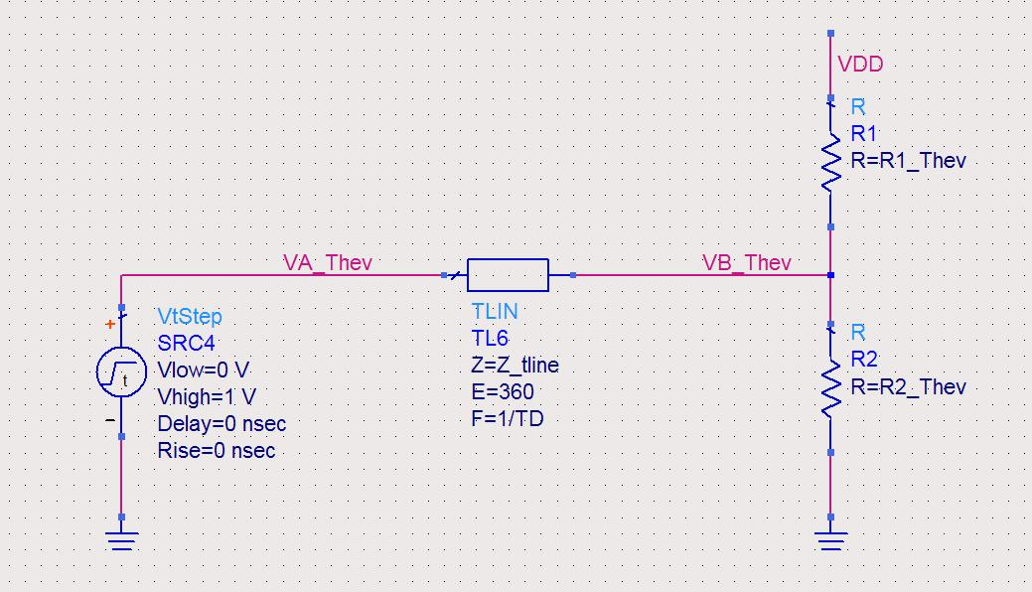
Transmission Line Terminations
Technique #2: Thevenin Equivalent - A technique to provide a termination impedance to an arbitrary voltage is to use two resistors to form a Thevenin equivalent circuit. - We tie one resistor between the signal line and V_{DD} (R1) and the other between the signal and ground (R2). - We select the values of the resistors to give us our desired termination impedance and termination voltage.

Slide 57
Transmission Line Terminations
Technique #2: Thevenin Equivalent ex) We have a 50 Ω transmission line that needs to be load terminated. We have a system with a 3.3v power supply. We want to use a Thevenin equivalent network to form a termination impedance of 50Ω to 2v. What are the values of R1 and R2? We solve using the two equations and two unknowns to get R1= ~80 and R2 = ~135. A source of error in this technique is that physical resistors only come in certain values. So we have to choose resistor values that are available.

Slide 58
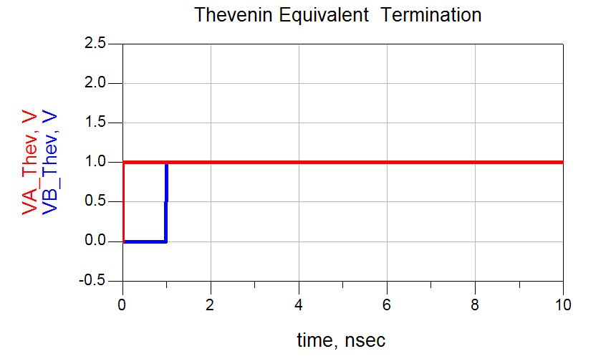
Transmission Line Terminations
Technique #2: Thevenin Equivalent

Slide 59
Transmission Line Terminations
Technique #2: Thevenin Equivalent Advantages: 1) A termination voltage can be created without adding an additional voltage generation circuit in your system. Disadvantages: 1) Requires an additional resistor compared to a load termination to Ground approach. 2) Since resistors only come in pre-defined values, the equivalent termination impedance we get might not be exactly matched to Z₀ and reflections may occur.

Slide 60
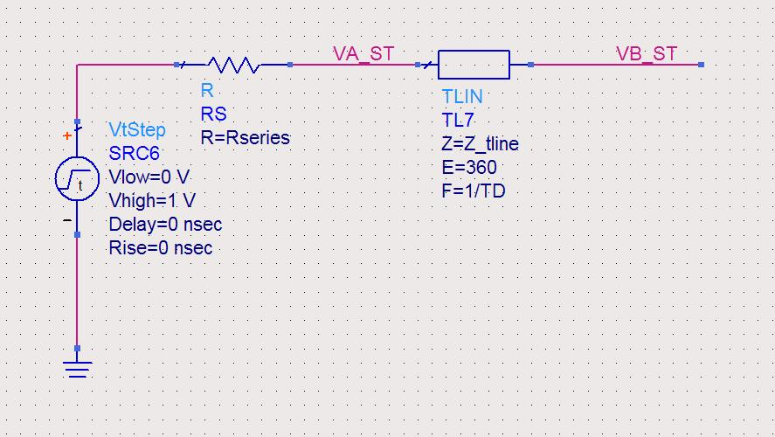
Transmission Line Terminations
Technique #3: Series Termination - What would happen if we added a resistor at the source and left the end of the transmission line open? - We will choose a resistance that is equal to the characteristic impedance of the transmission line. - We will assume the impedance of the transmission line is 50ohms.

Slide 61
Transmission Line Terminations
Technique #3: Series Termination 1) Initially, half of the source voltage develops at the beginning of the transmission line due to the resistive divider formed between the source resistor and the impedance of the transmission line. Since the impedances are equal, the voltage that develops is exactly half of the source voltage: 2) The half wave travels down the transmission line in a constant impedance and arrives at the load one prop delay (T_{D}) later. 3) The wave sees the open end of the T-line and evaluates Γ:

Slide 62
Transmission Line Terminations
Technique #3: Series Termination 4) The 100% positive reflection due to the open end of the t-line is superimposed on the incident wave. Since the incident wave is 1/2 of the intended voltage, the voltage step that is seen at the receiver is actually the intended voltage swing (i.e., 1/2 + 1/2). 5) The reflected energy travels backwards down the transmission line toward the source. When it arrives at the source it evaluates Γ. It now sees are series resistor as Z_{L} which we choose to match the characteristic impedance of the T-line: Since there are no re-reflections, there are no more transients on the transmission line and we are done!

Slide 63
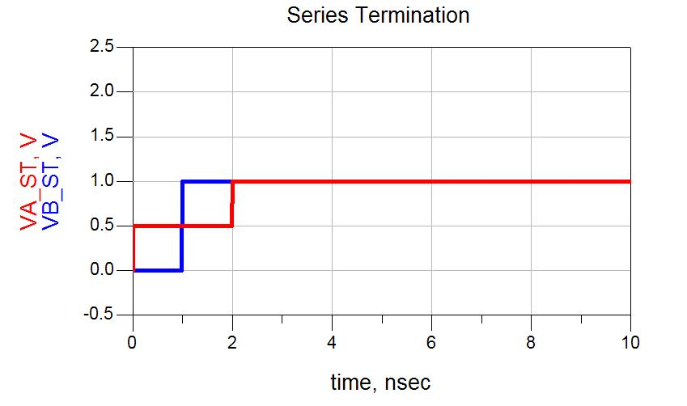
Transmission Line Terminations
Technique #3: Series Termination

Slide 64
Transmission Line Terminations
Technique #3: Series Termination Let's look at what happened… - We wanted to transmit a voltage step with an arbitrary magnitude to the receiver. - By placing a resistor at the source with the same impedance as the transmission line, ONLY HALF of the voltage traveled down the T-line. - HOWEVER, since the end of the line was open, it experienced a 100% positive reflection which when superimposed on the incident wave, produced a voltage at the receiver that was exactly what we intended! - When the reflection traveled back to the source, it was terminated with the source resistor, thus ending any further transients.

Slide 65
Transmission Line Terminations
Technique #3: Series Termination Advantages: 1) The transmission line is terminated but we didn't add any DC path to the circuit. This results in no additional power consumption. Disadvantages: 1) It doesn’t decrease the time constant of the receiver’s load.

Slide 66
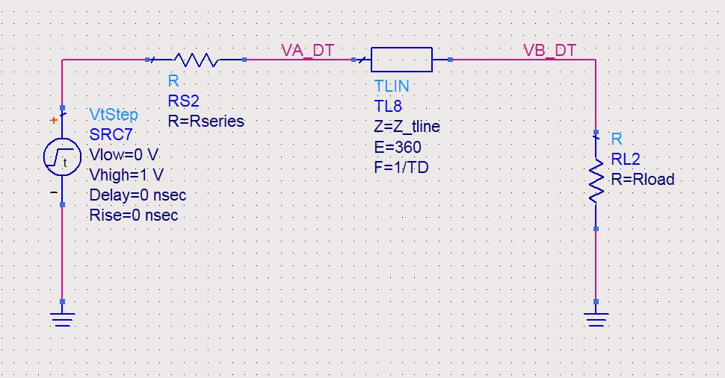
Transmission Line Terminations
Technique #4: Double Termination - We’ve seen that a load termination will reduce reflections at the end of the line. - We’ve seen that a series termination will reduce reflections of waves traveling backwards toward the source. - If we put both a Series and a Load termination, then we would be able to eliminate the most reflected energy. NOTE: In these simple systems, our ideal termination resistors are eliminating all reflections. In a real system, there will be other impedances that cause reflections (more later…)

Slide 67
Transmission Line Terminations
Technique #4: Double Termination 1) Initially, half of the source voltage develops at the beginning of the transmission line due to the resistive divider formed between the source resistor and the impedance of the transmission line. Since the impedances are equal, the voltage that develops is exactly half of the source voltage: 2) The half wave travels down the transmission line in a constant impedance and arrives at the load one prop delay (TD) later. 3) The wave sees the load termination and evaluates Γ:

Slide 68
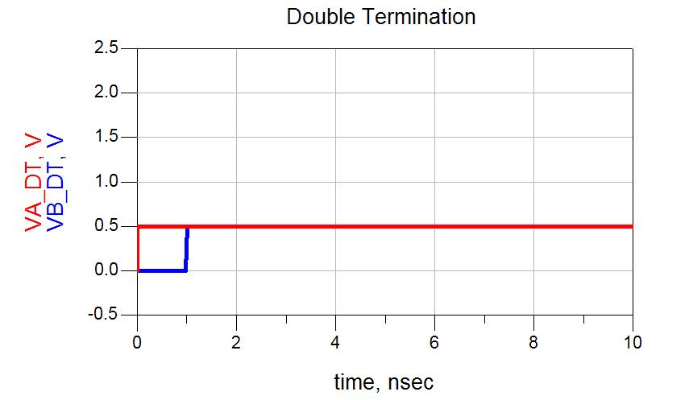
Transmission Line Terminations
Technique #4: Double Termination 4) Since there are no re-reflections, there are no more transients on the transmission line and we are done!

Slide 69
Transmission Line Terminations
Technique #4: Double Termination Advantages: 1) Both forward and reverse traveling waves are terminated Disadvantages: 1) The voltage level that is delivered to the load is ½ of what the driver outputs. 2) Requires two termination resistors.

Slide 70
Transmission Line Bounce Diagrams
Bounce Diagrams - A graphical way to keep track of reflections on a T-line. - We plot Time vs. Location. - We can calculate the Γ at each impedance discontinuity - Γ for each boundary and wave direction will be the same throughout the entire analysis. - The bounce diagram gives us a process to tabulate all of the information for each reflection. - We continue the diagram until the transients are small enough for us to ignore (< 1-2%).

Slide 71
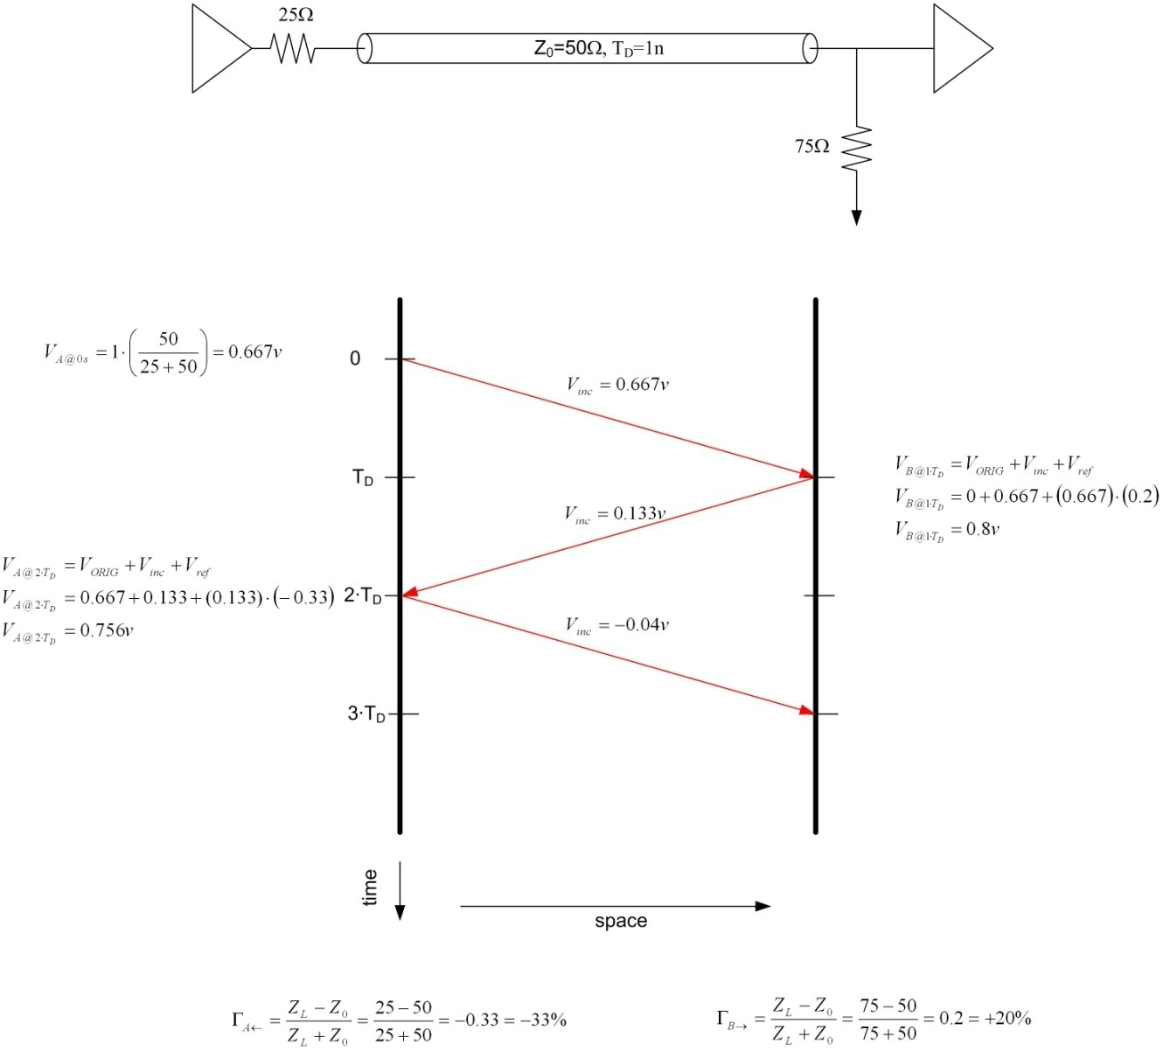
Transmission Line Bounce Diagrams
Bounce Diagrams

Slide 72
Transmission Line Bounce Diagrams
Reflections from LC’s - Until now, we have considered reflections from ideal T-line elements. - An ideal T-line has an impedance that is constant with frequency. - When we have reactive elements in our system (i.e., L’s and C’s), the reflections have a more dynamic response because the impedance of these elements change with frequency: - If we stimulated our system with sine waves, we could calculate the impedance of L’s and C’s directly in order to find Γ. - If we are stimulating our system with a perfect square wave, each spectral component will see a different impedance and will result in a different Γ.

Slide 73
Transmission Line Reflections from Capacitors
Reflections from Capacitors - If we use a perfect step (i.e., t_{rise}=0), then a capacitor will instantaneously look like a short circuit to the incident wave. - As the capacitor charges, its impedance will get larger until it ultimately looks like an open - If we have a finite risetime (which we always do), we can calculate the average impedance of a capacitor for a given change in voltage (i.e., t_{rise}) - The impedance of the capacitor must be combined with any other impedances that the incident wave sees: - The resultant reflection coefficient represents an estimate of the maximum magnitude of the reflected energy.

Slide 74
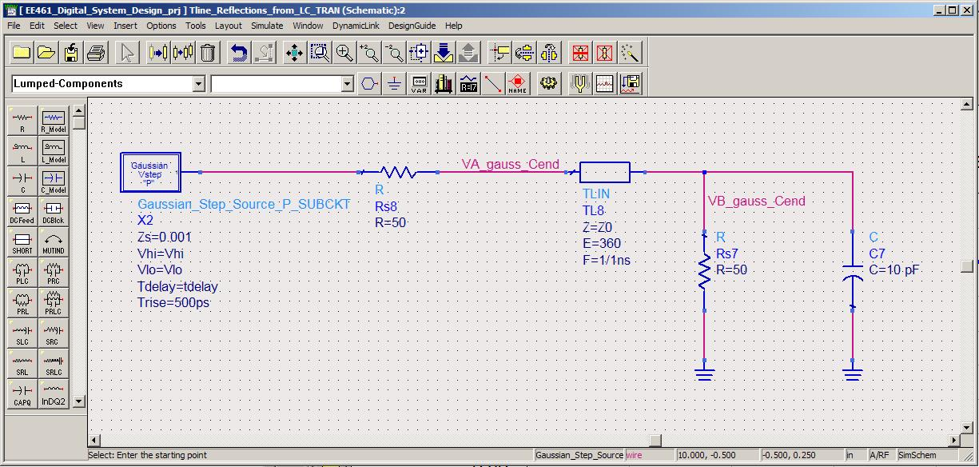
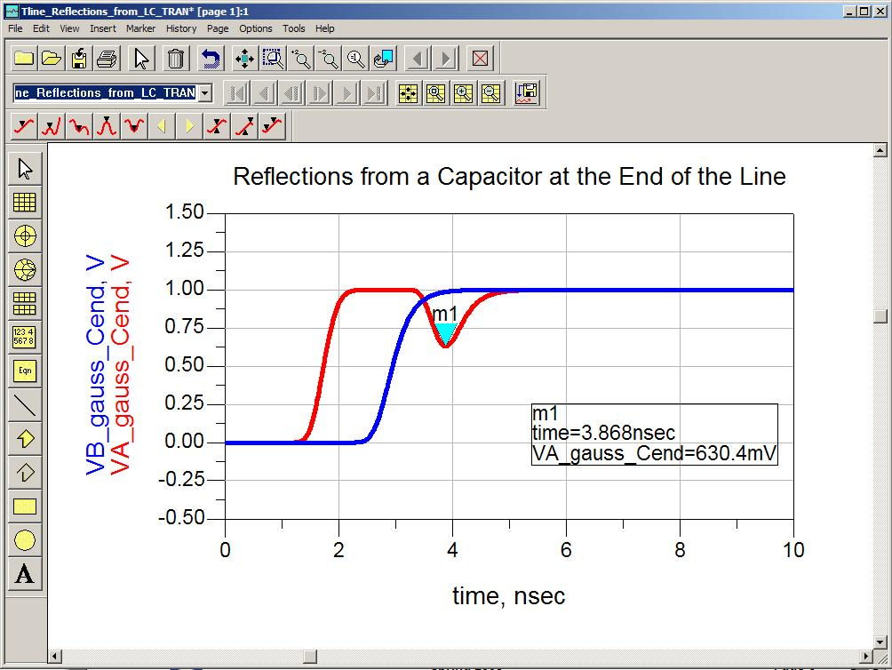
Transmission Line Reflections from Capacitors
Reflections from Capacitors ex) 500ps risetime w/ 10pF Load Capacitor in a double terminated system. -33% represents the maximum magnitude of the reflection that will be seen.

Slide 75
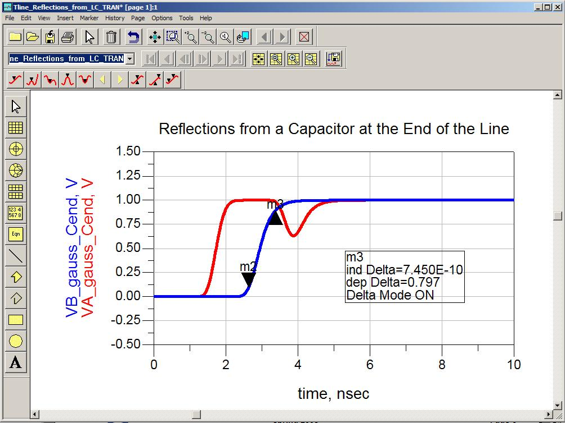
Transmission Line Reflections from Capacitors
Reflections from Capacitors - the resultant system risetime can be estimated using the Sum-of-Squares method. - the load risetime is found using: 2.2∙τ - In this example, the load time constant is the capacitance times the parallel combination of the 50ohm load resistor and the 50 ohm transmission line: τ=ZC=(50//50)∙(10p)=250p

Slide 76
Transmission Line Reflections from Inductors
Reflections from Inductors - If we use a perfect step (i.e., t_{rise}=0), then an inductor will instantaneously look like an open circuit to the incident wave. - As the inductor charges, its impedance will get smaller until it ultimately looks like a short - If we have a finite risetime (which we always do), we can calculate the average impedance of an inductor for a given change in voltage (i.e., t_{rise}) - The impedance of the inductor must be combined with any other impedances that the incident wave sees: - The resultant reflection coefficient represents an estimate of the maximum magnitude of the reflected energy.

