Slide 1
The world around us: Nurturing spatial reasoning in rural schools
Dr Chris Reading
SiMERR National Research Centre (UNE, Australia)
ISFIRE2018

Slide 2
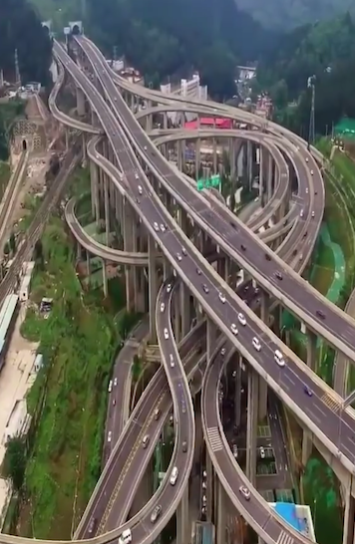
Path to the investigation
Qianchun Interchange
What is spatial reasoning?
How important is spatial reasoning?
Can spatial reasoning be learnt?
What can be done to improve students’ spatial reasoning?

Slide 3
https://theconversation.com/its-time-we-draft-aussie-rules-to-tackle-indigenous-mathematics-15032

Slide 4
What is spatial reasoning?
spatial visualisation
make sense of things without physically moving them around
motion of objects in solar system
spatial orientation
make sense of things when you move and objects stay still
dressing, moving in space (games, sport), setting out work on a page
mental rotation
when you stay still and objects move
reading maps, playing chess, doing jigsaws, drawing solids

Slide 5
How important is spatial reasoning?
included in ability tests for a wide range of occupations
need to nurture informal spatial reasoning that young children have
good indicator of mathematics competency
focus on spatial abilities for advanced learning opportunities in STEM

Slide 6
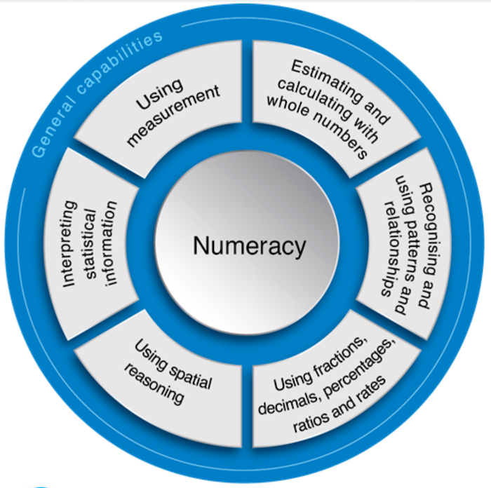
Mathematics curricula recognition
56 countries mathematics curriculum for compulsory schooling
less than 50% include spatial at strand/domain or descriptor level
main strand/domain in 4 countries (Georgia, Oman, Poland*, Canada*)
descriptor within (or across) strand/domain in 18 countries
TIMMS - http://timssandpirls.bc.edu/timss2015/encyclopedia/countries/

Slide 7
Can spatial reasoning be learnt?
improved spatial visualization; mental rotation scores & mathematical performance (Lowrie, et al., 2017)
10-week in-class intervention with 10 to 12 year olds, no accompanying mathematics teaching (Australia)
rural children’s spatial and numeracy ability fall behind urban children’s (Tain & Huang, 2009)
Measured spatial and numeracy skills of 4 to 7 year olds (China)
powerful new technologies allow visual and kinesthetic interaction
Lowrie, T., Logan, T., & Ramful, A. (2017). Visuo-spatial training improves elementary students’ mathematics performance. British Journal of Educational Psychology, 87, 170-186.
Tain, Z., & Huang. X. (2009). A study of children’s spatial reasoning and quantitative reasoning abilities. Journal of Mathematics Education, 2(2), 80-93.

Slide 8
What can be done to improve students’ spatial reasoning?
What are rural schools doing to nurture spatial reasoning?
How successful have rural schools been in nurturing spatial reasoning?
literature and internet search of projects reported publicly
focus: spatial reasoning; school students in rural areas; last ten years
search expanded using “Indigenous” as many of the projects identified were specifically for Indigenous students

Slide 9
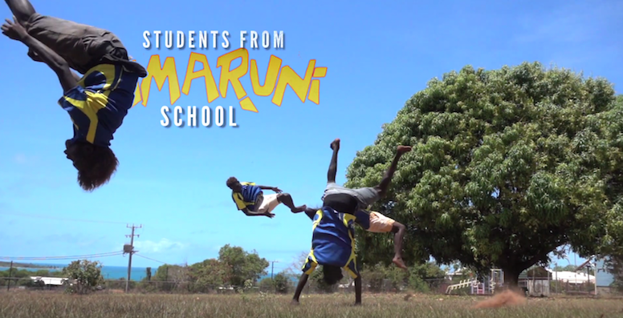
Indigenous language at Mijilang Community
spatial cognition and language are considered strengths of Indigenous students
focused on the use of intrinsic and relative frames of reference (FoR) in Mijilang English
FoR affect the use of spatial terms (e.g., “in front”, “behind”) in maths
Croker island, Northwest Arnhem Land (Australia)
Edmonds-Wathen, C. (2014). Influences of Indigenous languages on spatial frames of reference in Aboriginal English. Math Ed Res J, 26, 169-192.
https://www.youtube.com/watch?v=54iG7ElsbTk

Slide 10
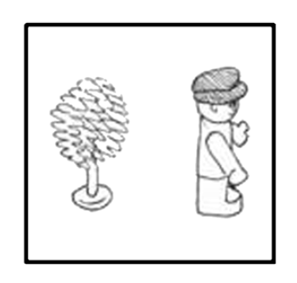
Students’ spatial language and thinking
involved students, caregivers and senior Iwaidja language consultants
“man and tree” task (with director and matcher) to elicit spatial frames of reference in speech
“wurdaka” (in front) & “warrwak” (behind) can be used intrinsically when front and behind would not be used in English
teachers need to understand students’ spatial language and thinking to assist with improvement in numeracy tasks
‘The man is in front, the tree, he gave the back of his neck to it, (it’s) behind.’

Slide 11
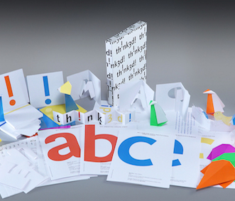
Th!nk3d! at two rural New England schools
Th!nk3d! – teacher-facilitated package to teach spatial reasoning through playful transformation
92 students in two rural elementary schools (USA)
pre and post spatial and mathematics assessments
intervention – six weeks of Th!nk3d! activities
Burte, H., Gardony, A. L., Hutton, A., & Taylor, H. A. (2017). Think3d!: Improving mathematics learning through embodied spatial training. Cognitive Research: Principle and Implications, 2(13).
http://www.think3d.us.com/about/

Slide 12
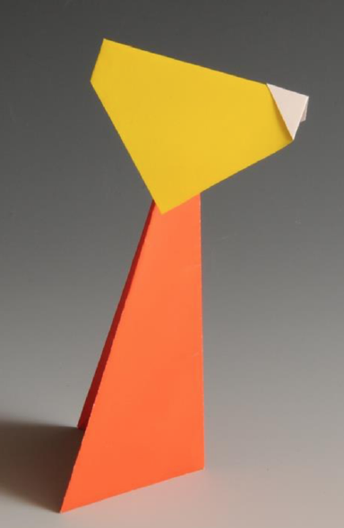
Improved spatial and mathematics ability
spatial improved in both paper folding & purdue rotations
no improvement in Make-a-Dice (spatial & maths)
maths accuracy improved on tasks involving visual representations (mainly Grade 5 & 6)
paper folding improvement best predicted improvement in maths accuracy
“spatial thinking should be considered a basic cognitive skill and practiced in elementary schools”
Origami nodding dog for reverse engineering

Slide 13
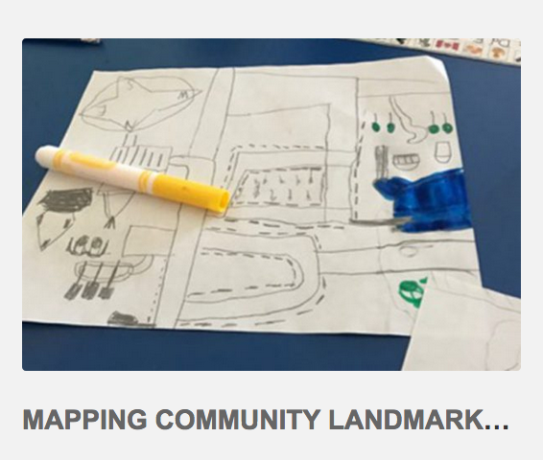
Family Math Night at Johnny Therriault School
inclusive, playful, engaging activities to strengthen positive relationships among home, school and community
collaborative design process – indigenous instructional leaders, First Nation educational counsellors, school board numeracy facilitators and Robertson Program team
student-led FMN to showcase student work and Indigenous knowledges
https://wordpress.oise.utoronto.ca/robertson/family-math-nights/

Slide 14
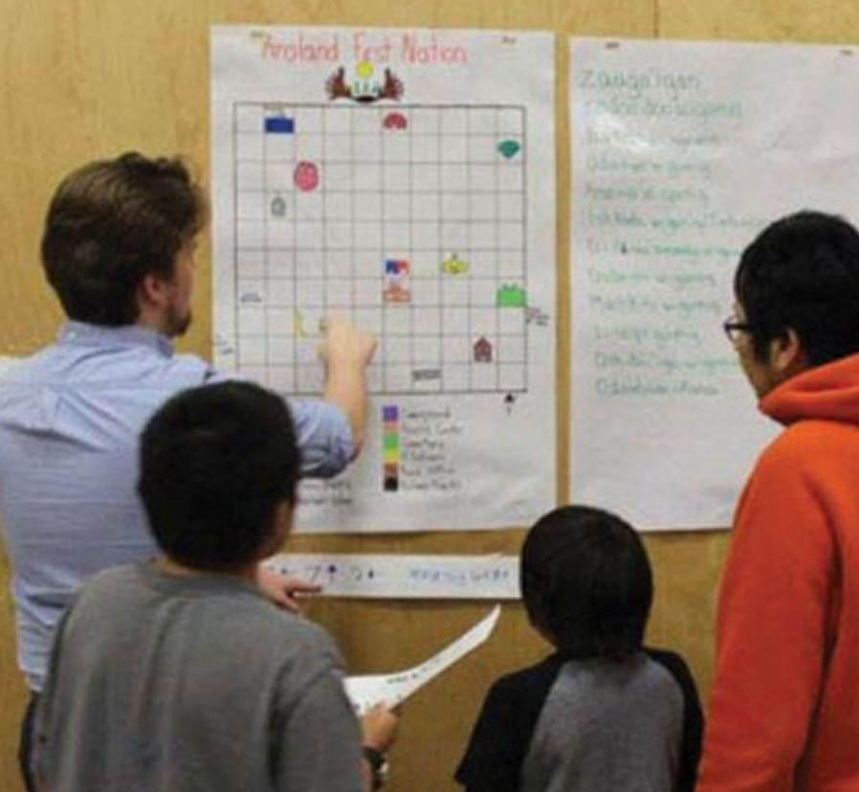
Focus on spatial reasoning and geometry
celebrate mathematics in a new light - Bev Caswell
“thinking spatially opens the eye and mind to new connections, new questions, and new answers” – Center for Spatial Studies
geometry – measuring & moving objects in space
mathematics is so much more than numbers and computation
http://www.chroniclejournal.com/news/local/math-night-celebrates-spatial-reasoning/article_0b9b2038-fd7a-11e6-8f70-c7c14e27c4da.html

Slide 15
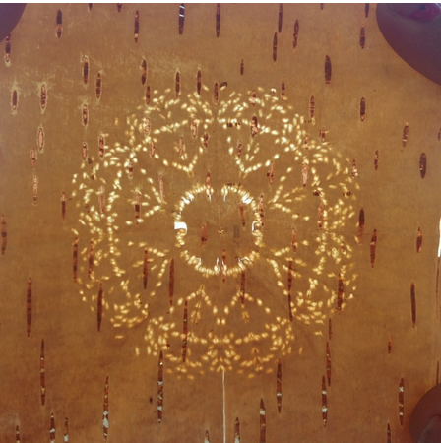
Coming Together to Learn Together
initiatives supporting mathematics with the Mi’kmaw community in Nova Scotia (decolonising mathematics)
Show Me Your Math - annual fair
Mawkina’masultinej: Let’s Learn Together! - Birch Bark Biting
educators and elders discussed culturally-based maths
role of Mi’kmaw language in mathematics
graduation rate for Indigenous students higher than for general population
http://showmeyourmath.ca/

Slide 16
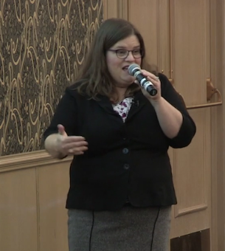
Space is more important than number
videos to understand ways of learning, values, language, culture
“tepiaq” (enough) with hand gestures (for how much/how many?) – but such words are absent from school-based maths
when it is about survival space matter
interpretations of words taken as shared when they are not
conflict – privileging numerical reasoning (curriculum) over spatial reasoning (community and embedded language)
https://thelearningexchange.ca/projects/lisa-lunney-borden-coming-together/
Borden, L. (2013). What’s the word for …? Is there a word for …? How understanding Mik’maw language can help support Mi’kmaw learners in mathematics. Math Ed Res J., 25, 5-22.

Slide 17
So what can be learnt from this?
collaborative process between community, elders and educators
connect with the local community, especially cultural norms and surroundings
spatial reasoning in context provides meaningful experiences
even short intense exposure to relevant activities can improve spatial reasoning
recognise importance of spatial reasoning and how it contributes to every-day life

Slide 18
Take-home message for rural teachers …..
change approaches to assessing students who are beginning school
plan activities that nurture pre-existing spatial reasoning
connect the learning of spatial reasoning to fundamental mathematical concepts

