Slide 1

Systemic Recruitment and Retention of Rural Educators
Dr. Harvey Rude, Director
Colorado Center for Rural Education
Harvey.Rude@unco.edu

Slide 2
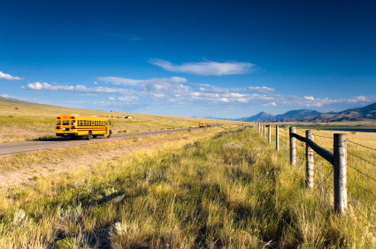
In the United States…
9.7 million students enrolled in rural school districts (>20% of all students in US)
  Of the rural students:
    2 in 5 live in poverty
    1 in 4 is child of color
    1 in 8 has changed residence in the last year
Source: Why Rural Matters 2013-2014, Johnson et al. 2014

Slide 3

What is rural?
Based on National Center for Education Statistics (NCES) definition
  Distance from urban clusters and urbanized areas
  For Colorado,
    < 6500 students
    < 1000 students for small rural subset
    -Distance from Front Range populations centers
Source: Colorado Department of Education and Rural Education Council

Slide 4
Shortages aren’t just a Colorado problem
The United Nations estimates that 39 million new teachers will be needed worldwide by 2030
  120,000 in the United States
Nearly all states have issues attracting and retaining educators – including our neighboring states
  Kansas, Nebraska, New Mexico, Arizona, Utah, Wyoming
Impact of these shortages is being felt in all districts, but more dramatically within the rural regions of the Rocky Mountain West

Slide 5
In Colorado…

Slide 6
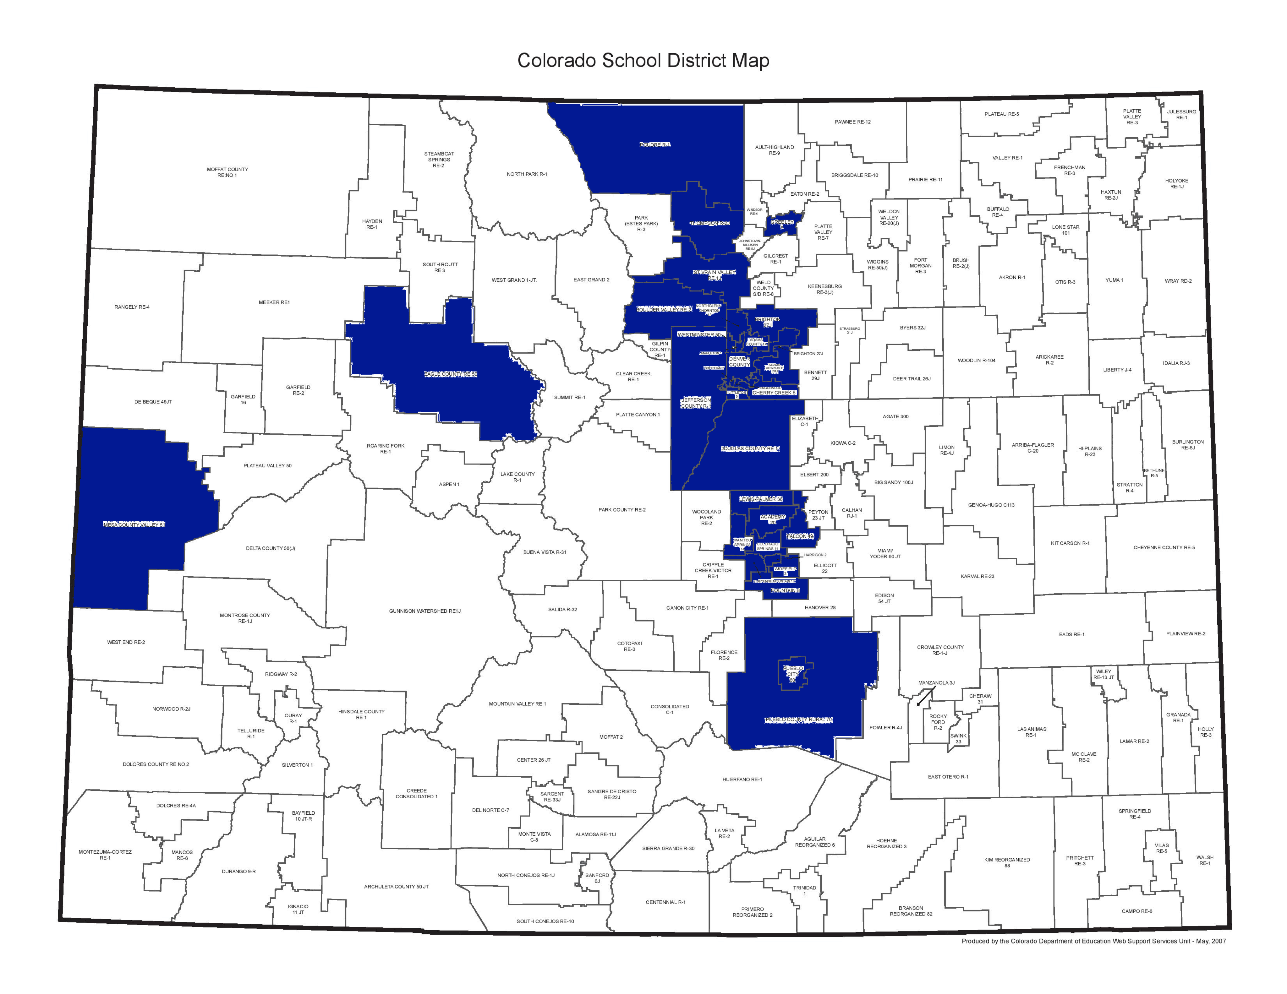

Slide 7
Colorado’s Current Shortages
Colorado continues to post record-low numbers for individuals completing educator preparation programs and enrolling in colleges/universities that offer these programs
Secondary math, secondary science, special education, cultural/linguistic diversity, special service providers - all in short-supply statewide
In rural and remote regions – all areas are a shortage including art education, elementary education and agricultural education

Slide 8
A growing shortage problem

Slide 9
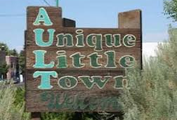
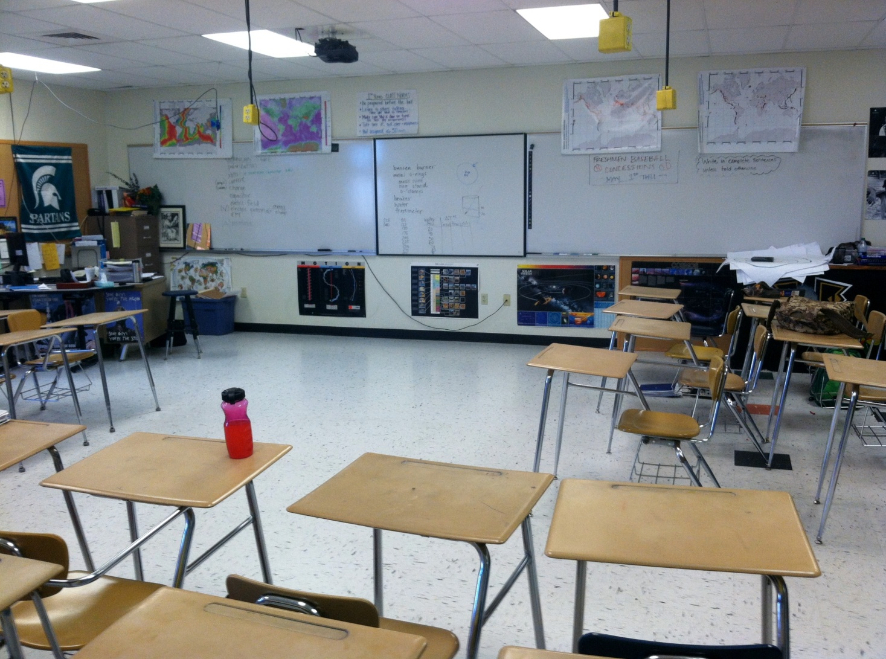
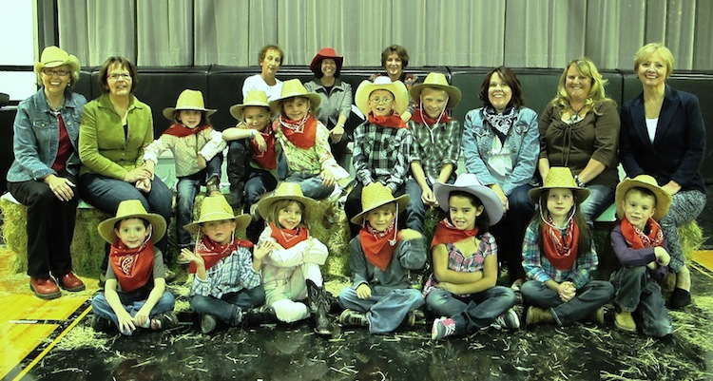
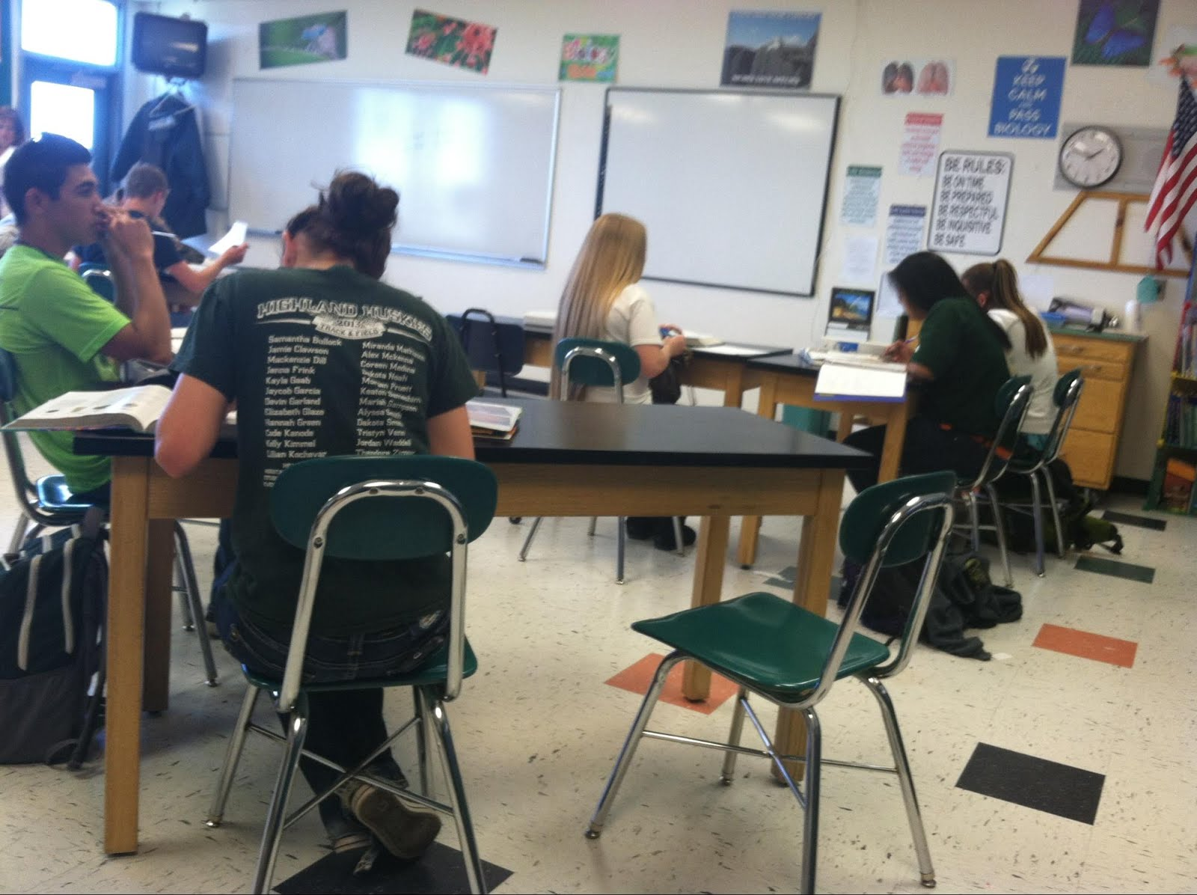
In Colorado….
Over 150,000 students in rural school districts
58 districts are on one K-12 site and/or one K-12 building

Slide 10
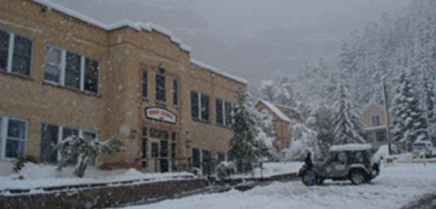
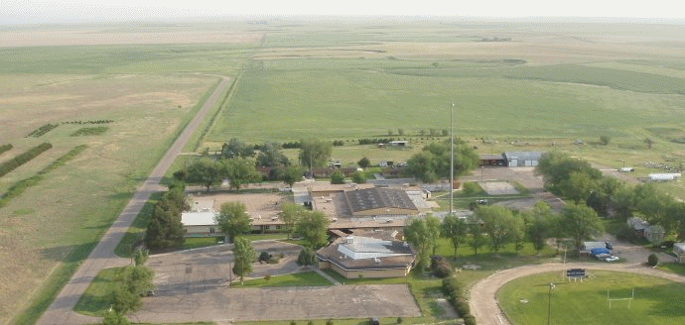
Some Similarities and Many Differences
Ouray R-1 School District (184 students)
in the mountains
Woodlin School District (93 students)
on the plains

Slide 11
Challenges of Teaching in Rural Schools
Isolation
  Fewer close colleagues for collaboration
Small faculty size
  May teach multiple subjects (=multiple preps)
  Sometimes “you are the entire science department”
Limited resources
  Tax base reduced, can’t take have advantage of scale of size
  Limited number of qualified Spec Ed and ESL teachers as well as school pyschologists
Small communities
  May be less inviting to outsiders

Slide 12
Challenges of Teaching in Rural Schools
Student body
  Generally more poor students
  Growing cultural, ethnic, and language diversity
Administration
  Often high turnover rates
  Local control by school boards
Limited technology resources
  Broadband access
Transportation
  Greater distance to and from schools
  Greater distance to neighboring schools/towns/colleges

Slide 13
Nature of the Students
Growing proportion of poor students
Growing cultural/linguistic/ethnic diversity
  Changing communities
  Changing nature of economic base of communities
    Small family-owned farms → large corporate farms
    Increased tourism in some mountain rural communities
Student performance and graduation rates

Slide 14
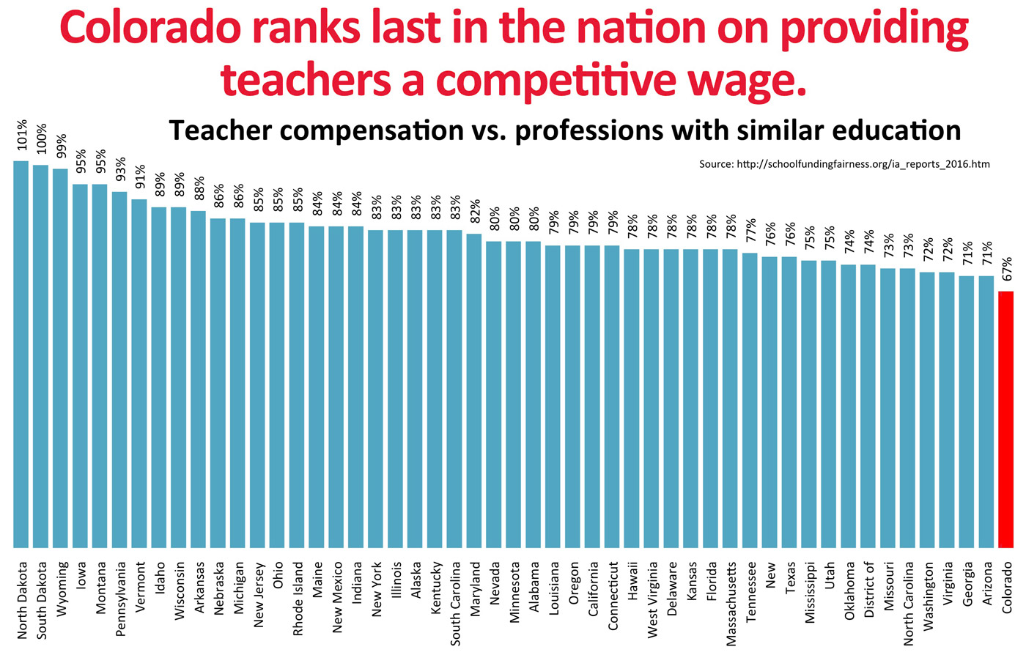
A look at Colorado
Colorado ranks last in the nation when it comes to providing teachers a competitive wage: http://www.schoolfundingfairness.org/ia_reports_2016.htm)
Notes:
Review Learning Policy Institute findings; discuss with elbow partners and share out surprising facts, findings, or insights (10-15 minutes)

Slide 15
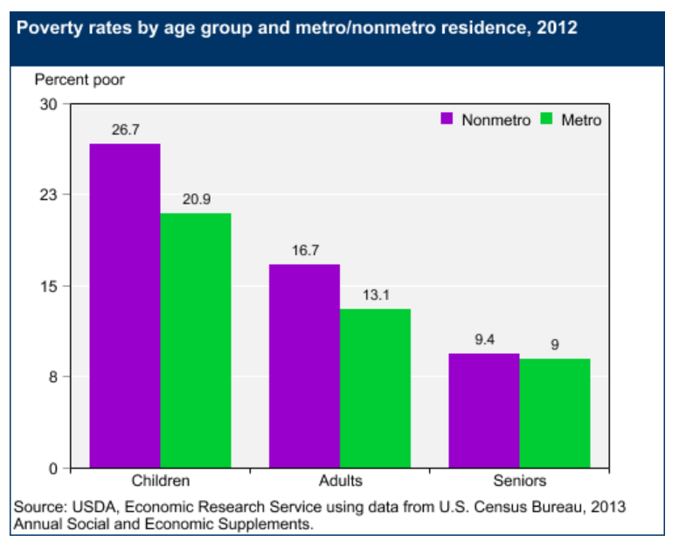

Slide 16
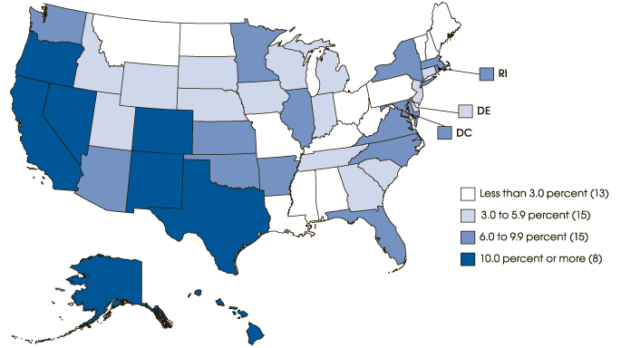
44% of America’s ELL students live in rural communities.
33% America’s towns (< 2,500) enroll ELLs
Percent of ELL’s in public schools 2011-2012 (NCELA)

Slide 17
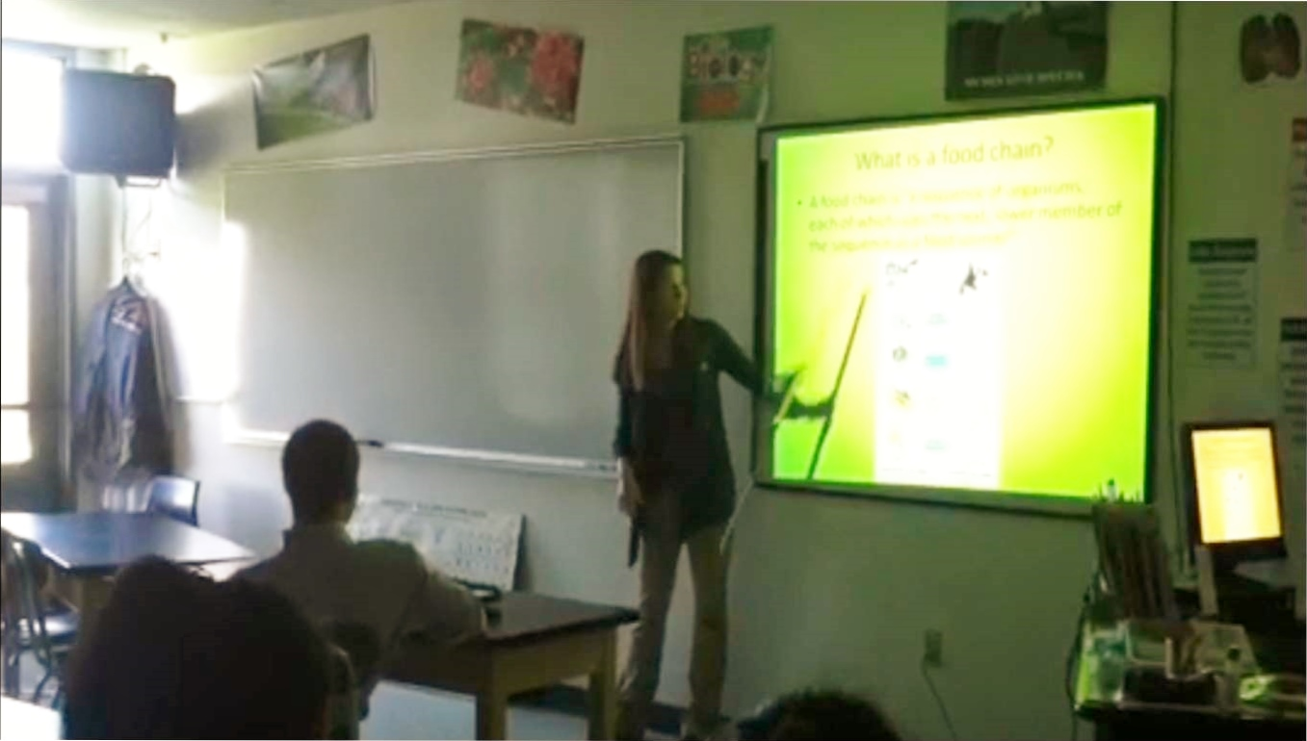
Opportunities
From a teacher’s point of view
  Smaller class sizes
  Ability to get to know each student and watch them grow and mature
  Ability to collaborate with staff outside content areas
  Opportunities to take on other roles such as faculty sponsor for clubs, athletic coaches, etc.

Slide 18
Opportunities
From the student’s point of view
  More one-on-one time with teachers
  Ability to build deeper relationships with staff and fellow students
  Greater involvement in school activities
  Chance to interact with younger students
  Possibility of online courses to expand course offerings

Slide 19
CCRE Current Programs
Recruitment Scholarships
  Rural Teaching Scholars
  Alternative Teacher Certification
  Specialized Service Professionals
Retention Scholarships
  Concurrent Enrollment Educator Qualification
  National Board Teacher Certification
  Added Endorsement
University-Rural School District Partnerships
Multiple “Pipeline” Initiatives

Slide 20
CCRE Initial Scholarships (SB 16-104)
Recruitment Scholarship | Retention Scholarships
Colorado Rural Teaching Scholar Stipends (CRTS) $2800 | Concurrent Enrollment Educator Scholarship (CEEQ) $6000 | National Board Certified Teacher Scholarship (NBCT) $6000
Notes:
Perhaps replace “pre-existing” with “Initial”

Slide 21
Colorado Rural Teaching Stipends: Incentives for teacher candidates to student teach in rural school districts
Priorities
Available funding
Placement in a small rural district
Placement in a rural district
Intent to remain in a rural/small rural setting after graduation
Prior experience in a similar setting
Notes:
55 (57%) of the total scholarships have been awarded to preservice educators completing their student teaching in one of 13 districts
Durango 9R 14
Ignacio 11 JT 6
Johnstown-Milliken Re-5J 4
Weld County RE-1 4
Alamosa RE-11J 3
Delta County 50(J) 3
Eaton RE-2 3
Garfield County Re-2 3
Mancos RE-6 3
Montrose County RE-1J 3
Roaring Fork 3
Weld County RE-3J 3
Weld County RE-8 3
UNDER APPLICATION PACKET REQUIREMENTS # 5: DELETE ”WHEN AVAILABLE”
UNDER PRIORITIES # 3: ”PLACEMENT IN A REMOTE RURAL DISTRICT” (TO DIFFERENTIATE FROM PROXIMITY RURAL).

Slide 22
Concurrent Enrollment Educator Qualification Scholarship:
For p-12 educators in rural Colorado school districts to pursue Concurrent Enrollment Educator Qualification certification.
Priorities
Available funding
Placement in a small rural district
Placement in a rural district
Intent to remain in a rural/small rural setting after graduation
Notes:
To date, CCRE has awarded 22 CEEQ scholarships to inservice educators working in one of 17 rural/small rural districts and who enroll in a CDHE approved CE program.
APPLICATION PACKET REQUIREMENTS: ADD # 5. TIMELINE FOR PROGRAM COMPLETION

Slide 23
National Board Teacher Certification Scholarship:
K-12 educators in rural Colorado school districts to pursue National Board certification.
Priorities
Available funding
Serving in a small rural district
Serving in a rural district
Intent to remain in a rural/small rural setting after graduation
Participation in CEA Rural NB cohort
Notes:
PRIORITIES # 3: SERVING IN A REMOTE RURAL DISTRICT

Slide 24
CCRE Existing and Future Scholarships SB 16-104 & SB 18-085
Recruitment |  |  | Retention
Colorado Rural Teaching Stipend | Alternative Teacher Licensure Stipend | Specialized Service Professionals Scholarship | Concurrent Enrollment Educator Scholarship | National Board Certified Teacher Scholarship | Dual Endorsement Scholarship
Current funding:
$2.8K stipends x 40 per year
$112,000 (annual total)
Current funding:
$6K stipends x 60 per year
$360,000 (annual total)
Notes:
NEED TO DIFFERENTIATE CURRENT FUNDING (I.E., 40 STUDENT TEACHER STIPENDS AND 20 CEEQ AND/OR NBTC SCHOLARSHIPS PER YEAR) AND NEW FUNDING (I.E., 60 PER YEAR; $240K TOTAL--IS THIS FOR ONE YEAR ONLY??)

Slide 25

Questions?
Harvey Rude
Director
Colorado Center for Rural Education
Harvey.Rude@unco.edu

