Slide 2
Learning to Teach with Avatars:
No matter where you live!
A mixed reality learning environment for ongoing teacher development in rural and remote areas
Susan Ledger
Associate Dean Engagement s.ledger@murdoch.edu.au

Slide 3
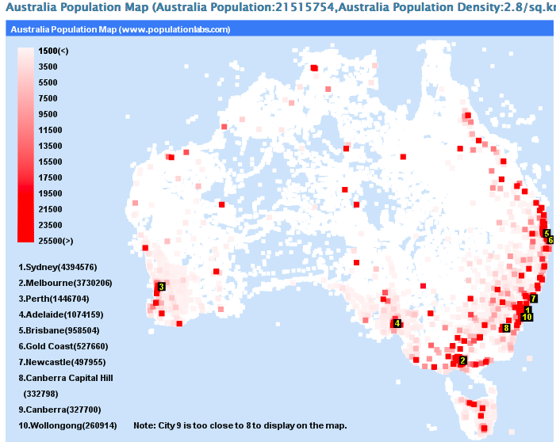
66% of people live in capital cities over 80% of the population live within 50km of the coast,

Slide 4
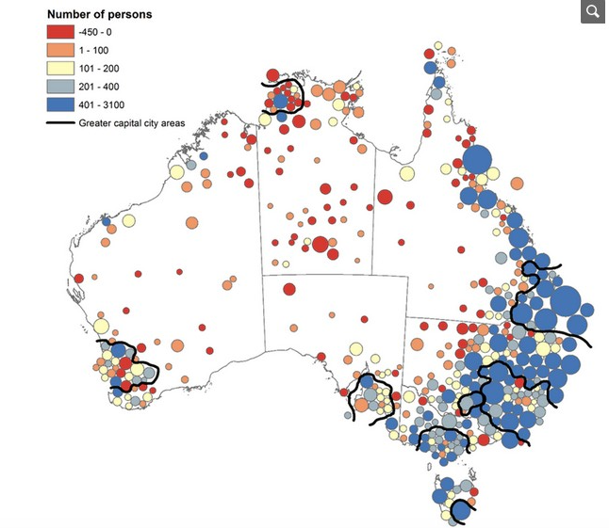
Australian Indigenous Population 2016 Census (3.3%)

Slide 5
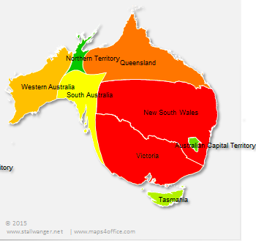
Metro-centric population and policy:
Only two of the 7 State Education policy documents mention rural, regional, remote or geography specifically.

Slide 6
32% of Australia’s population live in regional Australia
Common education issues:
provision and access of quality education,
tyranny of distance
access to technology,
higher education pathways
teacher turnover and expertise
cultural clashes
relevance and appropriateness of curriculum
inherent costs
social environment
and emotional well-being

Slide 7
1) Difficulty attracting and retaining teachers
2) Diverse contexts – multiage groupings; ESL;
3) Feedback not at point of need
4) Rural and remote students have limited options for school experiences
5) Engagement with parents and community
Professional Practicum in RRR contexts

Slide 8
Check out “Simlab” from Murdoch University on Vimeo. https://vimeo.com/280662232

Slide 9
A solution: Mixed Reality Learning Environments
Teachlive; Mursion and Simlab@Murdoch (Mursion site license)

Slide 10
Not only the classroom:
Interviews, Conversations & Difficult Discussions
Practice & Rehearse
Safe & non-threatening environment
Develop repertoire of responses

Slide 11
  Murdoch Simulation & Avatars
  2016 TeachLive - University of Central Florida
  2017 Mursion – Commercial Arm of UCF
  2017 SimLab@Murdoch [Mursion] –
          Australian Site license
SimLab@Murdoch (Mursion)

Slide 12

Benefit #1:
Learning anywhere anytime
Notes:
State by state

Slide 13
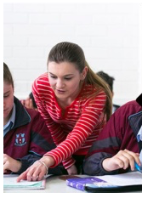
Benefit #2:
Personalised Learning
Notes:
State by state

Slide 14
Benefit #3:
Safe, Non-Threatening & Moderated Learning Environment
Notes:
State by state

Slide 15
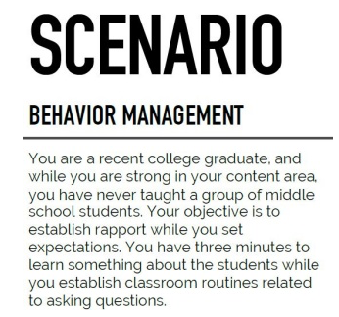
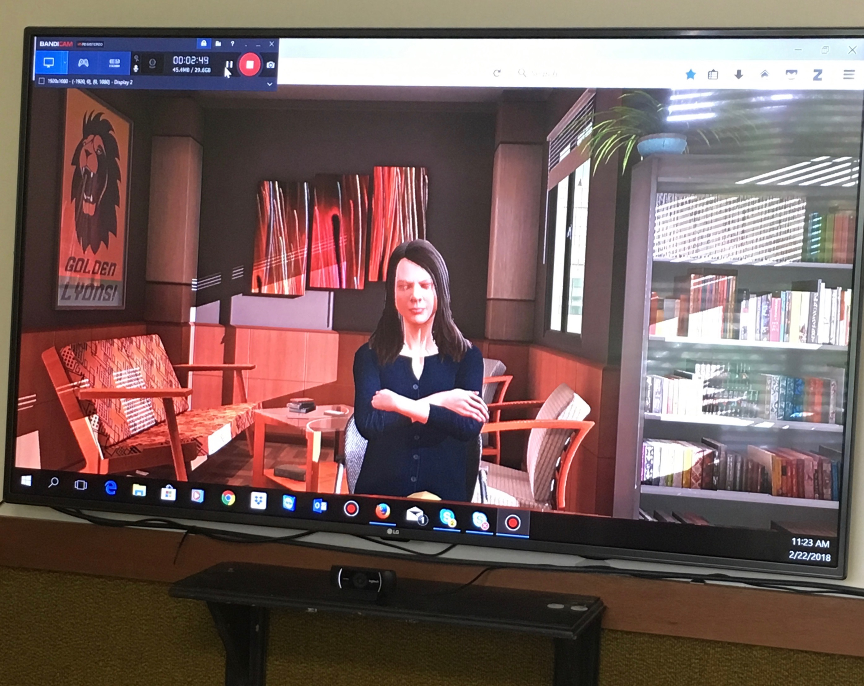
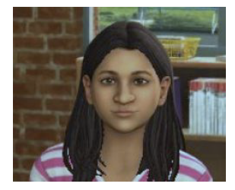
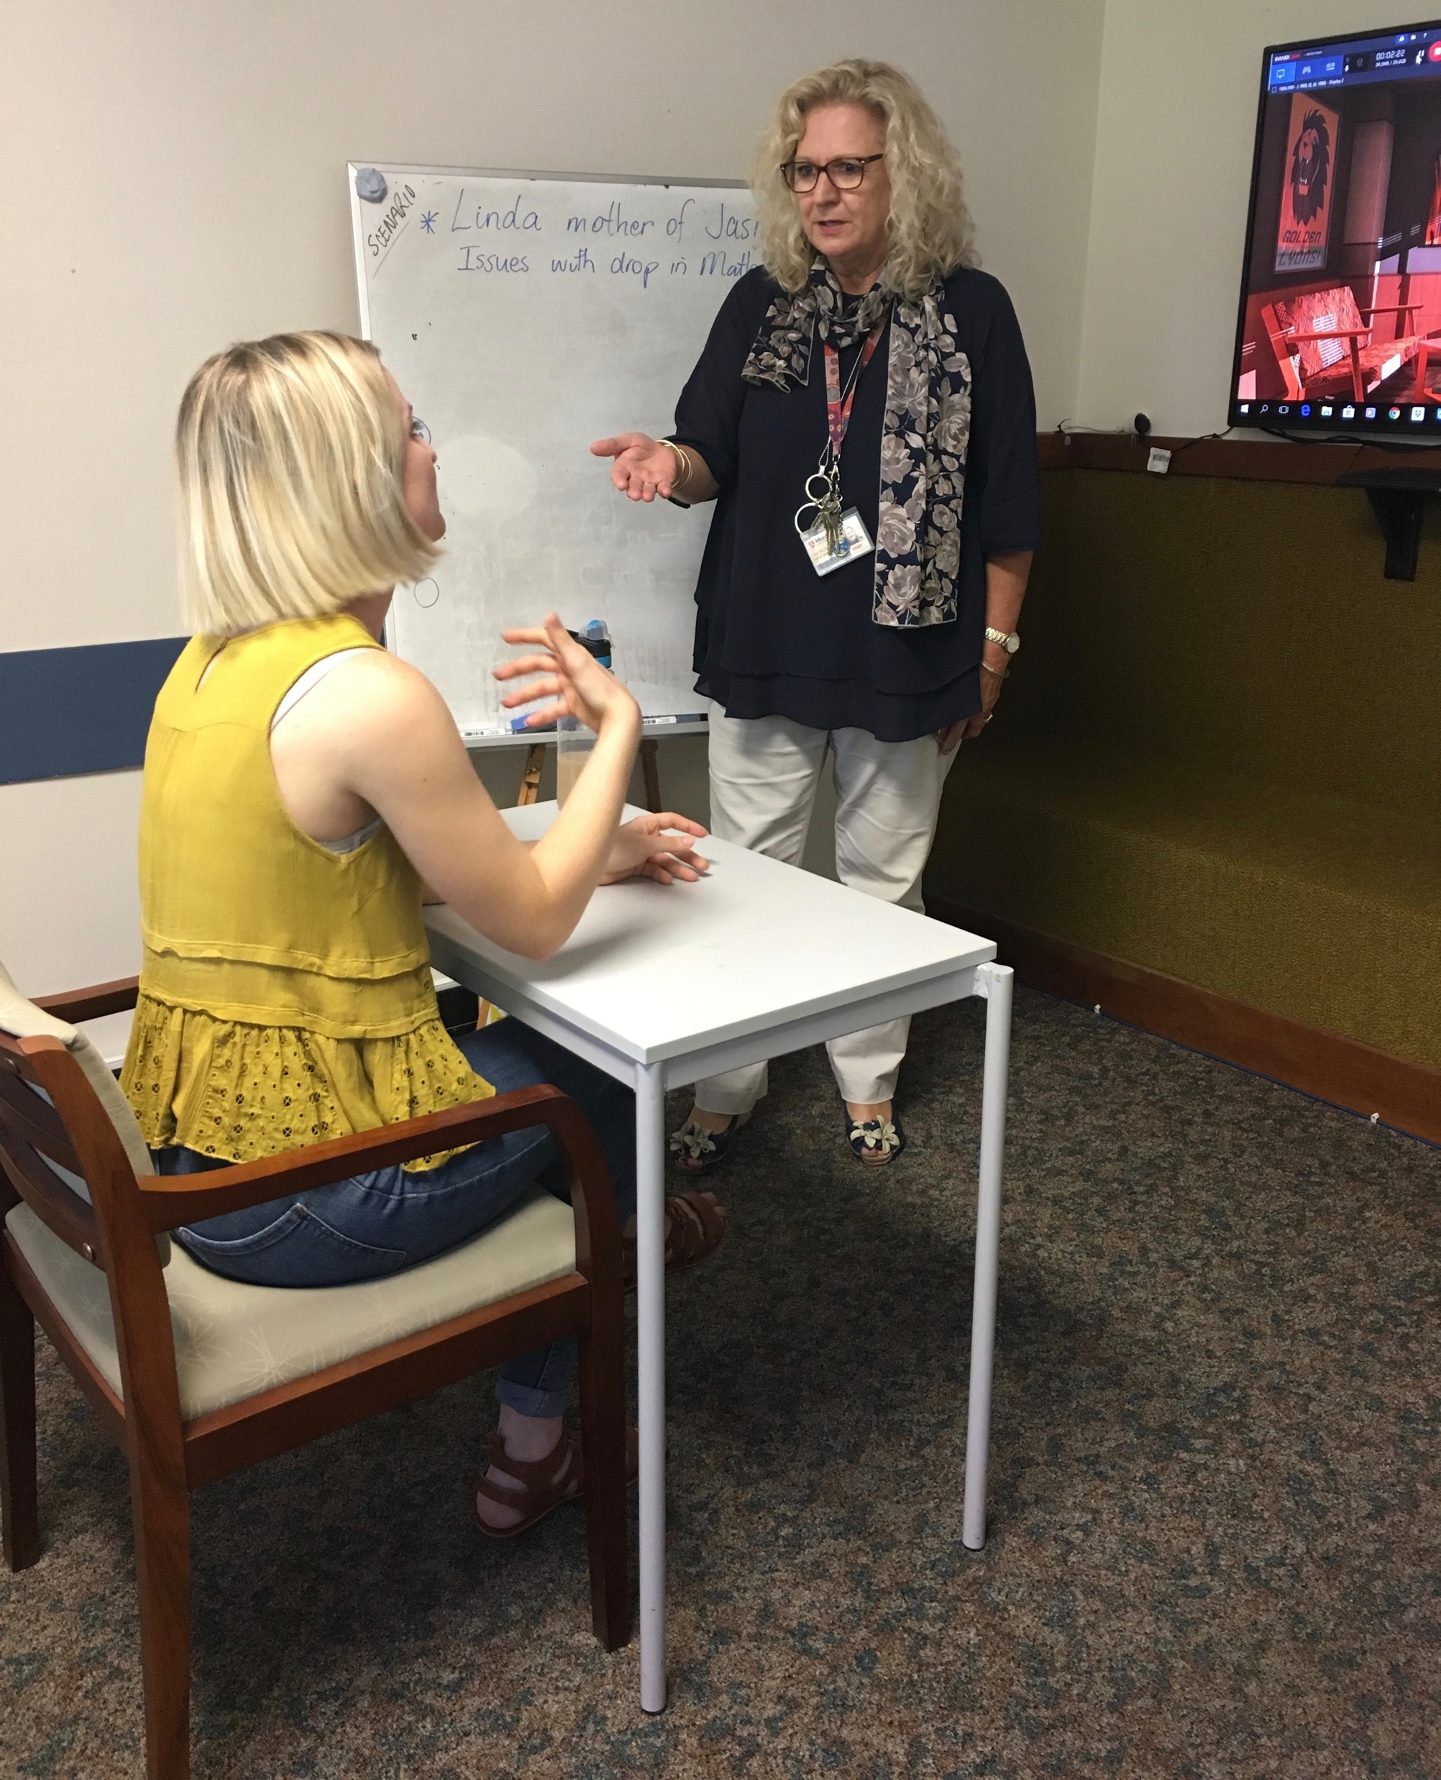
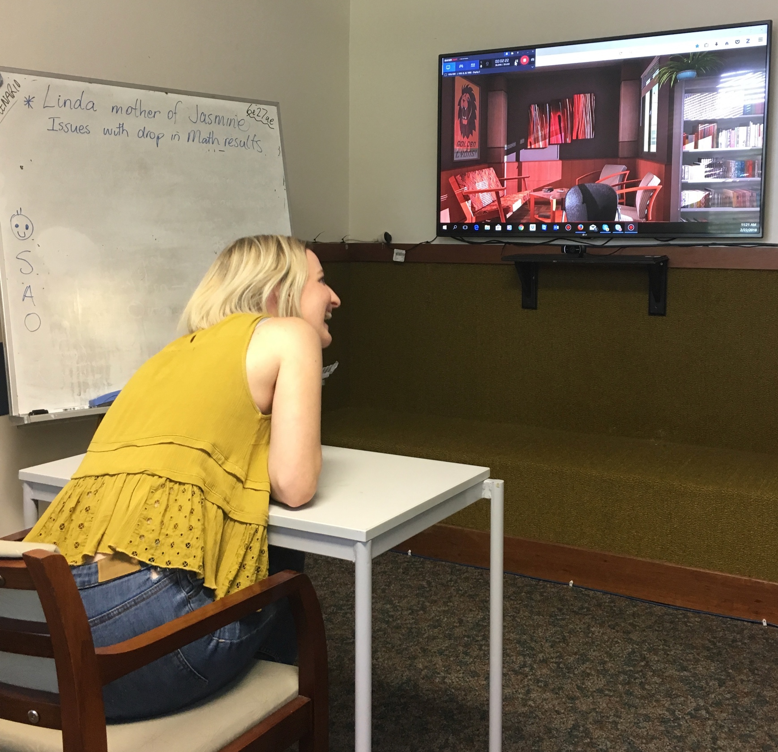
Irate parent: Jasmine’s achievement in Mathematics has declined and Linda wants the teacher to address the issue.
STEP 1: Parent Interview
STEP 3: Repeat Interview
STEP 2: Intervention Strategy
    Courtesies -Personalise
    Situation
    Action
    Outcome
Notes:
In 4th year students have just completed the following imulation – designed because this is something new teachers often struggle with. The situation … student goes in ‘cold’ and does their best to calm the parent.

Slide 16
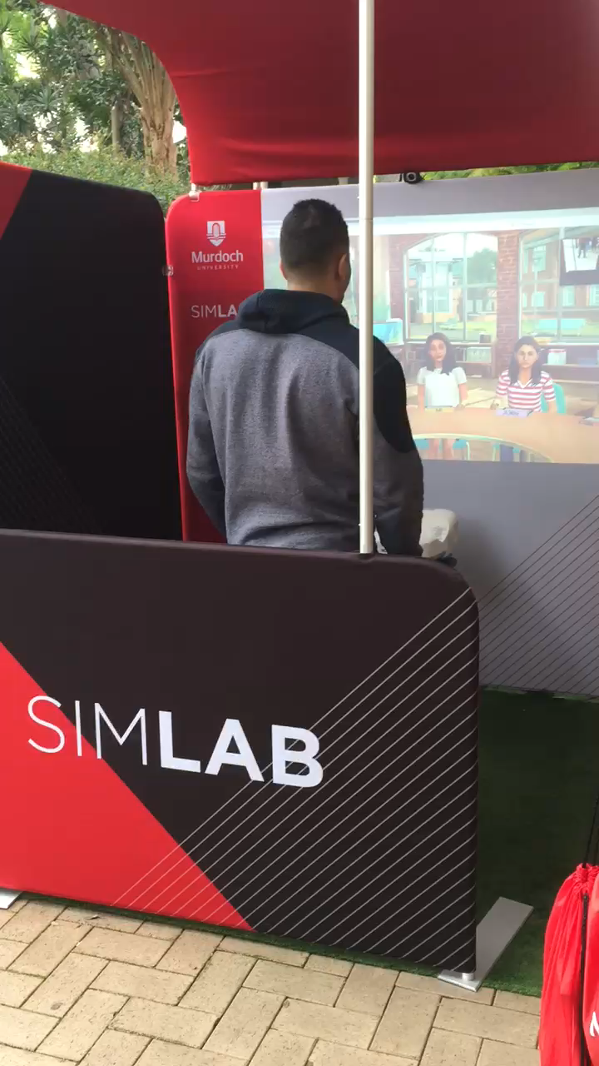
Portable Lab

Slide 18
Simlab@Murdoch:
Bridging the gap between metro and rural powered by Mursion
Access from laptop or lab
Used by individuals, group and school
Scenarios can be developed to depict context specific needs: special needs, ESL, gifted, multiage, indigenous…
How to respond to parents, community, colleagues, difficult conversations.

Slide 19
If you are interested in learning more
about SimLab@Murdoch™ Mursion
and its offerings, research collaborations, trialing or creative options
please contact me on
s.ledger@murdoch.edu.au
or the following for a live demonstration via Zoom or Skype:
Simlab@murdoch.edu.au

Slide 20
Results:
Online Critique – Survey
n=320
First Year B.Ed Program PSTs
BED 150 Introduction to Teaching Unit
Prior to Placement

Slide 21
What was the lesson focus?
LESSON INTENT
It was quite similar to gradual release. I began the lesson by hooking students in by introducing props. I read the story to all students before spending time getting to gauge what they gained from the introduction. Students were then going to be arranged in small groups for co-operative work before working alone on independent writing (R39)
I created a short interactive interesting lesson on descriptive writing using popcorn. My lesson had a lot of Q and A (R85)
My main teaching strategy was questioning. I asked probing questions to draw the teaching content out from the students (R102)
Give students an outline of various types of questions, including Convergent, Divergent and Evaluative (R209)

Slide 22
Micro-lesson Effectiveness

Slide 23
Engagement

Slide 24
Language

Slide 25
Feedback

Slide 26
Building Rapport

Slide 27
Perceived Benefits
Being able to listen back to myself and watch my movements was really helpful and has made me feel much more confident about the way I present myself in those ways. It did allow me to hear when I was nervous at the start as I spoke a little quicker than normal, which I will be aware of in future (R258).
.it allows PSTs to encounter classroom difficulties in a safe environment where mistakes have no impact on students. The failure aspect of learning is embraced whereas in a real life situation a student teacher would be less inclined to take any risks for fear of real life implications. (R304)
I believe it provides experience without the pressure of failure as you always have the option to pause if you need to regain composure (R20)
a way to build confidence, learning how to stand up infront of a class, practicing lesson plans/activities on students- able to see what worked, what didn’t (R266)
Gives us a head start for our pracs. Enables us to understand the different behaviours of children (32)
If I had not participated in the program before going into a
school, I would have felt like I was being thrown in "the deep end” (99)

Slide 28
Perceived Challenges
It provides a good inside into the experience of a classroom but however nothing beats the real thing. I think this tool will help pre-service teachers get a feel before going out into the real world (R2)
It gives people experience, but I think talking to fake people with someone watching you from the other side of the world is even scarier than a real classroom (R19)
Another challenges is how the system can be a bit delayed, again making the situation not feel as natural as being in a real classroom (R270)
It can be daunting to know that you could be being judged. Although it is a nerve-wracking experience it has many benefits (R138)
The benefits outweigh the challenges (R63)

Slide 29
SELF EFFICACY
How confident did you feel in relation to teaching in the Teachlive Simulation lab?
n= 320

Slide 30
It reduces anxiety levels and gives a bit more experience and confidence (R3)
Makes you realise that teaching is for me, and doing this before my first week of prac made it worth while (R180)

Slide 31
DISCUSSION
Micro-teaching 2.0 proved to be effective in preparing students for placement in the eyes of PSTs and Academics.
Rural and remote participants valued the opportunity to practice and rehearse the art of teaching & public speaking
The benefits of using AVATARS outweighed the challenges.
Students realised the importance of knowing the students in order to differentiate instruction.
Students developed confidence and self efficacy in regards- lesson planning, engagement, language, feedback, building rapport
Needs: questioning, maintaining Interest & conclusions
The experience enabled a ‘just in time and 360 feedback loop’ not afforded in typical classroom context.
The experience in front of Avatars highlighted the need to teach students how to critique lesson plans.
Early identification of at risk PSTs before placing in schools

Slide 32
CONCLUSION
Can Micro-Teaching 2.0 support the development of PSTs teaching skills: plan, teach, assess and reflect?
Absolutely
2. How can TeachlivE technologies benefit PSTs in rural and remote locations?
By providing comparabable and creative learning experiences not typically afforded 3. Is Teachlive beneficial in preparing PSTs for real life classroom contexts?
Yes
Whats next? Further research
  Potential capabilities of MRE & Avatars eg teaching strategies, curriculum,
  classroom management, public speaking, interviewing,
  questioning skills, feedback.
  Analytics behind interactions – ReflectLivE
  Possibilities & challenges of AVATARS for rural education
  Including virtual schooling opportunities
  The emerging role of AI Robots to prepare students

Slide 33
What next
https://www.youtube.com/watch?v=LguXfHKsa0c
Sophia Awakens

Slide 34
 | Allen, Dwight W., and Fortune, Jimmie C. (1965) "An Analysis of Micro-Teaching: A New Procedure in Teacher Education." School of Education, Stanford, California.
REFEREnCES
Chini, J., Straub, C. L., & Thomas, K. H. (2014). Learning from avatars: Learning assistants practice physics pedagogy in a classroom simulator. Physical Review Physics Education Research, 12(1), 010117.
Dieker, L., Hynes, M. C., Hughes, C. E., Stacey, H., & Becht, K. (2015). TLE TeachLivE: Using technology to provide quality professional development in rural schools, 34(3), 11–16.
Dieker, L. a., Rodriguez, J. a., Lignugaris/Kraft, B., Hynes, M. C., & Hughes, C. E. (2013). The Potential of Simulated Environments in Teacher Education: Current and Future Possibilities. Teacher Education and Special Education: The Journal of the Teacher Education Division of the Council for Exceptional Children, 37(1), 21–33. http://doi.org/10.1177/0888406413512683
Dieker, L., Hynes, M., Hughes, C., & Smith, E. (2008). Implications of Mixed Reality and Simulation Technologies on Special Education and Teacher Preparation. Focus on Exceptional Children, 40(6), 1–19. Retrieved from http://proxy.lib.utk.edu:90/login?url=http://search.ebscohost.com/login.aspx?direc
Long, W. A. (1989). Personality and learning. 1988 john wilson memorial address. Focus on Learning, 11(4).
Mertler, C. A. (2009). Action research: Teachers as researchers in the classroom (2nd ed.). Thousand Oaks, CA: Sage
Piggot-Irvine, L. (2015) Goal Pursuit in Education using Focused Action
Research. US: Palgrave.

