Slide 1
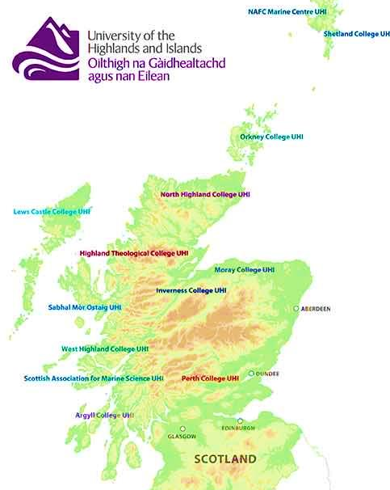

The role of values in a teacher leadership programme for Scottish Island Communities
Professor Morag Redford
ISFIRE 2018

Slide 2
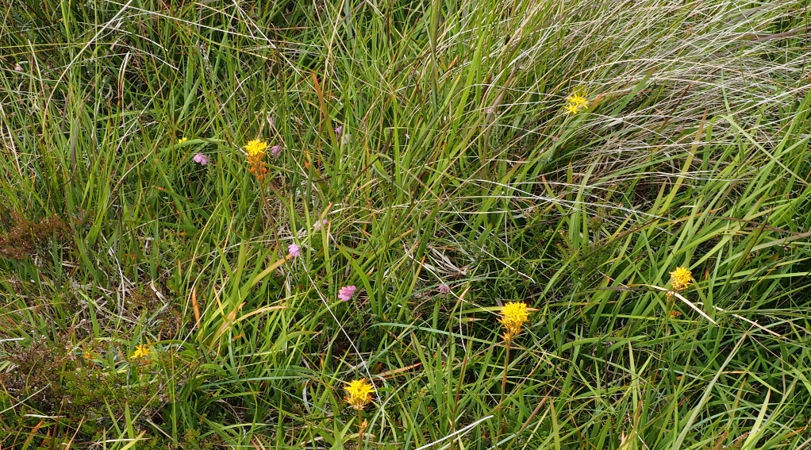
Building capacity for Rural Leadership
The challenges of teacher leadership in a Scottish context
The theoretical framework used to inform the project
Two phases of analysis:
  Data collected during the programme
  Participant interviews 18 months later
Discussion of the issues considered during a project to build capacity for rural leadership
Machair, Isle of Lewis
All photographs ©Morag Redford

Slide 3
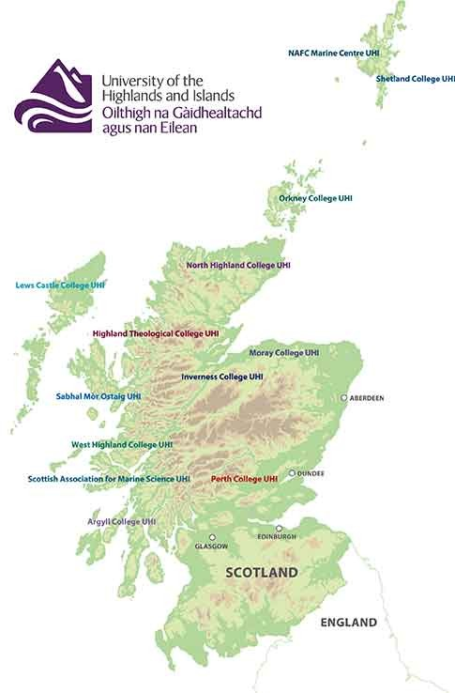

Shetland Islands
The challenges of teacher leadership in a Scottish context
Orkney Islands
Western Isles
(Na h-Eileanan Siar)

Slide 4
Agency
Model for ecological Agency (Priestly, M, Biesta, G and Robinson, S, 2015: 30)
Iterational
Life Histories
Practical Evaluative
Cultural
Projective
Professional Histories
Ideas, values, beliefs, discourses, language
Structural
Social Structures (relationship roles, power, trust)
Material
Resources
Physical Environment
Short term
Long term

Slide 5
Inter-Authority Developing Leadership programme
Aims:
To explore leadership of learning
To lead an enquiry focused development
To develop skills in educational leadership
Structure: three taught days, interwoven with online webinars in mixed authority groups
Content: starts with the values base in the professional standards: social justice, integrity, trust and respect, professional commitment. We consider these in relation to professional and island value systems, and explore understandings of educational leadership. Reflective journals and practitioner enquiry are introduced as tools to support the development of work in school.
The programme is designed to support teachers to lead a project in school that fits with their knowledge, skills or responsibilities.

Slide 6
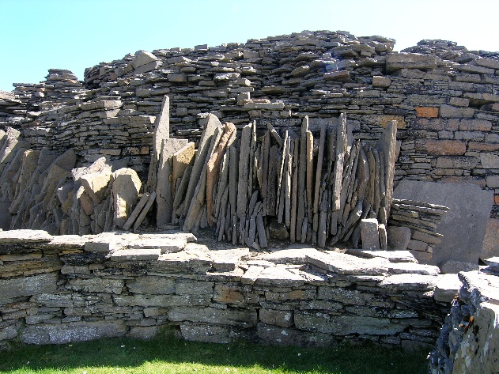
Design group themes
Opening up opportunities: encouraging, supporting, developing, leading learning, curriculum
Values: island values, supporting leadership, professional values, school ethos, community values
Creating leaders: leading in their own school, between schools, leading curriculum, sharing practice, working with others
The Midhowe Broch, Rousay, Orkney

Slide 7
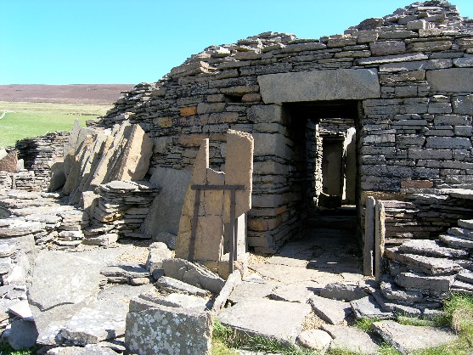
Participant themes
Opportunity: something new, career development, ‘authorisation’ to lead
Working with others: meeting teachers from across the authority, space to discuss, space to share ideas, wider connections, hearing different views
Structured professional learning: reading, discussion, no written work required, practitioner enquiry supported, outcomes shared through workshops at an inservice (professional learning) day
The Midhowe Broch, Rousay, Orkney

Slide 8
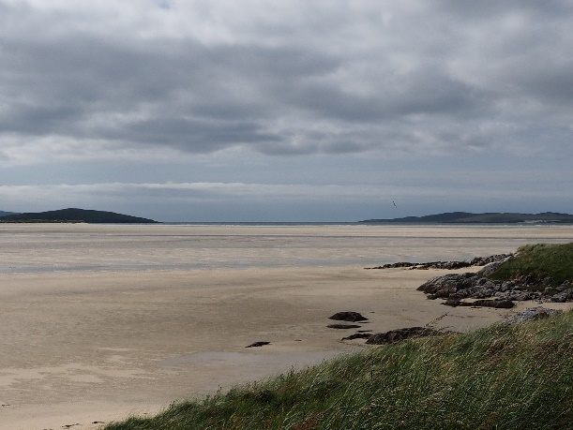
Revisiting Participants
Values:
‘confirmed values that had been eroded’
‘relevant to our island communities’
‘at the end of the day they are our GTCS values’
‘confirmed the integrity of the profession’
Luskentyre, Harris, Western Isles

Slide 9
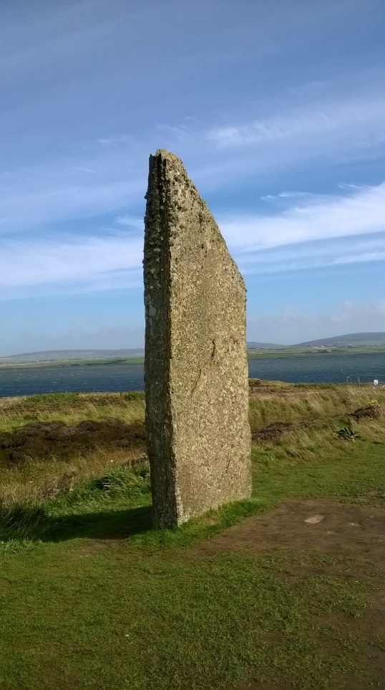
‘A personal tapestry of leadership’
Recognised skills
A leader in the classroom
How to work with others
Confidence to lead others
Taken on wisdom in a different way
Optimism
Developing a process of thinking
Nurturing and identified strengths
Up to date, current thinking
Communication skills
Ring of Brodgar, Orkney
Notes:
What they led:
Installation of sumdog programme one rural primary school
Reader/ scribe for modern foreign languages examinations
Daily practice of times tables facts
Learning folders in early years
Introduction of an online gallery to support moderation in art
Mentoring to support resilience
Introduction of resilience materials in secondary school

Slide 10
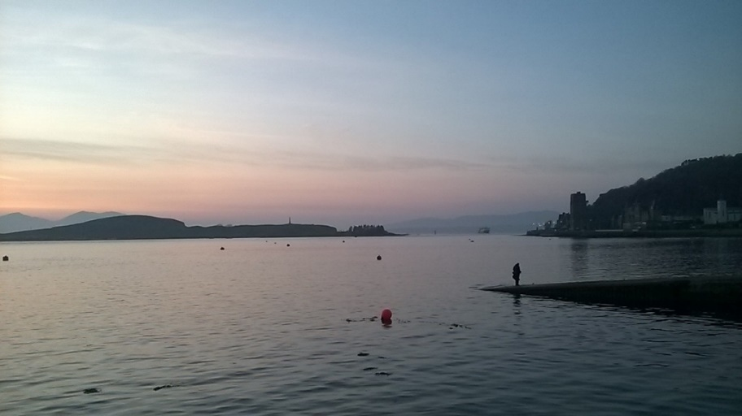
Discussion
  ‘Creative, reflexive and valuable’
  Where next for participants and organisers ?
  How has it contributed to leadership development ?
  Why can it offer more in rural contexts?
  Lerwick, Shetland

