Slide 1
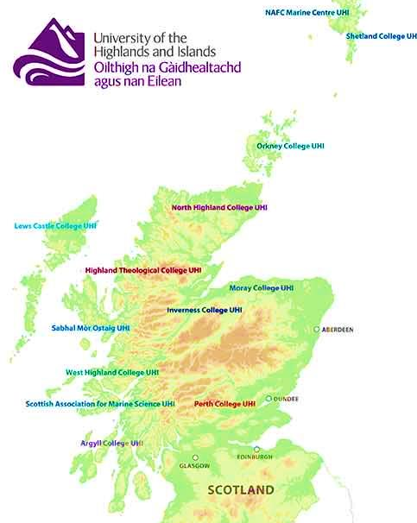


Place-based rural teacher education in Scotland
Professor Morag Redford
Anne Paterson
Chief Education Officer
ISFIRE 2018

Slide 2
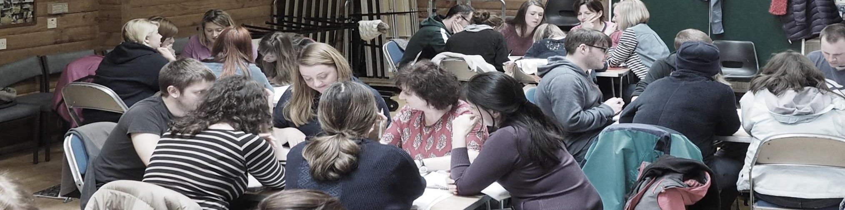
In this paper
We explore the joint programme of initial teaching qualification and induction year in Scottish Teacher Education:
Through the theory of ecological agency (Emirbayer & Mische, 1998; Priestley, Biesta & Robinson, 2015);
From a University-based study on student teacher agency; that informed
A local authority based study of teacher agency in a rural context, to
Implications for rural teacher education in Scotland.
All photographs ©Morag Redford

Slide 3

Agency
Model for ecological Agency (Priestly, M, Biesta, G and Robinson, S, 2015: 30)
Iterational
Life Histories
Practical Evaluative
Cultural
Projective
Professional Histories
Ideas, values, beliefs, discourses, language
Structural
Social Structures (relationship roles, power, trust)
Material
Resources
Physical Environment
Short term
Long term

Slide 4
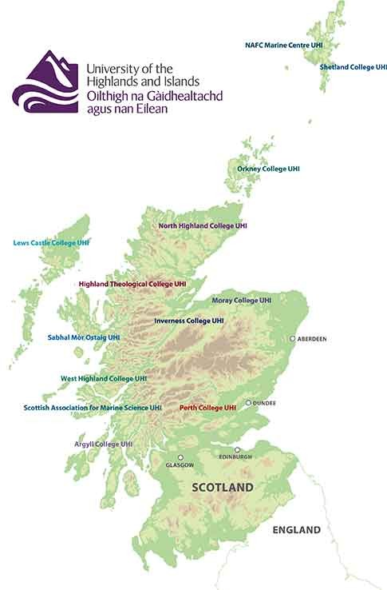
Study 1:
Teacher Education at UHI

Slide 5
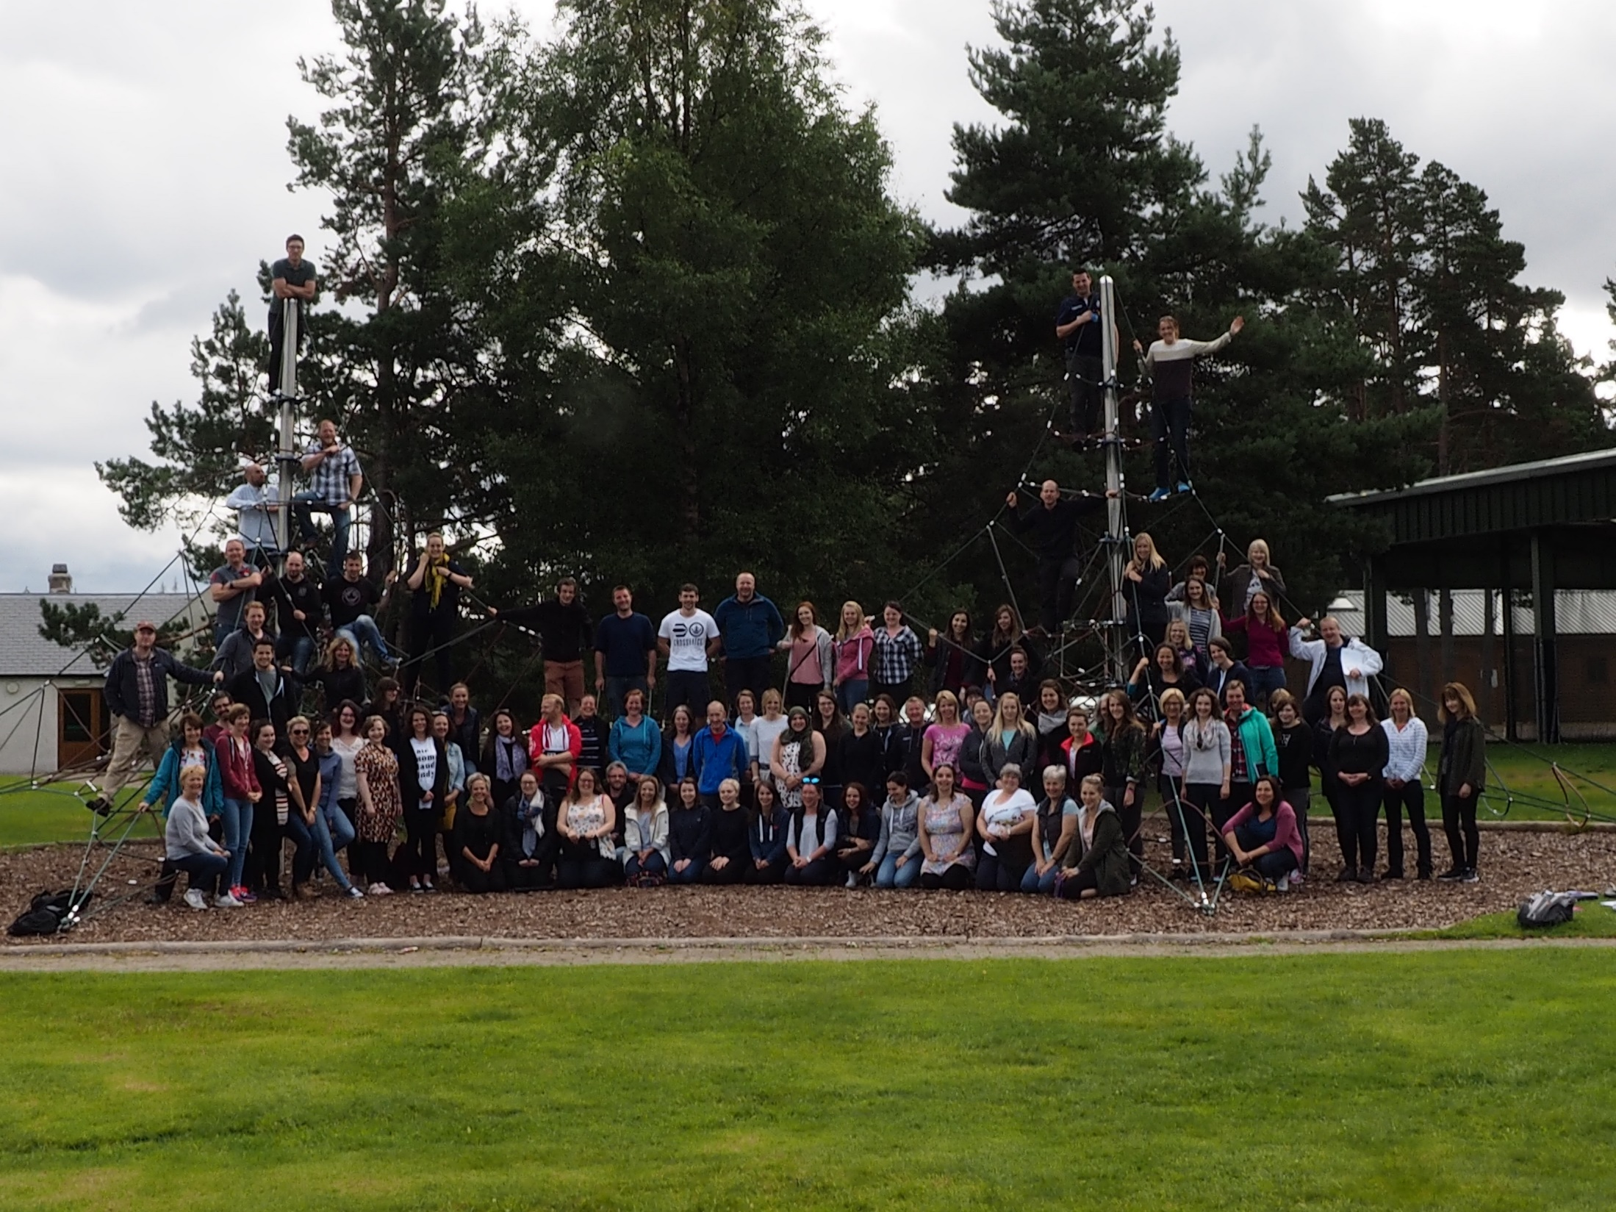

Slide 6
Students valued relationships more than cultural or material factors

Slide 7
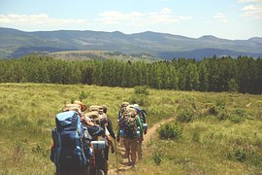
Student Teacher Agency
Trajectories towards the professional ‘landscape’ of practice
Through the woods of induction year

Slide 8
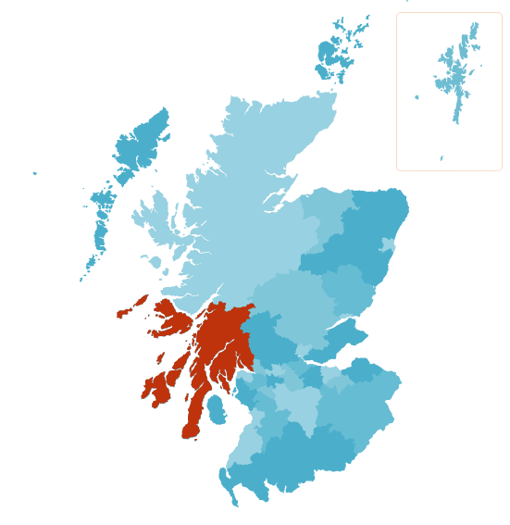
Study 2:
Newly Qualified Teachers Recruitment and Retention in Rural Education
Notes:
Coverage of Argyll and Bute Council Area in Scotland - one of 32 local authorities.

Slide 9
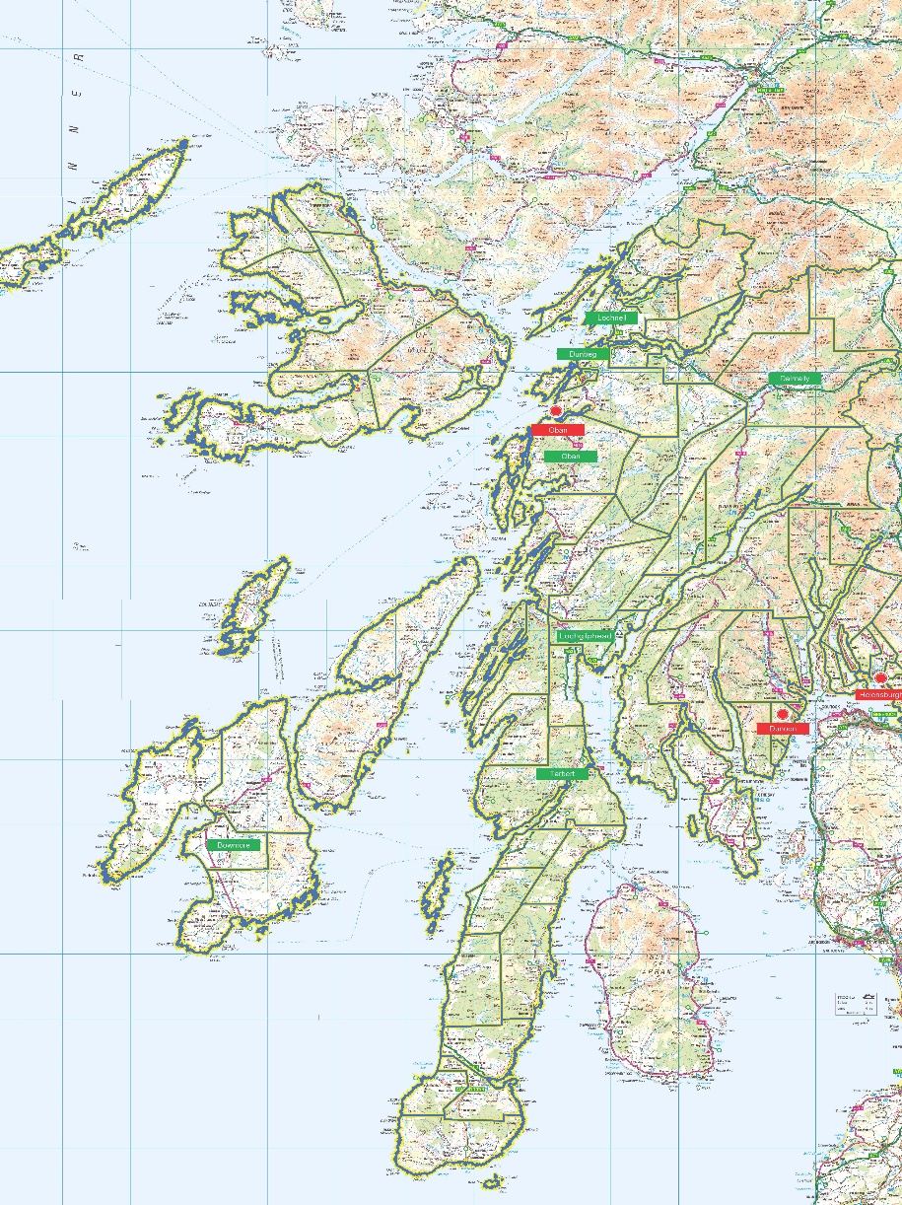
Argyll and Bute Council
Notes:
The red is rural schools in rural towns (12) and the green indicates very remote (17)schools.
The Scottish Government’s Urban / Rural Classification (2014) is used to determine which schools in Scotland should be considered rural schools and included in the Rural School List. In Argyll and Bute the following percentage of schools are classified as Accessible Rural 7.0%, Remote Rural 5.2% and Very Remote Rural 38.3%. This is in comparison to a Scotland percentage of Accessible Rural 11.7%, Remote Rural 3.2% and Very Remote Rural 2.9%. Currently 58 schools within our authority are listed as Very Remote Rural. Scottish Government (2015)

Slide 10
Triad Map
What knowledge and understanding of rural education have you brought to the probation year?
Consider Skills / knowledge / Approach / Attitude
During your probation what has supported your development as a rural teacher?
In the future what sort of teacher would you aspire to be?

Slide 12
Iterational
“ I was on placement in a very small school with one teacher and a multi composite class and undertook an interdisciplinary learning activity covering the age and stages and involving the community”
“We regularly engaged with other students throughout UHI and who belonged to rural communities.”

Slide 13
Influences on current support in rural school (Practical Evaluative)

Slide 14
Practical Evaluative
“I worry a lot and it would be good to have a lot of class teachers who teach at the same stage to observe and speak with…..that would be my one drawback of teaching out with an urban setting”
“being in a remote area is more difficult to have good connections with other schools”
“Many CPD opportunities are offered by the same people/organisations meaning that variety is limited”
“I think this is the part I find tricky…when I have queries (eg where do I find jotters) I need to turn to senior staff”
No it can be very isolating. Although we have internet, the connection is not so good”
“My current school is really at the heart of its community and I feel very lucky to have experienced my first year of teaching here”

Slide 15
Projective

Slide 16
Projective
“the atmosphere and supportive network that most rural schools have to offer”
“ the feel supportive families and supportive staff”
“the community spirit within the schools and the importance within the community”
“if it had good communications with urban areas”
“community links and access to outdoors for learning”
“I would not be prepared to … a multi composite class has many challenges which are eased by having other teachers to work with”
“I would prefer to work in a larger school as I am still learning” “if UHI had not offered the course locally I would not have done the PGDE”
“the opportunity to innovate using technology to connect to other schools and wider world”

Slide 17
Impact of Place
Rural background- life history
Community of practice and networking
Deeper knowledge of children
Scotland has 34% rural schools across 94% of the land mass

Slide 18
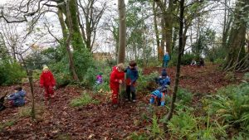
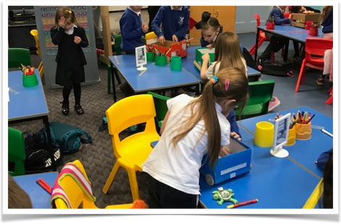
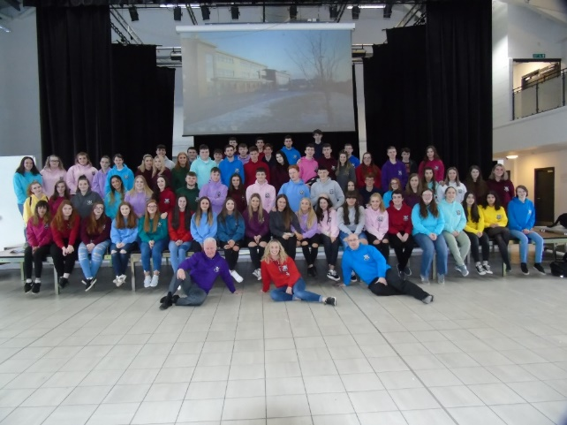

Discussion
  What should Scotland be doing next?

