Slide 1
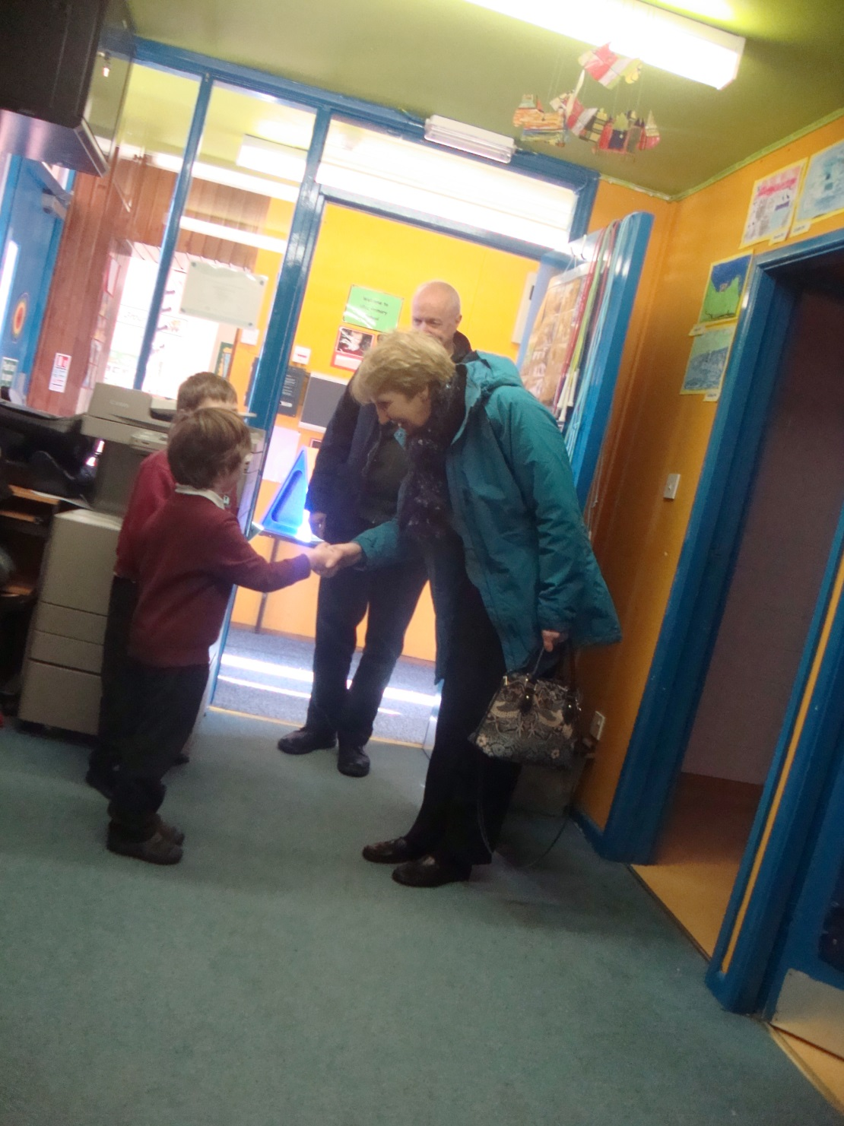
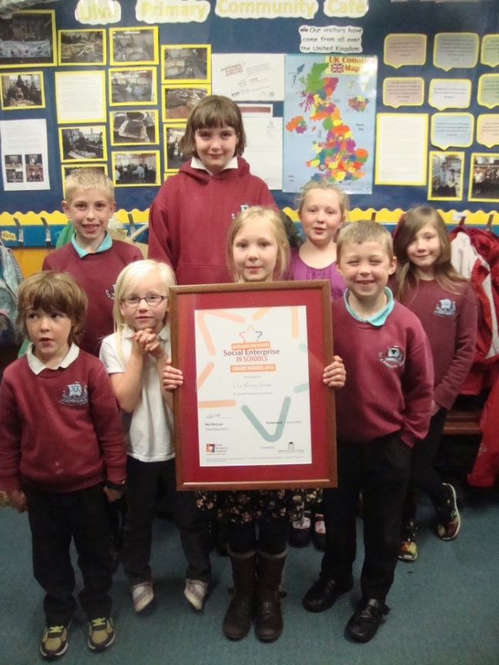
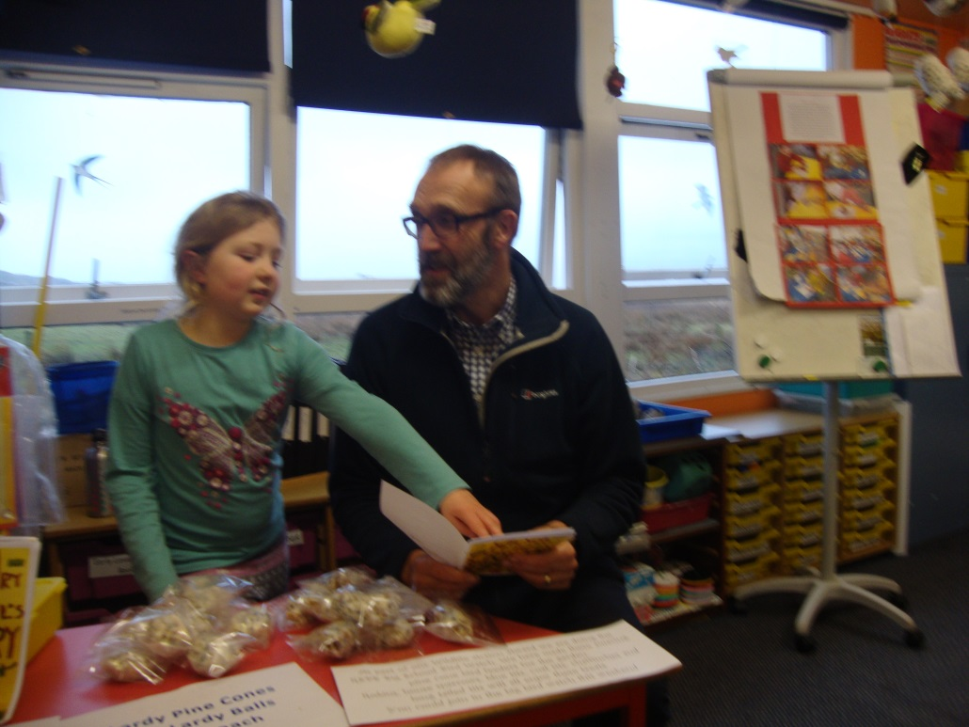
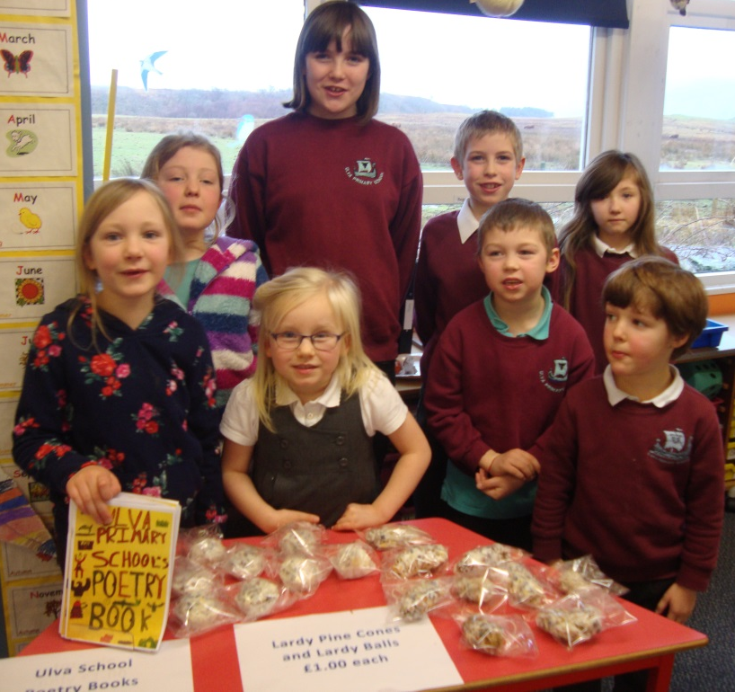
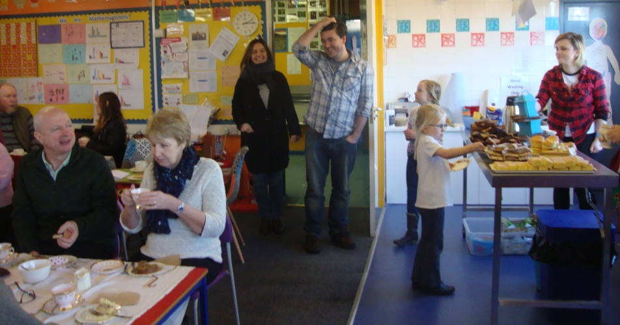


Ulva Primary School Community Cafe
Notes:
Who we are and roles
2013 – review of Rural Education and linked classification in 2014 of Urban / Rural
Scottish Government (2015) acknowledged that key areas of policy such as the economy, transport, education and health can have a particular impact on rural communities, and seeks to reflect this in mainstream policy development. But we have little current research, in Scotland in relation to pedagogy and curriculum in rural schools.
In Scotland initial teacher education is all University based, with programmes accredited by the General Teaching Council for Scotland and student places managed nationally by the Scottish Government as part of their teacher workforce planning. None of the ITE programmes offer specific rural content although the one year routes in UHI provide examples of rural pedagogy and a placements in rural schools.
UHI Education partnership – some provision 2007 – 2012 with the University of Strathclyde. From 2013 – 14 ITE in UHI has steadily grown – student places being one of the Government to acknowledge the challenge of recruitment and retention in rural areas.

