Slide 1
Swine industry

Slide 2
There are many breeds of swine
Different types of breeds are raised for specific purposes
The types of breeds are divided into sire or boar breeds and dam or saddle breeds

Slide 3
Terminology
Barrow
Male castrated pig
Boar
Un-castrated male pig
Boar Pig
Un-castrated male pig under one year of age
Farrow
To give birth to a litter of pigs
Gilt
Female swine which has not farrowed
Litter
Offspring of a sow from one gestation
Swine
Offspring usually under 120 pounds
Sow
Female that has given birth, usually over one year of age

Slide 4
Swine have been utilized by humans for thousands of years for their meat production.
Pigs were domesticated as early as 9,000 years ago in Asia, Africa, and Europe.
Throughout history, they have been a primary source of meat and protein for many people around the world.
In the past few decades, the American pork industry has seen a transformation in the scope of swine production.
The swine industry has undergone drastic changes, more so than any other livestock industry.

Slide 5
Swine production began in America on the family farm, where pigs would be fed table scraps and other foods until fattened
At which time they would be sold or harvested for the owners to eat.
The family farm opened the market for swine production systems.
Some operations grew larger and larger, becoming the major pork producing facilities in America.
These farms were plentiful in numbers across all of the united states, owning the vast majority of market

Slide 6
Sire or Boar Breeds
Sire breeds are known for their growth rate and carcass merit.
This breed type consists of the berkshire, the hampshire, the poland china, the spotted poland china, and the duroc.

Slide 7
Berkshire
The berkshire originated in england in and around berkshire and wiltshire counties
The development of the breed began during the early and mid 1700s
The first berkshires were imported into the united states in 1823
Berkshires are black in color with six white points, four white feet, a white stripe in the face, and a white tail tip.
They also have erect ears, a short snout, and a dished face.
Selection of berkshire's has been focused on fast and efficient growth, meatiness, and good reproductive abilities.

Slide 9
Hampshire
The hampshire breed also originated in England
Hampshires were imported into the united states between 1825 and 1835 and major development of the breed occurred in Kentucky
They are black in color with a white belt encircling the body, including both of the front legs and feet
For registration, the white belt can include not more than 2/3 the length of the body
Some white is also allowed on the hind legs, as long as it does not extend above the bottom of the ham or touches the white belt
Hampshire's have erect ears and are noted for their foraging ability, muscling, and lean carcasses
This breed is popular and is used in many crossbreeding systems
The hampshire is believed to have the best mothering ability among the sire breeds.

Slide 11
The Poland china
The poland china originated in Ohio
The breed was developed between 1800 and 1850.
This breed was originally called the warren county hog
The name poland china was officially adopted at the national swine breeder’s convention in 1872
They are black in color with six white points, four white feet, a white tip on their nose, and a white tail tip
The poland china breed has drooping ears and is one of the larger breeds of hogs
These hogs produce carcasses with low back fat and large loin eyes
They are also used in many crossbreeding programs

Slide 13
The spotted Poland china
The spotted poland china was developed in Indiana
It was developed by crossing hogs of poland china breeding with spotted hogs being grown in the area
Spots are black and white, and at least 20% of the body must either be black or white to be registered as a spotted poland china
Spots also have forward drooping ears
Breeders strive to produce large-framed hogs with efficient gains and good muscling.

Slide 15
Duroc
The duroc originated in the united states from red hogs raised in the eastern US before 1865
Durocs are red but can vary from light to dark, with a medium cherry color being preferred
They also have forward drooping ears
Durocs possess good mothering ability, growth rate, and feed conversion, and is one of the most popular breeds in the united states.

Slide 17
Dam or Sow Breeds
The sow breeds are known for their prolificacy and excellent mothering and milking ability while producing acceptable carcasses
All the sow breeds are white in color, but their ear types vary with the breeds
This breed type includes the chester white, the landrace, and the yorkshire.

Slide 18
The Chester white
The Chester white originated in Chester county, Pennsylvania
Yorkshire, Lincolnshire, and Cheshire hogs were mixed in breeding prior to 1815
These hogs formed the foundation of the Chester white breed
They are solid white in color with forward drooping ears
The Chester whites are known for their mothering ability.

Slide 20
landrace
The landrace originated in Denmark, Norway, and Sweden
In 1934, the first landrace hogs were imported into the united states for experimental purposes by the USDA
They are white in color and have very large drooping ears
They also have very long bodies, which make them better equipped to carry and nurse a larger litter
Landrace sows are known for their mothering ability and large litters.

Slide 22
Yorkshire
The Yorkshire originated in England in the county of Yorkshire where it was called the large white
These were imported into the united states in the 1800s
At that time, many of these hogs were raised in Minnesota, where they became known as Yorkshires
They are solid white in color. However, they sometimes have black pigment spots on their skin, which are called freckles
Yorkshires have erect ears and a slightly dished face
These hogs are known to have large litters, high feed efficiency, rapid growth, good mothering ability, and long carcasses. They are often used in crossbreeding programs.

Slide 24
Hereford
The Hereford breed was developed in Missouri, Iowa, and Nebraska
Early development occurred from 1902 to 1925
Foundation stock for this breed included the duroc and the poland china
Chester white and Hampshire hogs could have also been used in the early breeding.
Herefords are red in color with a white head and ears, white feet and underline, and a white tail tip
This breed has forward-drooping ears
Herefords are prolific, good mothers, and have good foraging ability

Slide 26
Pietrain
The pietrain was developed in europe and is known as the world's leanest, heaviest- muscled breed
The pietrain is known as the European secret formula for achieving the ultimate in lean, heavy-muscled hogs
Pietrains make competitive market hogs which are functional, yet different, with extreme width and muscle thickness
Pietrains are large-framed hogs which excel in leanness and growth rate
Pietrains resemble the spotted poland china
They will sire black hogs when bred to black sows, white hogs when bred to white sows, and a conventional spotted color when bred to spots

Slide 28
Rare breeds
The following breeds are considered either rare or minor breeds.
Minor meaning existing in small numbers.
The red waddle is one of the first breeds of swine developed in america. They were discovered in the early 1900s in the forest and swamp regions across the southern states into Texas.

Slide 29
mulefoot
The Mulefoot hog has a strong resemblance to the Poland China breed. They are black and may have white markings on the face and legs. The Mulefoot is considered a dual-purpose hog, produced for both bacon and lard. The breed is active, vigorous, and a hearty outdoor hog. Mulefoots normally have a docile, quiet disposition and are very easy to handle.

Slide 31
Tamworth
The Tamworth originated in Ireland
Development of the breed took place in central England in the counties of Stafford, Warwick, Leicester, and Northampton
The Tamworth’s are considered one of the oldest of the purebred breeds
They were first introduced into the united states in 1881
The color of the pig is red with shades varying from light to dark
For registration purposes, they should be free from black hairs
Tamworth’s are considered bacon-type hogs
They are highly prolific, have large litters, are excellent mothers, and are very good foragers
Their ears are large, carried rigid, and slightly forward

Slide 33
Pig body parts

Slide 34
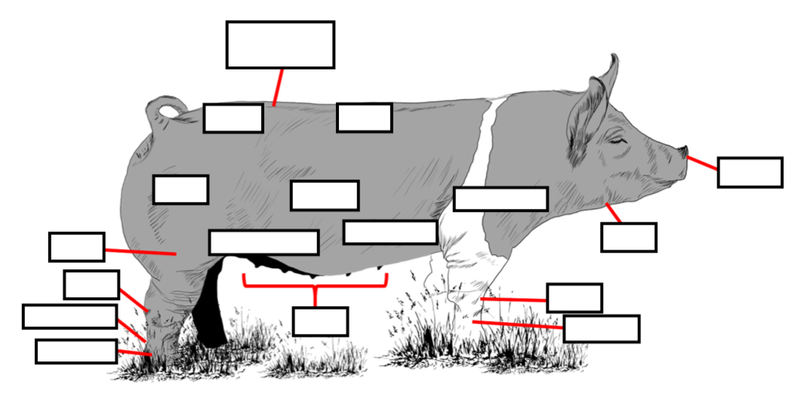
Gilt body parts

Slide 35
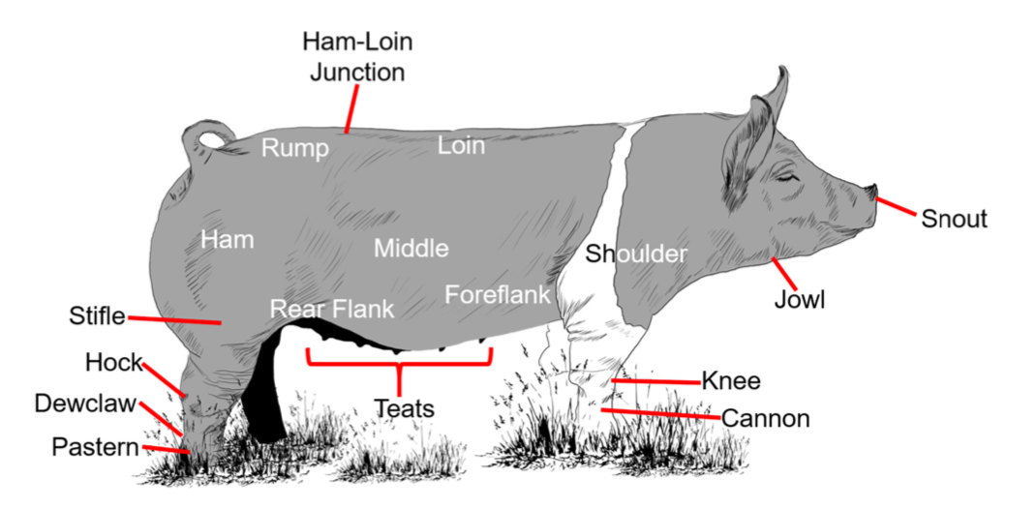
Gilt answer key

Slide 36
Boar body parts

Slide 37
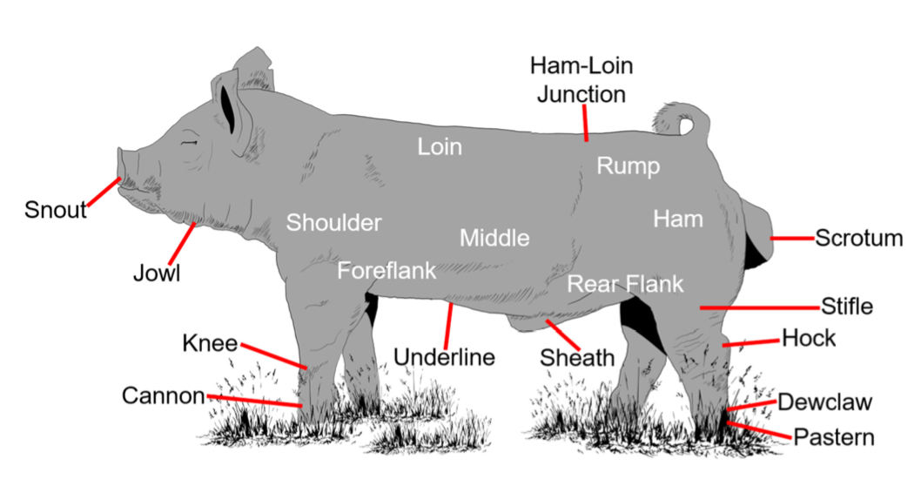
Boar answer key

Slide 38
Swine operations and procedures

Slide 39
Why is the production of pigs different?
A gilt or sow can reproduce up to 3 times a year, meaning she could potentially have 30 piglets
Shorter pregnancies
Pork is a more affordable meat

Slide 40
Types of operations
Swine can require more intense management than other species of livestock, since they are typically raised in controlled environments.
There are many types of swine production operations
First let’s look at the two different types of farrow-to-finish systems, the pasture system and the confinement system. Both systems have advantages and disadvantages.

Slide 41
the pasture and confinement systems
The pasture system has a low building and equipment investment
Has fewer problems with manure, odor, and insects
However, pasture systems require more land, are more labor intensive, and are susceptible to weather problems.
The confinement system needs less land and has lower labor requirements
However, it requires a high building and equipment investment and usually must serve as the major enterprise.

Slide 43
Farrow-to-Finish operation
The first type is a farrow-to- finish operation where the pigs are managed from birth to market
From birth to 22-26 weeks a pig will grow to slaughter weight
Sows nurse their piglets for an average of 3 weeks before they are weaned (separated from the sow)
A farrow-to-finish operation owns and manages all phases of production

Slide 44
Feeder pig operation
The second type of operation is a feeder pig operation or farrow-to-nursery where the pigs are owned only until they are weaned
Weaned at about 40 pounds, the pigs are then sold to a finishing operation

Slide 45
Finishing operation
The third type of operation is the finishing operation
This consists of pigs which are purchased after they are weaned
Fed to market weight usually 210 to 230 pounds, the pigs are then sold for processing

Slide 46
Purebred operation
The last type of operation is the purebred operation also known as a seed stock operation
This operation uses its own stock for replacement animals and never goes outside itself for new breeding stock
Therefore, the operation extends from birth to market
Replacement animals are then chosen, and the rest are culled from the herd
Their value lies in the genetic potential of a hog's traits, including gain, growth, and maternal and carcass characteristics.
The offspring of seed stock operations are often marketed as breeding stock to both farrow -to-finish and farrow-to-nursery operations.

Slide 47
Housing
Housing is also a major factor to consider in swine production
The important thing to remember when using an existing building is to keep the floor dry and the animals sheltered from drafts, rain, and snow and to provide shade in hot weather.
Larger farrow-to-finish farms have separate facilities for pregnant sows, farrowing sows, weaning weanling, piglets and growing or finishing pigs.
The gestation house is designed for pregnant females, which are penned alone.
They are separated in pens to reduce stress caused by fighting and competition, which could potentially compromise the pregnancy.
In smaller operations pregnant females are often grouped together according to farrowing date and body condition.
Once sows are nearing their farrowing date, they are moved to the farrowing barn.

Slide 48
An a-frame building is easy to build and provides a watertight roof with a rear wall
A- frame buildings are mobile, can be fitted with doors, located in a spot where water will not puddle, and Arranged to face away from prevailing winds
This type of housing is often used for farrowing sows

Slide 49
The open-front building is another type of housing
These buildings have natural ventilation, minimum insulation, and provide minimal protection during cold weather
Therefore, they work well in the summer and poorly during harsh winters
Open-front buildings are used primarily for growing and finishing pigs and for pregnant sows

Slide 50
Confinement buildings provide superior cold weather performance in comparison to open-front buildings but tend to be hot during the summer months
These buildings are used primarily for farrowing houses and nurseries
A good confinement house includes temperature control, proper ventilation or controlled air exchange, farrowing crates, proper sanitation and feeding, watering, and waste-handling equipment

Slide 51
Nutrition
Because pigs are non-ruminants, meaning they have one true stomach similar to humans, they are not able to efficiently break down and utilize forages, like cattle and other ruminant animals.
Consequently, pigs are fed a grain-based diet, usually made up of cereal grains or corn.
Pigs require sufficient energy, protein, vitamins, and minerals in their diet.
Protein is the key element in hog feeds.
Typically, a young animal requires a higher level of protein in the diet than does an adult.
This is because young pigs have a much lower daily feed intake.
High levels of nutrients are needed for proper growth and development of body tissues.

Slide 52
Gestation to lactation
Breed management is a very important aspect of swine production and extends from gestation to lactation
The goal in a breeding program is to have a high percentage of sows farrowing large litters in a short period of time
Boars should be purchased at least 45 to 60 days prior to the breeding season and isolated to ensure that they are free from disease before exposing them to the breeding herd
Boars can be kept outdoors with few problems, provided they have sufficient feed, water, and protection from the weather or any other harmful factors

Slide 53
Individual pens may also improve longevity of the boar.
Boars that are from nine to 12 months old should not be bred more than once a day, five days a week
However, a boar that is greater than 12 months old can be bred twice a day, seven days a week
Boars must also be kept from severe heat because boars subjected to high temperatures may have reduced semen quality for four to six weeks following the heat stress, making them less genetically efficient
Whenever possible, it is recommended to use individual boar pens to decrease fighting and competition for feed

Slide 54
Sows are also an important part of the breeding program
They require a more intensive management program from gestation to lactation
The pre-breeding program starts with the selection of gilts at six months of age
At this time, the gilts should be penned beside the boars to stimulate the onset of estrus
An increase in feed intake should take place to increase ovulation rate
It is also very important to prevent heat stress of the gilt because heat stress to a gilt can decrease its ovulation rate and reduce its reproductive efficiency
The gilt should also be sprayed for lice during this time

Slide 55
The pre-farrowing phase should consist of deworming and vaccinating for diseases two weeks before farrowing
The sows and gilts should be moved into the farrowing house and washed five to seven days before farrowing is expected
The sows' teats and bellies should be washed with mild soap and water to prevent contamination to the newborn piglets

Slide 56
The farrowing house should also be cleaned and sanitized prior to moving the sows in
Finally, the farrowing phase consists of the birth of the piglets
Assistance may be needed during this time if the sow has any problems farrowing
Assisting a sow during farrowing if she is laboring but not having any piglets for an extended period of time can greatly reduce the number of stillborn.

Slide 57
Natural service and artificial insemination or AI are both used extensively in swine operations.
With natural service or hand mating, a boar can naturally cover up to 20 sows.
However, if semen is collected from the same boar, it could cover about 150 sows with AI.
Artificial insemination has more benefits to producers, such as utilizing superior genetics that would otherwise be unavailable.

Slide 58
Birth to weaning
The first concern is death loss
There is an average loss of 25% of pigs lost from birth to weaning
About 65% of this loss occurs within the first four days after birth
These deaths occur in a number of ways
The first is stillborn piglets or mummies, where the piglet is born dead
Crushing death occurs when the sow lays on the piglets in the farrowing pen
Starvation occurs if the sow doesn't produce enough milk or if the sow doesn't have enough teats and runts can't compete
Suffocation is also a cause of death; this occurs when piglets are born with a thick placenta tissue and the membrane is not immediately removed.

Slide 59
Supplemental heating is also necessary for piglets
Piglets must be kept in an environment of 85 degrees to 95 degrees Fahrenheit
This can be obtained by the use of heat lamps
Heat lamps or heating pads work well for providing supplemental heat.
Processing litters is also a major factor of the management system
Processing a litter includes navel cord care, clipping the needle teeth, docking the tail, iron injections, ear notching, equalizing the litter, castration, and creep feeding

Slide 60
The navel cord should be clipped or tied off on day one, leaving the cord about one inch in length. The navel cord should then be treated with disinfectant to prevent infection.
Tail docking usually occurs on day one. The tail is cut off about 1/2 half inch from the body to prevent tail biting or cannibalism. Treating with a disinfectant is necessary to prevent infection.
Ear notching is the most commonly used method for identification purposes. This should be done on day 1 to facilitate record keeping. The litter number is usually placed on the right ear. The individual pig number is notched on the left ear.
Paint branding is another common method for identification of swine. This method is usually used when temporary identification is needed. For instance, in stock shows or pig sales.

Slide 61
Equalizing the litter is sometimes necessary. Piglets may be transferred from a sow that has too many pigs to a sow that has a fewer number of pigs. This is done to assure that all pigs are sufficiently nourished and to increase litter weaning weights.
Castration should be done within five to seven days after birth. Pigs that are to be marketed as barrows for slaughter should be castrated. Barrows produce more acceptable carcasses, while the meat from boars may have an odor when choking that is offensive to most people, often refer to as boar odor or boar taint.
Piglets should be started on a creep feed at about 2 weeks of age. This feed should be high in protein, vitamins, and minerals for added nutritional purposes.

Slide 62
https://www.youtube.com/watch?v=zhHREL8n9NE

Slide 63
Question time
How many needle teeth can a piglet have? And why is important to clip them?
Clipping of the needle teeth also occurs on day one. There are four needle teeth that may be clipped to prevent pigs from injuring each other and from injuring the sow's teats and utter. Clipping needle teeth is especially important in confinement systems.
Why are piglets given iron injections?
Iron injections are important to prevent iron deficiency anemia. This develops rapidly in nursing pigs because of low storage of iron in newborn pigs and the low iron content of the sow's colostrum and milk. Within three or four days after birth, the piglets should be injected with 1 cc of iron dextran in the neck or in the ham muscle.

Slide 64
Ear notching
All pigs in the same litter should have the same ear notch in the right ear.
The pig’s left ear is used to show individual identification for each pig in the litter.
Every pig in the litter will have a different notch number in the left ear.
Ear notches are read with the litter number (right ear) first followed by the individual identification number (left ear) read second.

Slide 65
Standard notches in the pig’s right ear are the 1 notch located on the bottom of the ear near the pig’s head.
The 3 notch is located on the side of the ear close to the tip.
The 9 is located on the outer half of the top of the ear
The 27 notch is located closest to the head on the top of the ear
The largest notch number is the 81 notch which is located at the tip of the ear.
Any combination of the standard notches can occur with no more than two notches of any one number.
For example: 3 +3 =6 and you never see 3+3+3=9.
This does not exist and neither does 81+81.
There is only one tip on an ear, so there can only be one 81 notch.
The right ear has a maximum number of 161 (81 + 27 + 27 + 9 + 9 + 3 + 3 + 1 + 1 = 161)

Slide 66
Standard notches on the pig’s left ear are are the 1 notch located on the bottom of the ear near the pig’s head.
The 3 notch is located on the side of the ear close to the tip.
The 9 is located on the outer half of the top of the ear.
The maximum number of the left ear is 26 (9 + 9 + 3 + 3 + 1 + 1 = 26).
Yet, it is highly unlikely you would have 26 pigs born in a litter.

Slide 67
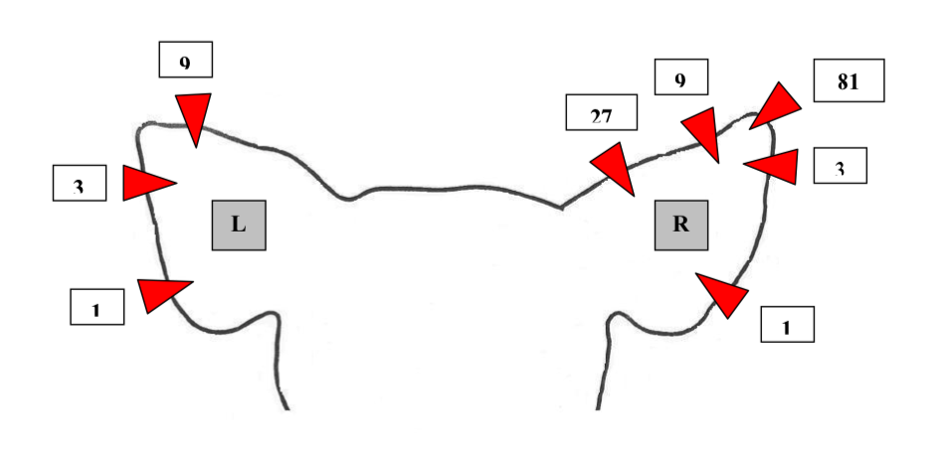
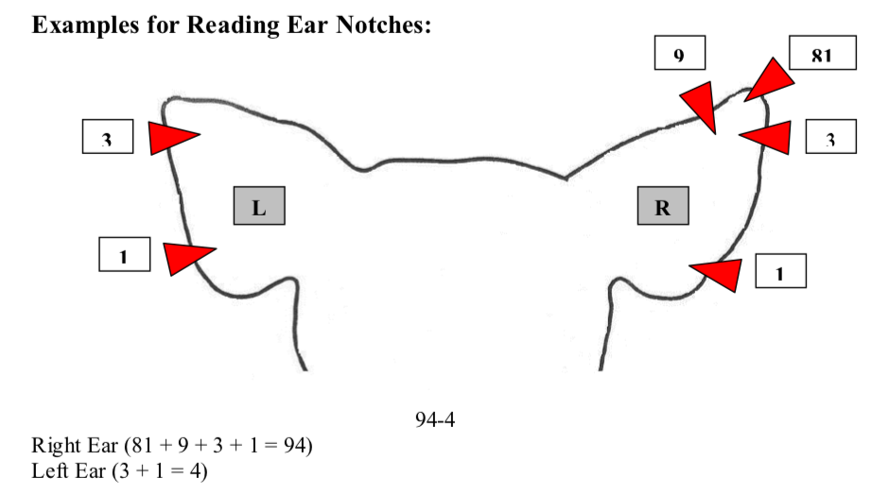
Looking at the back of the pig’s head is the easiest way to read ear notches. Left ear is on the left and right ear is on the right.

Slide 68
Swine management

Slide 69
Objectives
Today's successful swine operation requires an intensive management program, which consists of many variables.
Management practices discussed will include sow and farrowing management, litter management, environmental control, waste management, and shipping procedures.

Slide 70
Routine Sow Management
The most productive periods in the life of a sow are pregnancy and lactation
Factors such as nutrition, housing, season of the year, age at weaning, parity, genotype, and disease affect the reproductive performance of sows
Proper management of the sow is necessary to maximize reproduction.
Sows are polyestrous, which means they cycle at 21-day intervals throughout the year
The length of estrus, also known as sexual receptivity, is between 40 and 60 hours. Ovulation occurs in the sow at about 40 hours after the onset of estrus.

Slide 71
After a gilt or sow has been breed, the gestation period lasts for 114 days
Near the end of the gestation period, the sow should be washed with warm water and a mild antibacterial soap prior to entering the farrowing facilities
This will eliminate soil and fecal material, which contain bacteria
This washing process reduces the number of bacteria, which are potential diarrhea producing agents for nursing pigs

Slide 72
This procedure also eliminates roundworm eggs that could serve as a source of infection to nursing pigs
Internal parasites should be treated by giving the sow and intramuscular injection of ivermectin
The sow will routinely be given vaccinations for problem diseases and treated twice per year for external and internal parasites
In addition, the sow should be examined for evidence of scaly mange and other skin problems prior to entering the farrowing facility and treatments administered, as necessary.

Slide 73
Farrowing Management
Farrowing management should begin about five days prior to the anticipated farrowing date
Good management practices include observing the sow to catch any problems or any indication that a problem exists and preparing the sow and facilities for farrowing
Heat lamps should be placed in the farrowing pens ready to provide warmth for newborn piglets
The period from the beginning of abdominal contractions to the first piglet usually ranges from one to three hours, but may range from 15 minutes up to 10 hours

Slide 74
It is very important to be able to detect the onset of the second stage of labor or the next piglet
Normally, labor continues in a natural progression, and piglets are born without complications
However, sometimes the sow has difficulty and cannot have the piglets
This problem is more common in gilts

Slide 75
If assistance is not provided for complications in farrowing, the result could be stillborn pigs
You should be present for first-litter gilts to monitor for complications and provide assistance to the sow and piglets, as needed
It is sometimes necessary to assist newborn piglets by removing mucus from the nose and mouth
If piglets are born with an abnormally thick membrane, suffocation is possible
Be sure the piglets are dry and able to nurse immediately after birth

Slide 76
Litter Management
At birth, the mucus should be removed from the nose and mouth
The navel cord should be clipped approximately one inch from the belly and disinfected with a solution of iodine
At about one to two weeks of age, the litter should be processed
Processing includes clipping needle teeth, ear notching for identification, vaccinations, tail docking, and navel cord care.
These procedures are performed at an early age to minimize discomfort to the animals and to protect them from injuries and infections. Piglets are also castrated at one to two weeks of age to minimize stress. Castration prevents boar odor in the carcasses of grown animals at the time of slaughter.

Slide 77
Environmental management
The social environment is the interaction the pig has with other pigs.
The social environment is often not considered adequately when constructing a swine facility.
For instance, with many pigs in each individual pen, the level of social stress and fighting is higher and causes productivity to decrease.
The microbial environment can be controlled by sanitation, ventilation, and management of the social environment.

Slide 78
An effective and efficiently operated waste management program will help in reducing disease problems.
The thermal environment includes air temperature, wind speed, and moisture. Management of the thermal environment should be a major objective in order to achieve maximum efficiency concerning heat loss or heat production in the animals.
As pigs experience colder temperatures, they begin to adapt by huddling.
When pigs experience warmer temperatures, they begin to limit their heat production.
Eating increases heat production. Therefore, pigs eat less to limit heat production.
This, in turn, decreases the rate of gain.
Maintaining a constant temperature for animals to maintain a constant level of productivity.

Slide 79
Waste management
Odor control is a major problem for swine producers.
A common problem is neighbor complaints.
The facility location in relationship to neighbors should be considered before constructing a swine facility.
Odor sources from swine units primarily consists of manure and pesticide sprays.
Each of the primary sources can be controlled with proper management practices.
First, become familiar with federal, state, and local pollution control agencies and regulations.
Second, don't become lax on routine management of waste. Timely manure disposal is a priority.

Slide 80
Third, maintain a good neighbor policy.
Keep buildings and manure as far away from neighboring homes as possible.
Finally, keep a regular and efficient cleaning schedule. Dispose and maintain manure regularly and properly
A few good ways to effectively deal with manure are to turn it into compost, use a lagoon, spread it out over your field using a manure spreader

Slide 81
Selection for breeding and market

Slide 82
Breeding selection
When selecting hogs for either a breeding operation or as market hogs, understanding the basic anatomy of the pig is important.
Starting with the head or face, pigs should have a firm, trim jowl.
Females should have a feminine-looking face, while boars should have a stout head.
The shoulder, also known as the blade, should be clean and set wide apart.
Along with having a wide chest, the top should be level and trim, while possessing a trim middle.
Last, the ham or stifle should be muscular.

Slide 83
Structural correctness and growth performance are the two main factors in selecting breeding hogs.
Because of the confinement conditions in which hogs are raised, pigs should have a correct angle in their shoulder and hocks and adequate cushion in their pasterns.
Frame size, body capacity, and muscling are taken into consideration when determining an animal's growth rate.
They should be large in size and wide in their skeleton.
Contrary to belief, the underline is important in both females and males.
Both should have a minimum of six evenly-spaced nipples.

Slide 84
Breeders use performance records (EPDs) when selecting their breeding stock.
Maternal epds, which are an indicator of the dam's mothering ability
Birth date, litter size, number weaned, 21-day litter weight, sow productivity index or SPI, and parity, or the number of litters which the dam has produced.
Terminal epds, which are an indication of market value, are the days to 250 pounds, adjusted fat thickness, and adjusted loin eye area.

Slide 85
Regardless of the type of operation, all selection and breeding programs should be goal-based depending upon market demand.
For example, a commercial operation which sells hogs to a slaughterhouse should select and breed for carcass quality and growth potential.
A seed stock operation which specializes in selling replacement females should select and breed for maternal characteristics, such as number born alive and 21-day literal weight, along with structural correctness to increase longevity within a herd.

Slide 86
Market selection
Today’s market hog are lean and muscular
Productivity and carcass merit have become the main factors when evaluating market hogs
Productivity describes a hog which has the ability to grow fast with a high rate of gain
As well as being structurally correct with skeletal width and a heavy structure

Slide 87
Structure
Feet: pig’s feet should be pointed straight ahead. Avoid animals that toe in or toe out.
Legs: pigs should stand square and straight on their feet and legs. Look for the animal to have long, smooth strides as they walk.
Hocks: Evaluate the hock for proper flexibility. Avoid animals that have too much flex (sickle-hocked) or have limited flex (post-legged). If the legs are pointing forward, the hocks should be also. Avoid animals that are bowlegged or cow-hocked.
Pasterns: Ideally, the pasterns make a 45-degree angle with the ground. Avoid weak pasterns as well as pasterns that seem to pop when the animal walks. This indicates that the animal’s structure may worsen with time.
Shoulders: the animal’s shoulder should tie in smoothly with its neck and make a 45-degree angle with the body.

Slide 88
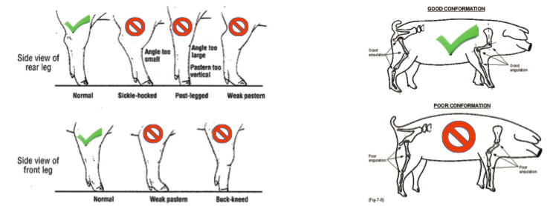

Slide 89
Muscle
Muscle and structure go hand-in-hand.
Evaluate the animal’s muscle from behind, from the side and when looking down their top.
It is extremely important for a market barrow to have enough expressive muscle because they are evaluated on ability to produce a carcass that results in the maximum amount of lean meat with a minimum amount of excess fat.
Market barrows should have a thick, level, muscular loin, and a long, level, wide ham.
The loin should be heavily muscled, indicated by a deep groove down the center and rounded on the edges.

Slide 90
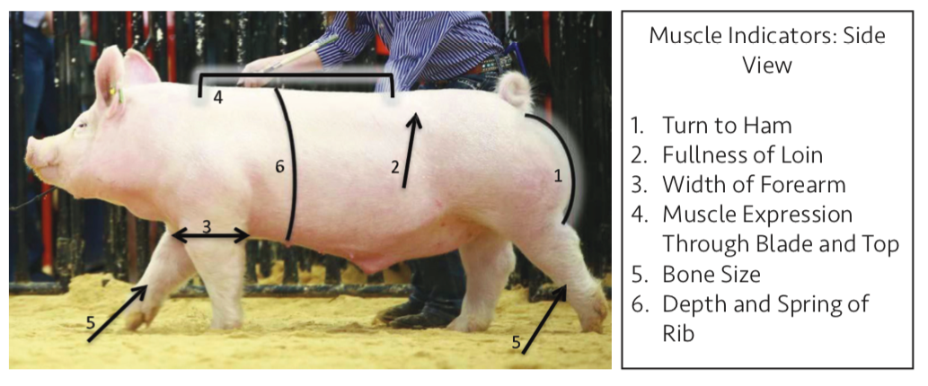
The muscling in the ham should be long and deep creating an expressive look in the animal’s hindquarter.
Expressive muscle refers to muscle that you see on a live animal.
Heavily muscled pigs will also be wide in their shoulders and chest floor.
Muscle indicators for breeding gilts are similar to a market barrow’s , however, excessive muscling on a breeding gilt should be avoided.
A breeding gilt should be thick through the center of her ham, wide in her top, and have a base width equal to the width of her top.

Slide 92
Evaluation of finish
There are numerous places to use to observe fat deposition on a hog, including the jowl, elbow pocket, loin edge, and seam of the ham.
The ideal market hog will be relatively lean while still maintaining muscle and expression.
It is important to have a leaner, trimmer design with little to no excess fat in the jowl, underline, or over the shoulder blades, or in the seam of the ham.
A groove down the top and a dimple right in front of the tail are also good features indicating leanness.

Slide 93
In production agriculture, once a market hog reaches their final destination to be harvested, they are analyzed and sold using a grid.
This grid emphasizes carcass weight and percent lean or percent muscle.
A carcass can either receive a premium, discount, or regular market price depending on their percent lean in relation to their hot carcass weight.
Therefore, heavy muscled, leaner designed barrows that have a higher cutability are ideal for market hogs.
The least desirable combination is having a light muscled, low cutability hog that is very over-conditioned.

Slide 96
“Growthy”
Describes an estimation of the potential an animal has in terms of skeletal growth.
These animals tend to have more length and extension to their body
Look for animals that have more length and extension to their cannon bone, as well as through their neck to head

Slide 97
“Level or level designed”
Describes animals that are good in their spine or top line.
From the top of their shoulder (at the base of their neck) to pin set (back side of the hip).
These animals are usually level in their top and level in their hip, not only at the profile, but they stay strong and uniform in how they handle when set in motion.

Slide 98
“heavy muscled”
Refers to the amount of product an animal covers its skeleton with.
Can also refer to how much product a market animal may hang on the rail.
Look for it down an animal’s top, from blade to hip, and in the animal’s hip from top to bottom.
One of the MOST overlooked places to evaluate muscle is in the animal’s forearm.
Sometimes too much muscle will affect an animal’s balance or structure in a negative way
The right kind of mass and expression of muscle is usually a good thing.
Be sure to look for expression and definition to differentiate between true muscle and fat cover.

Slide 99
“stout featured” vs “frail”
The trend is to have “burly” “dense” bone work.
Bigger footed, bigger boned creates the illusion of a bigger, stouter base with more durability and perhaps more longevity.
Just makes those stouter, wider built, heavier muscled animals look more proportionate.
Look at circumference of the front and back legs and the size of their feet.
Be careful that isn’t just the illusion of hairy or leg wool legs, just creates the illusion of bone.
“Frail” is just a description of animals whose foot size and bone circumference doesn’t match their overall mass, muscle or width.

Slide 100
“deep” or “deep bodied”
Depth of body is an indicator of rib, internal capacity, and fill.
An important feature to look for in breeding stock
Helps an animal’s look of being balanced
“Deep” is like everything else- it needs to fit and be proportionate to the build, frame and design of the animal.

Slide 101
“Maternal wedge”
“Maternal wedge” sometimes called “feminine wedge”.
When viewed from the side we want that female to be elevated or “shallow” in their chest floor, and then get progressively deeper and more maternal in their underline as we move to their navel and on to their flank.
All while still having a strong, level top line. This creates the “wedge” or maternal triangle view.

Slide 102
Ear notching speed game

Slide 103
Instructions
2 teams
Each group will nominate a group member to come up to the board per round.
There will be a pig displayed with ear notches
Your goal is to read that pigs litter number and individual number the fastest!
The fastest one per round will earn 1 point for their team
Other team members be ready! If neither of them can read the notches correctly, another member of your team can have a go!

Slide 104
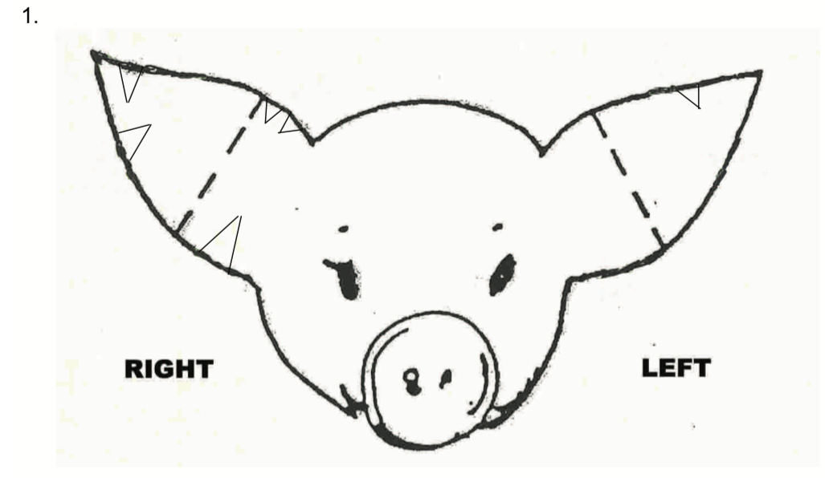

Slide 105
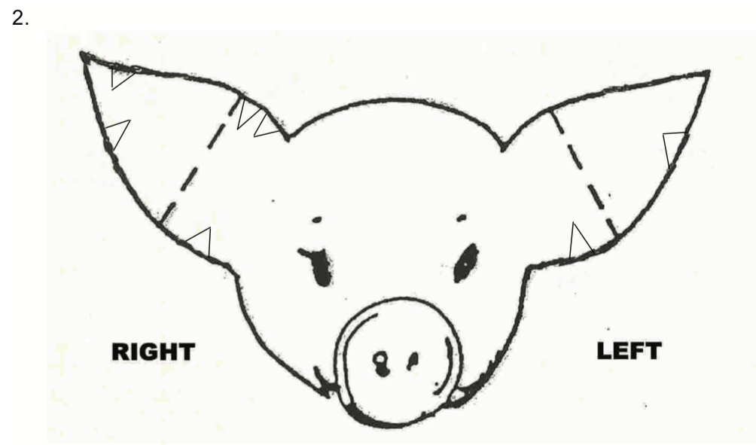

Slide 106
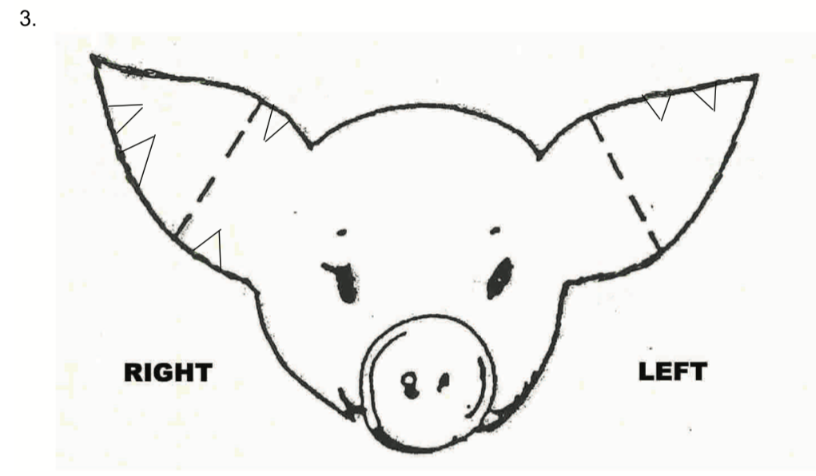

Slide 107
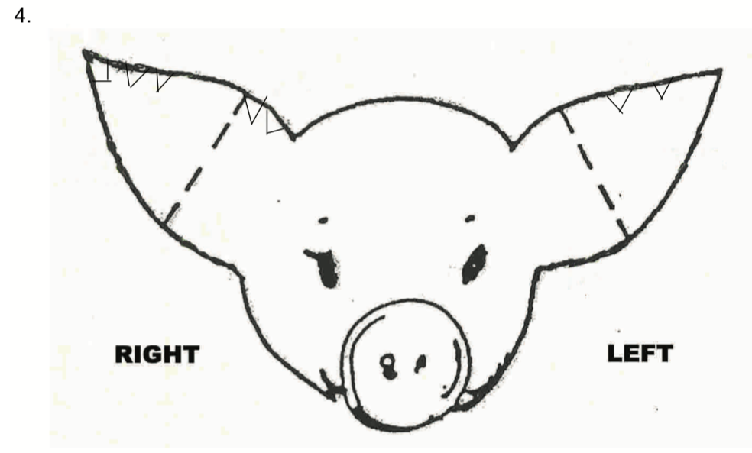

Slide 108
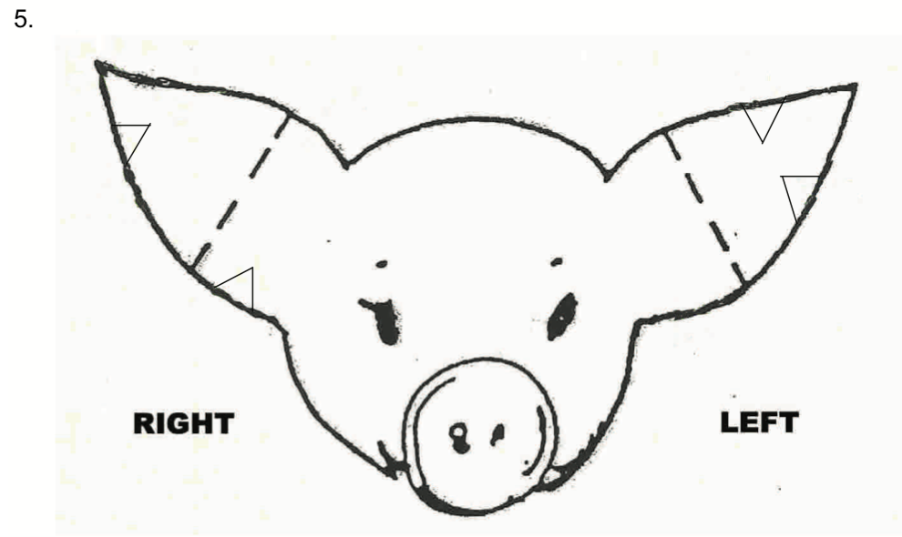

Slide 109
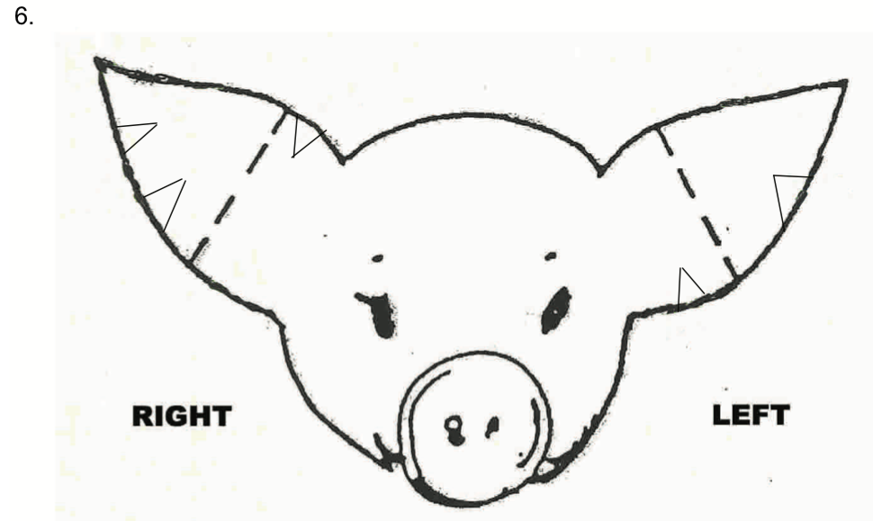

Slide 110
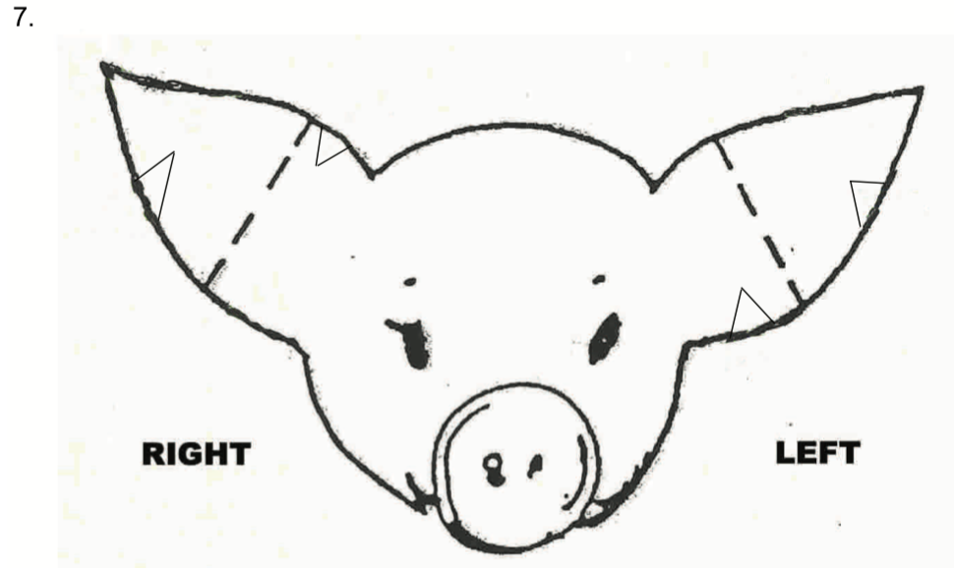

Slide 111
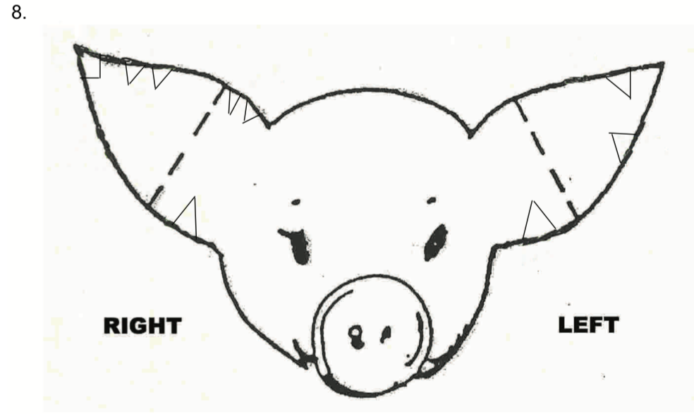

Slide 112
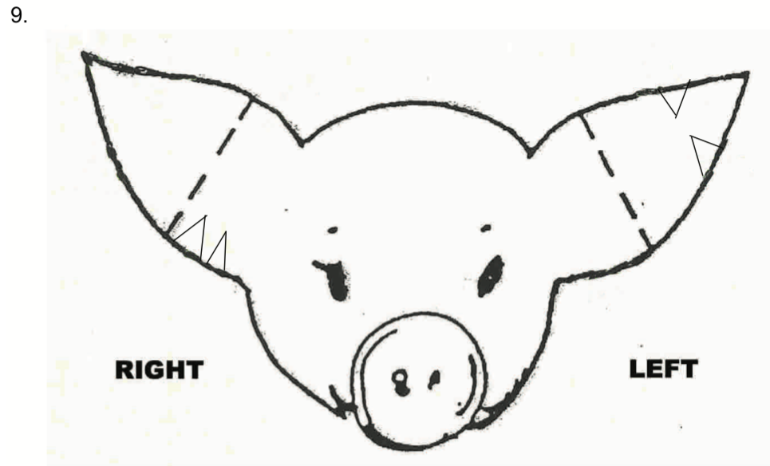

Slide 113
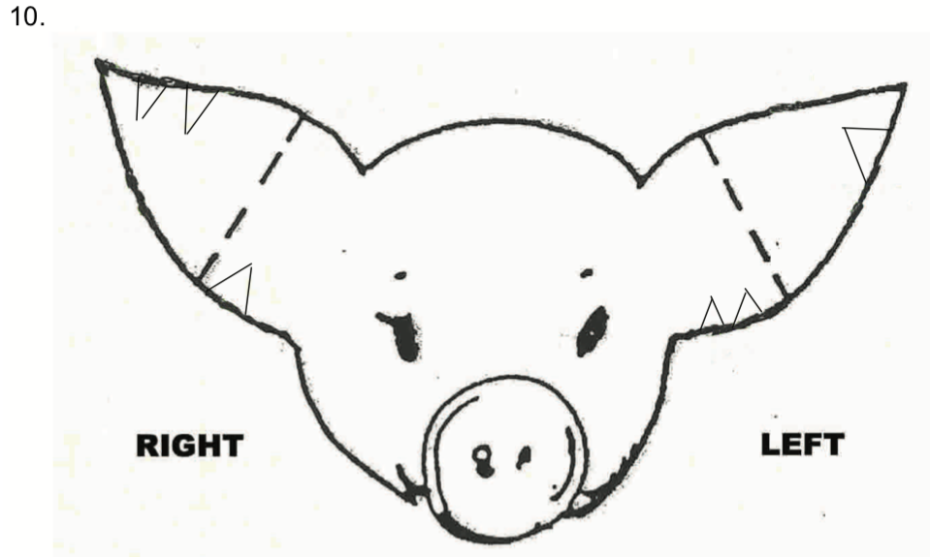

Slide 114
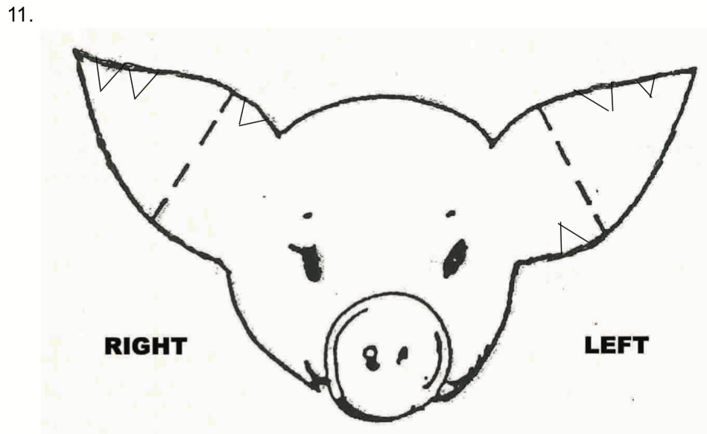

Slide 115
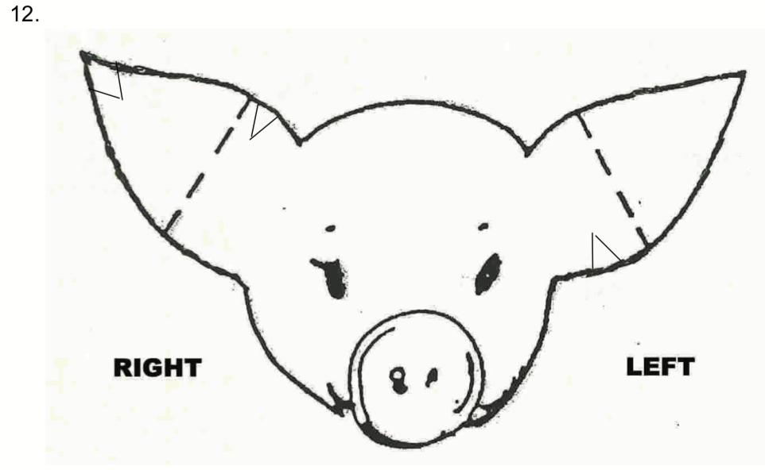

Slide 116
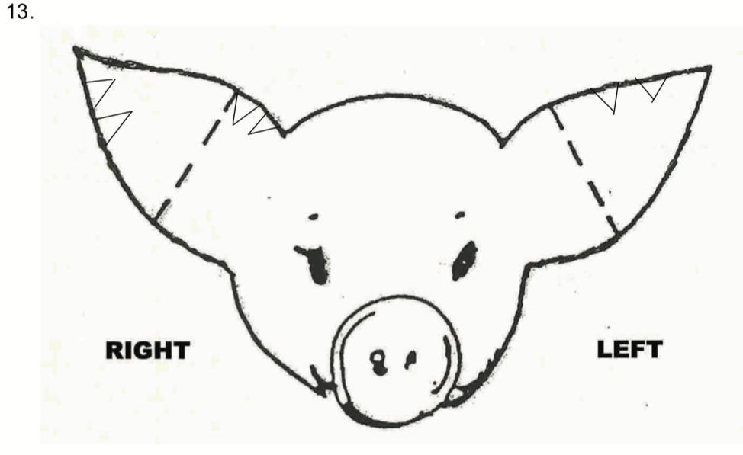

Slide 117
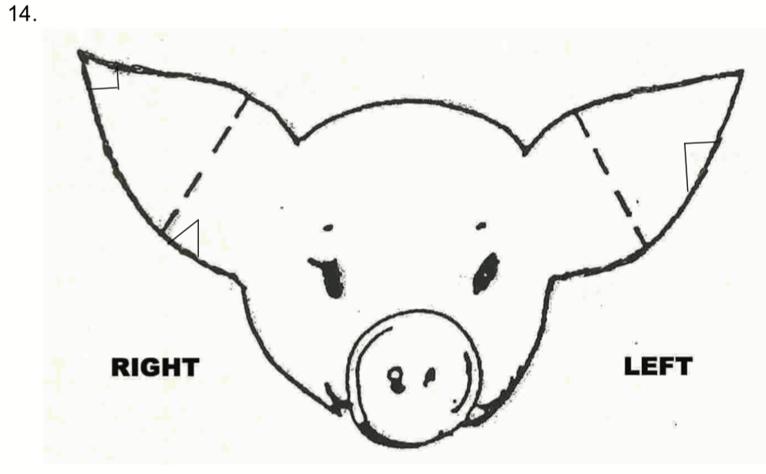

Slide 118
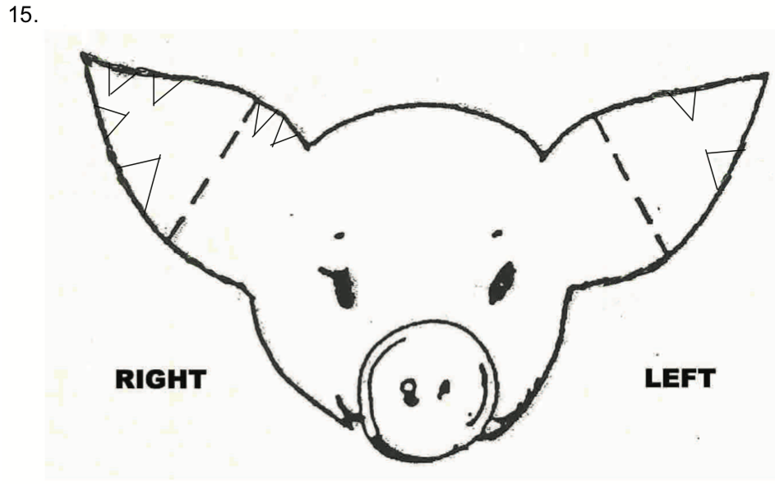

Slide 119
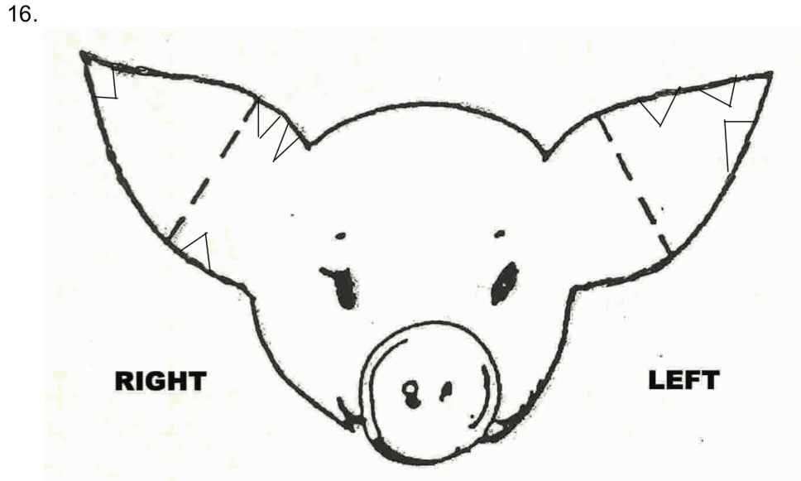

Slide 120
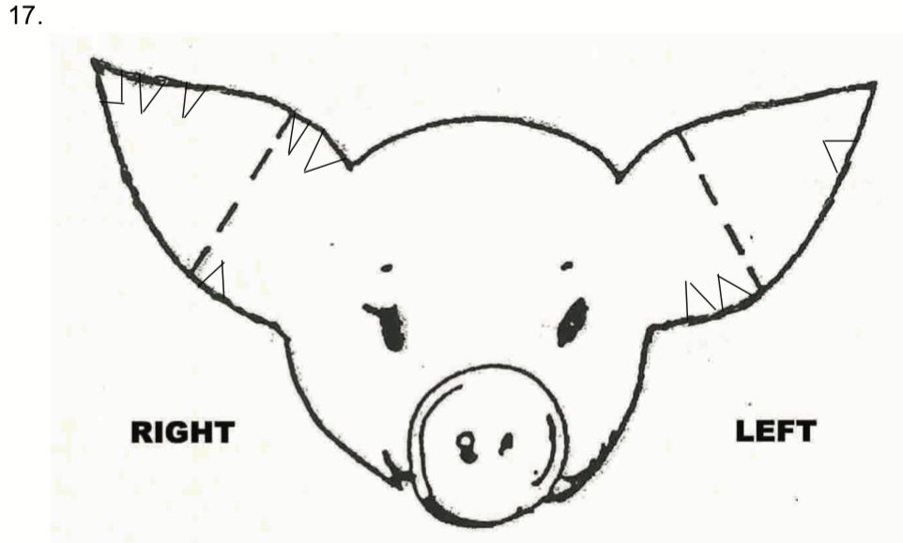

Slide 122
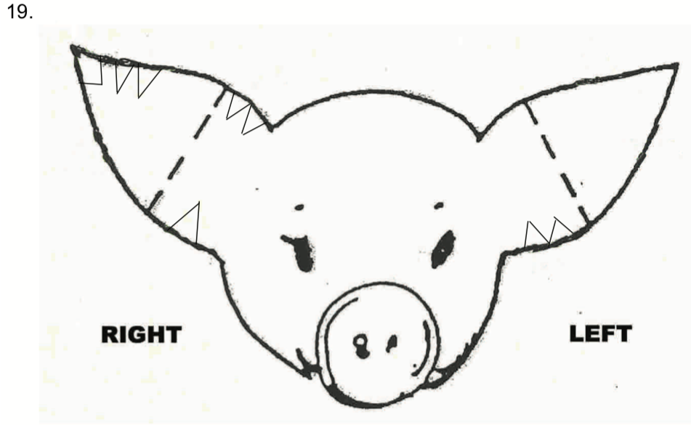

Slide 123
