Slide 1
Project Learning Tree
PLT’s E-Units:
Workshop Title
Presenter 1 Name, Presenter 1 Title
Presenter 2 Name, Presenter 2 Title
Notes:
Remember to update the red text with your workshop-specific information.

Slide 2
Lexi Brown
MSU Extension Forestry
32 Campus Drive MS0606
Missoula MT 59812-0606
(406) 243-4706
alexios.brown@montana.edu
www.montana.edu/extension/forestry/projectlearningtree

Slide 3
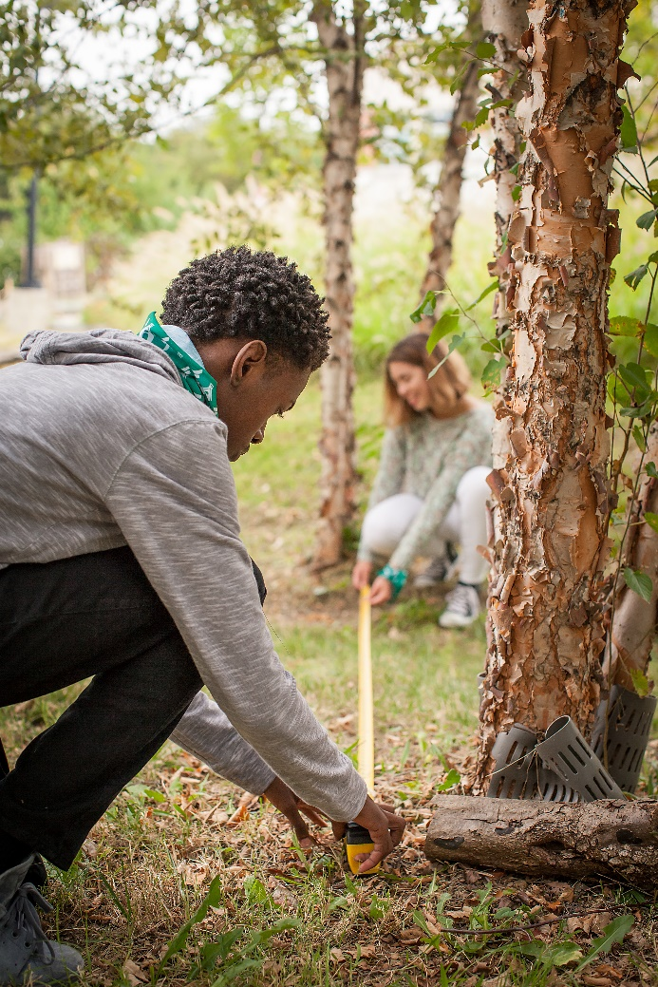
Project Learning Tree
A Comprehensive
Environmental Education
Program
High quality, preK-12 curriculum materials
Professional development for educators
International network of partners

Slide 4
PLT uses forests as “windows on the world” to help students
Understand ecological systems
Think critically and creatively
Make informed decisions on environmental issues
Take responsible action

Slide 5
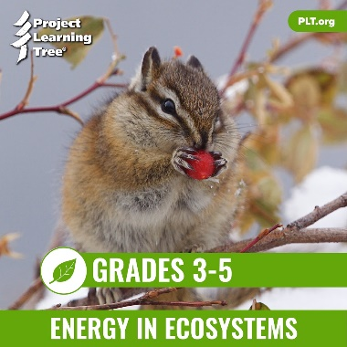
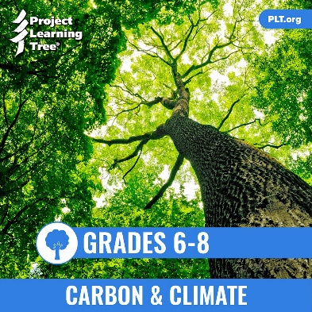
PLT’s E-Units
Designed by teachers
Housed entirely online for access anywhere
Constructed around targeted performance expectations in NGSS
Aligned with Common Core and C3 Framework
Notes:
Use this slide to introduce the PLT E-Units in general, pointing out that PLT began with the standards and NGSS’s three-dimensional approach in the initial design of the unit.
In addition, the e-units are aligned with two other academic benchmarks: Common Core (ELA and Math), and The College, Career, and Civic Life (C3) Framework for Social Studies.

Slide 6
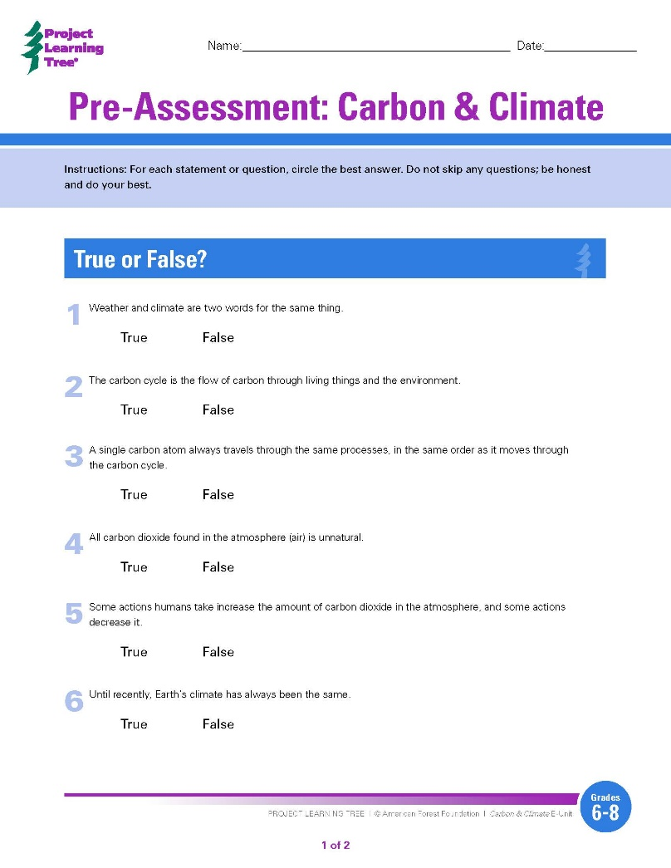
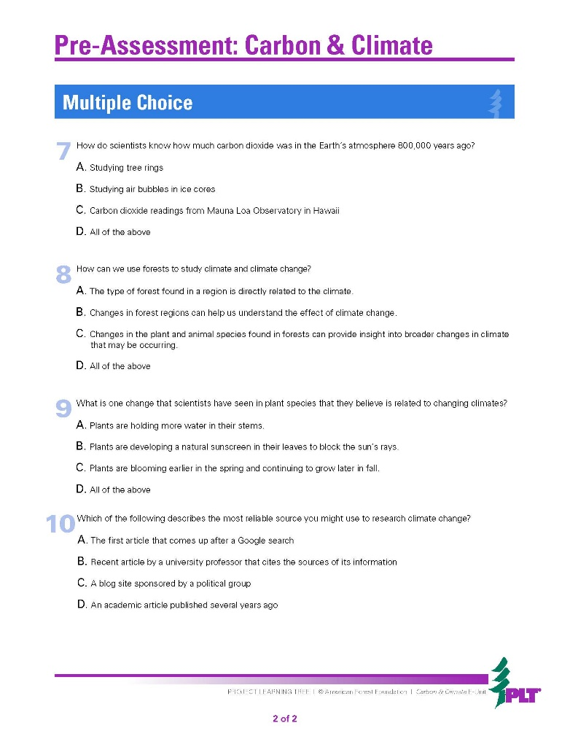
Unit
Assessment
Notes:
Use this slide to point out that the e-units have built-in unit assessments. They include pre-assessment instruments, such as this one from the Carbon & Climate unit for grades 6-8, which helps teachers determine their students’ prior knowledge on the topic.

Slide 7
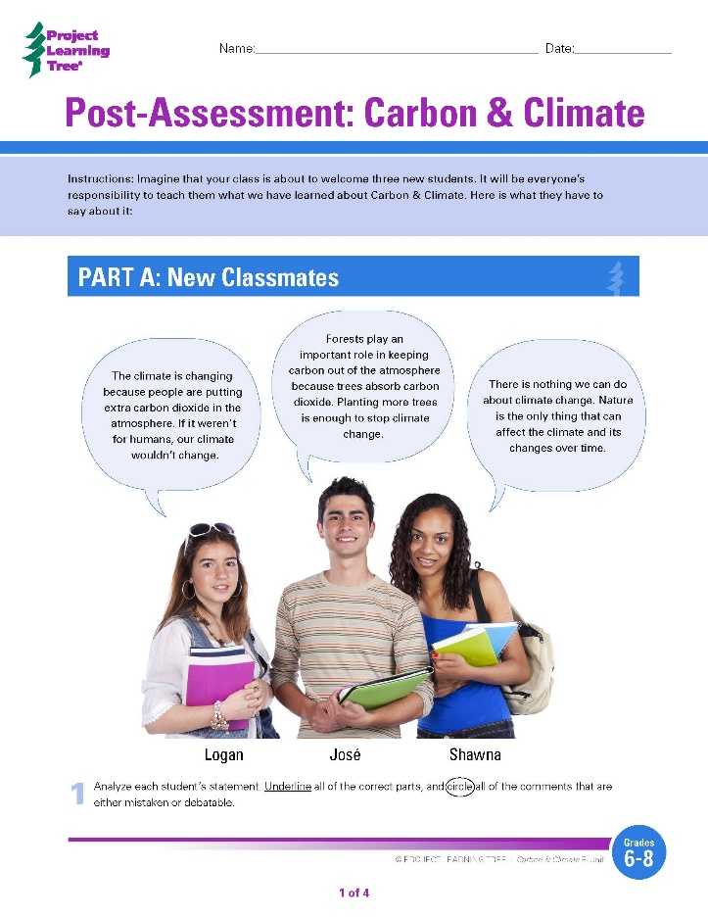
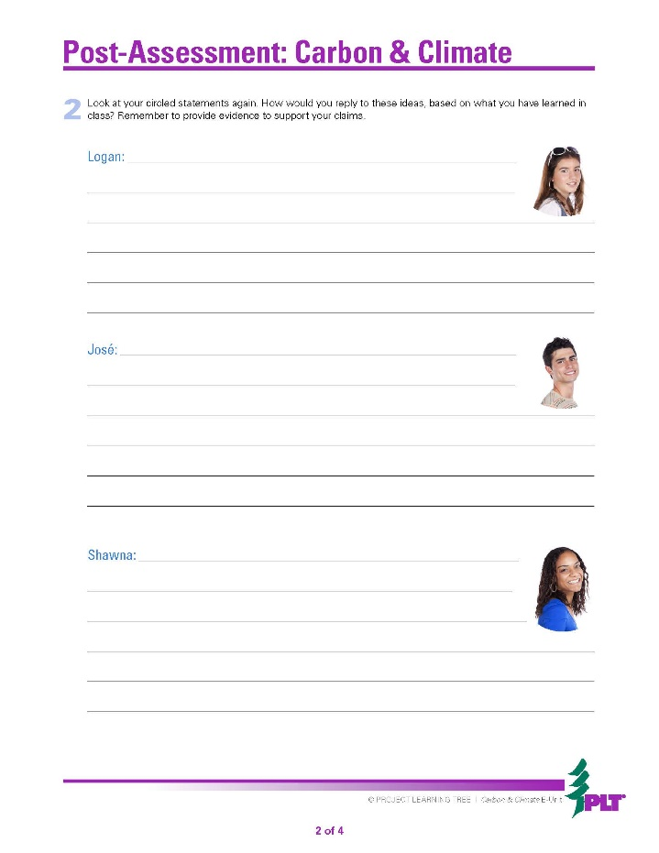
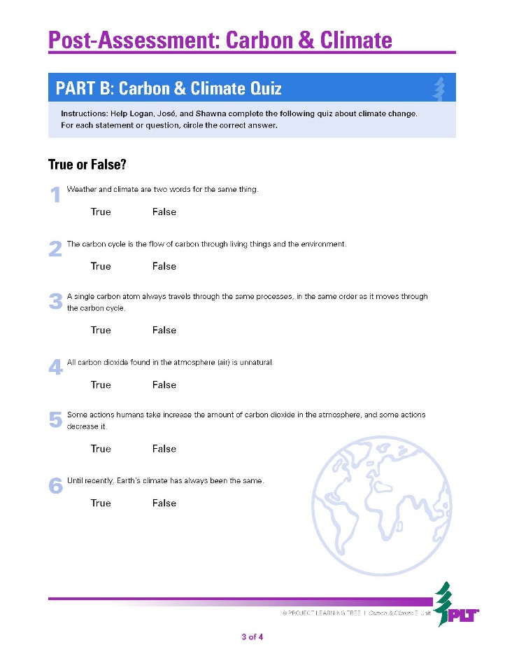
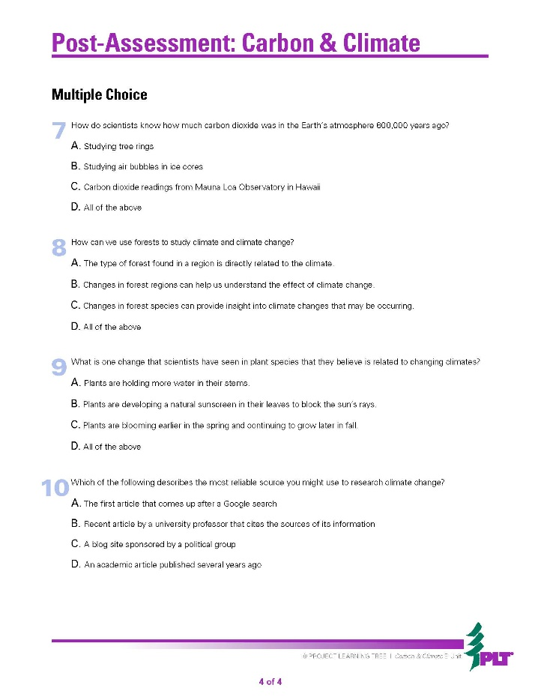
Notes:
The e-units also include post-assessment instruments, that include the same true/false and multiple choice questions as the pre-assessment as well as more open-ended questions (as on the first two pages of the Carbon & Climate post-assessment) to help teachers determine student knowledge gains over time.
In addition to the unit-level assessments, each e-unit also includes activity-level evaluation options and assessment rubrics to help teachers conduct formative assessments at various points throughout the unit.

Slide 8
Exploring an E-Unit
Treemendous Science E-Unit
Energy in Ecosystems E-Unit
Carbon & Climate E-Unit
Notes:
PLT has 3 e-units available at this time, each for a different grade level band.
This slide contains links to the three live e-unit websites. Click on one of the pictures (or on the URL) to go to that e-unit. You must be logged into your e-unit account in advance to access the embedded links.
Subsequent slides provide screen shot images from the Energy in Ecosystems unit if wifi is not available or reliable.

Slide 9
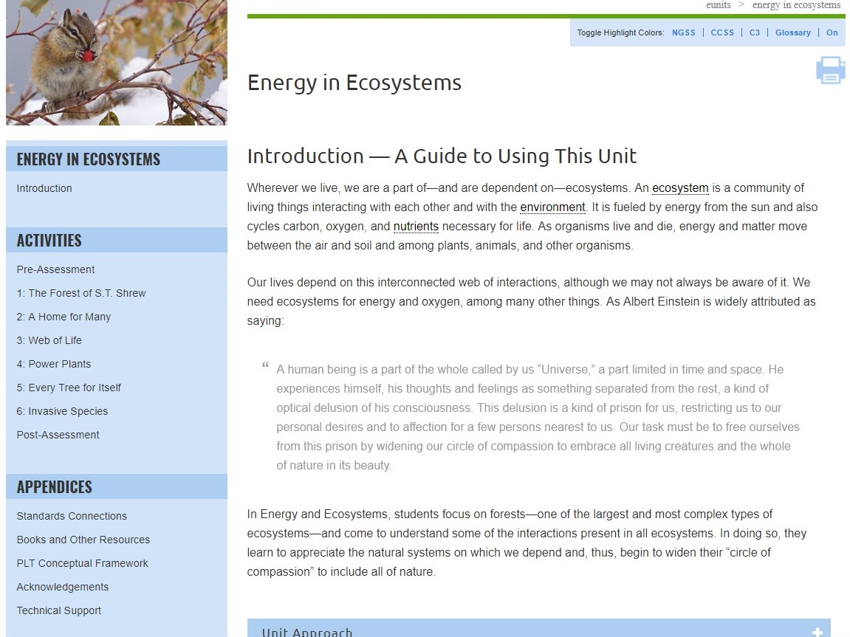
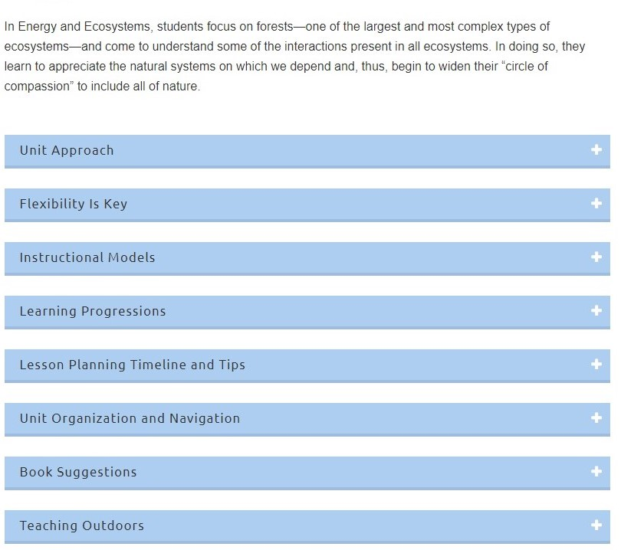
Notes:
Us this and the following slides to walk through a sample E-Unit (Energy in Ecosystems for Grades 3-5). Each unit has an introduction that includes many useful sections. Pick one or two to highlight, such as the Learning Progressions or Lesson Planning Timeline and Tips.

Slide 10
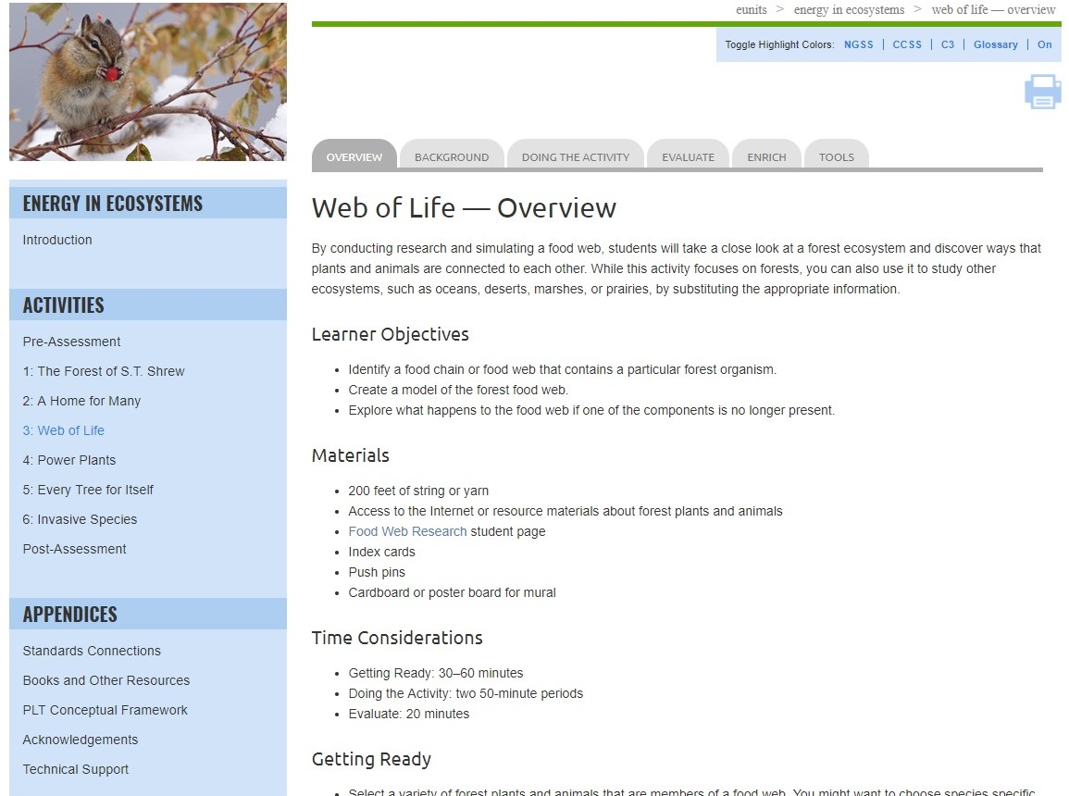
Notes:
Use this slide and those that follow to explain the e-unit navigation and layout.
Be sure to review the unit-level blue left-hand navigation bar, as well as the gray tabs across the top for individual activities.

Slide 11
Notes:
Use this slide to point out that in-depth background information is provided for each activity. (For the K-2 Treemendous Science! unit, background information is provided for the unit as a whole. Note that this section may include helpful photos, charts, or diagrams.

Slide 12
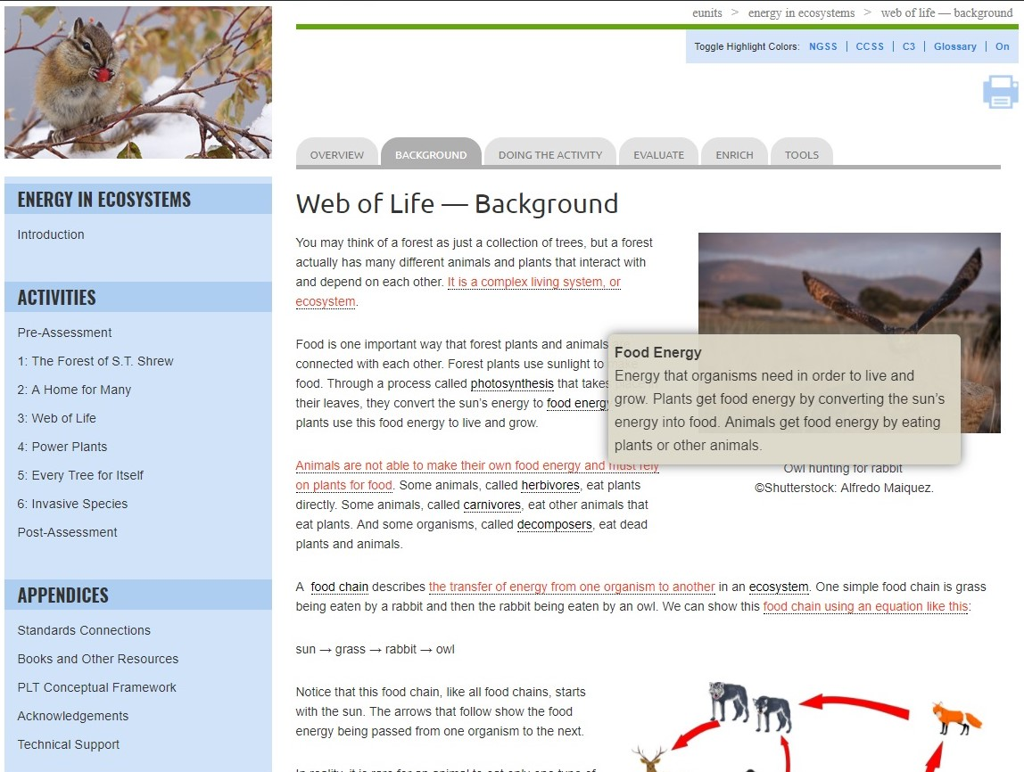
Notes:
Also note that the background and other activity sections include pop-up definitions for key vocabulary.

Slide 13
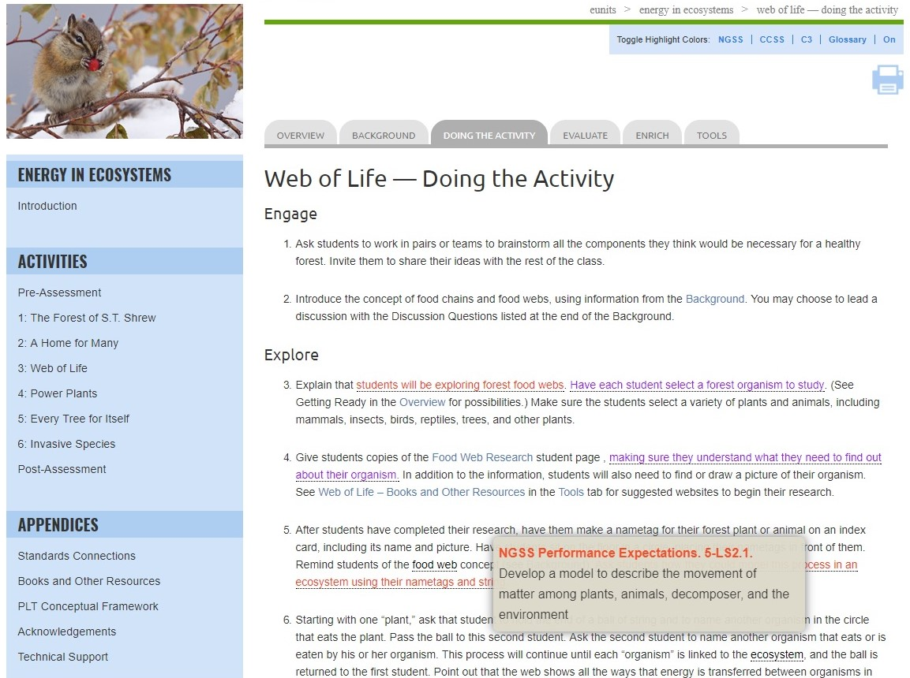
Notes:
Use this slide and the one that follows to show the interactive standards pop-ups.
Each e-unit is built around performance expectations from the Next Generation Science Standards (NGSS). The specific connections are identified with the pop-up feature.
While the e-units are based on NGSS standards, they will also help meet relevant state science standards.

Slide 14
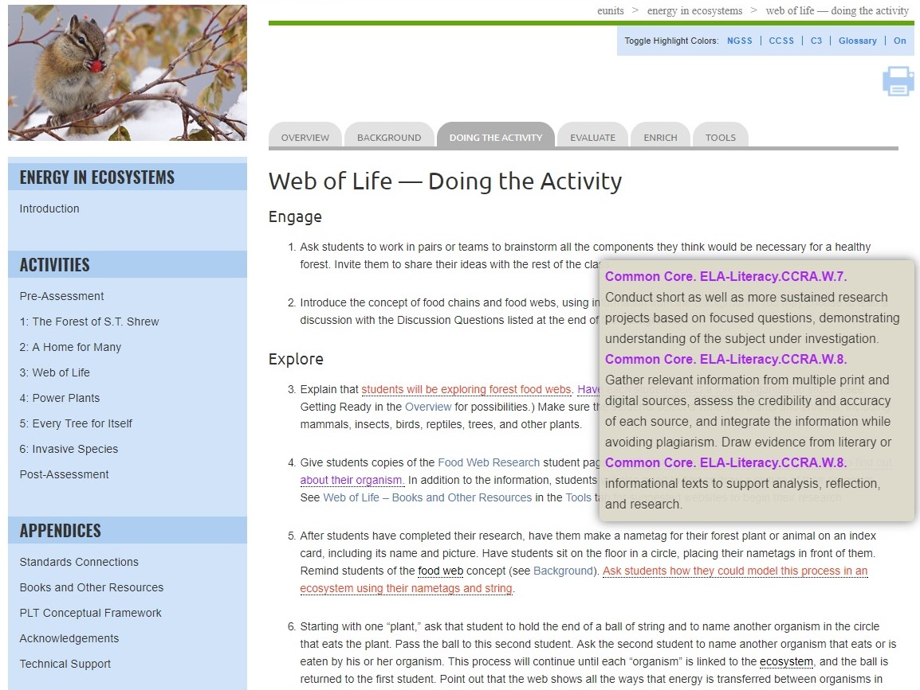
Notes:
Each e-unit also integrates math, language arts, and other discipline areas in fun and creative ways, drawing on both mathematics and English language arts benchmarks from the Common Core State Standards.
Remember to mention that red pop ups signify NGSS connections, purple are Common Core (English language arts and mathematics), and green are the C3 Framework (social studies).

Slide 15
Notes:
Use this slide to point out that the units are designed around the 5E Instructional Model:
Engage
Explore
Explain
Elaborate
Evaluate
The 3-5 Energy in Ecosystems and 6-8 Carbon & Climate units identify Engage, Explore, Explain, and Elaborate sections within the Doing the Activity tab. Note that Evaluate is listed in a separate tab.
Please note that this slide includes an imbedded screen video showing the headers that indicate the relevant parts of the model: Engage, Explore, Explain, and Elaborate within Doing the Activity.

Slide 16
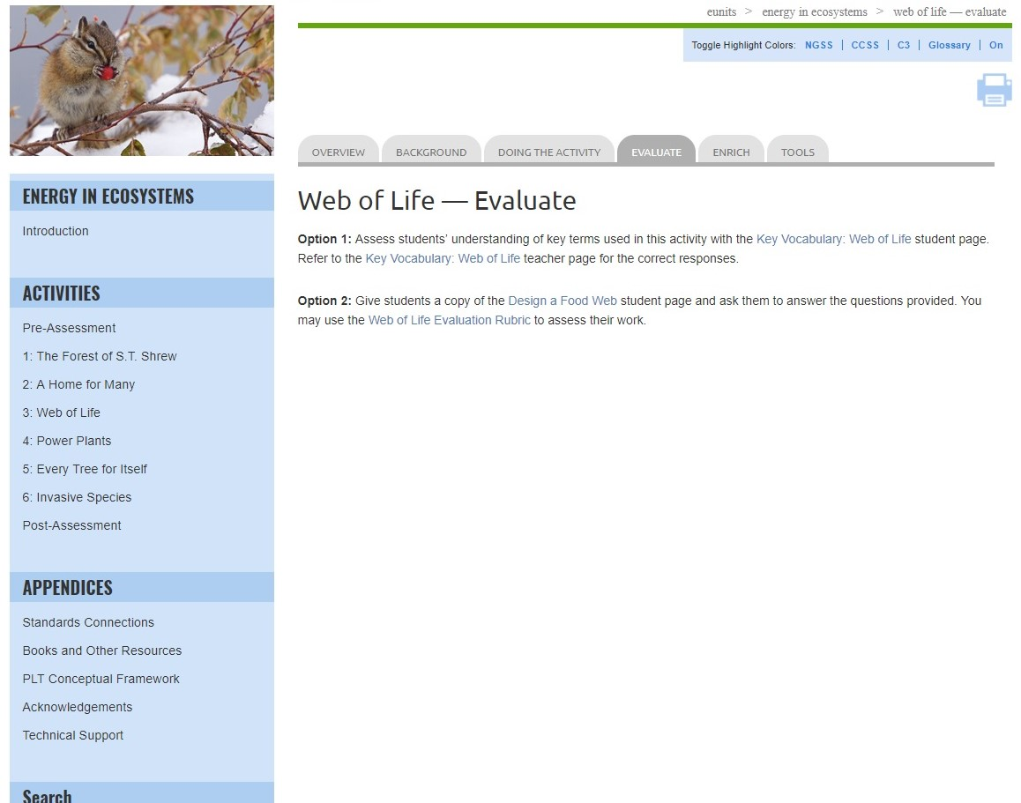
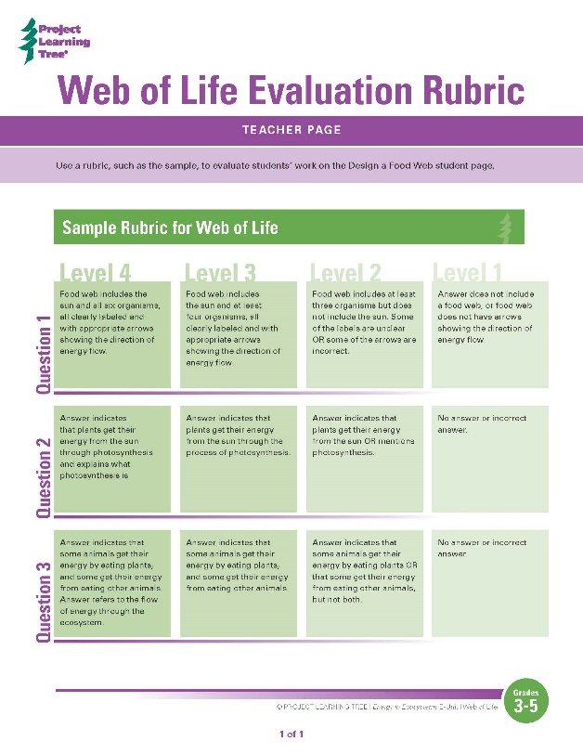
Notes:
In addition to Pre- and Post-Assessment instruments, each unit contains multiple assessment options. Including:
Vocabulary worksheets
Rubrics to assess student learning
Additional evaluation options

Slide 17
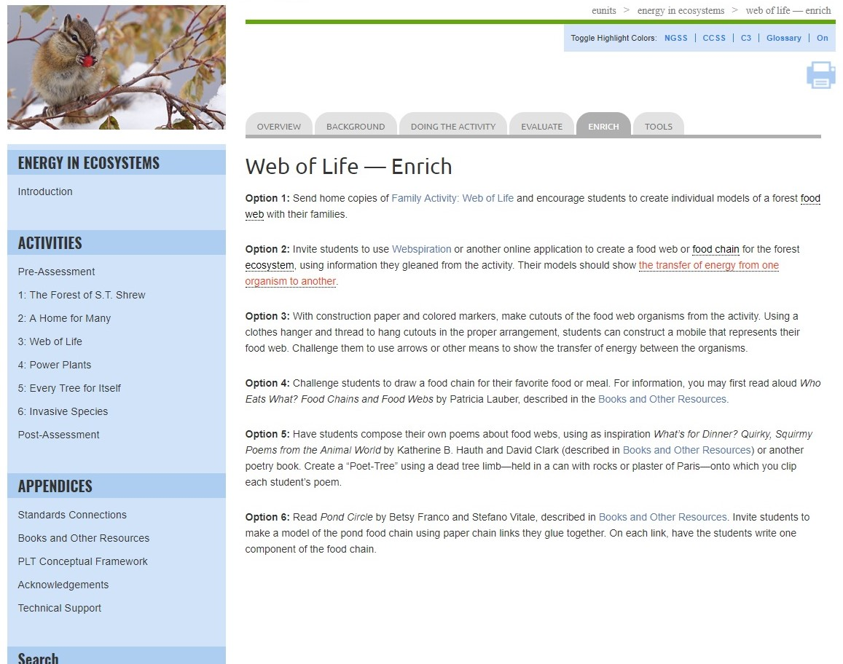
Notes:
Each activity and unit also provides suggested enrich options to extend learning

Slide 18
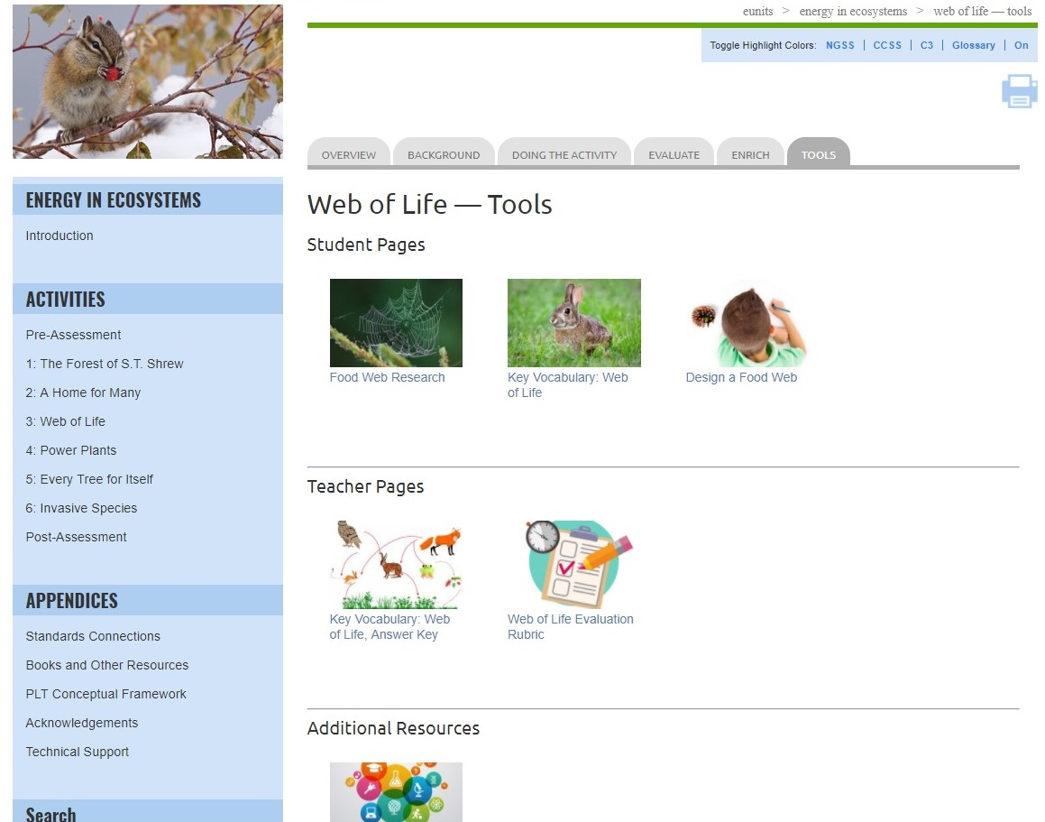
Notes:
Tools include:
Student pages
Teacher pages
Links to Additional Resources

Slide 19
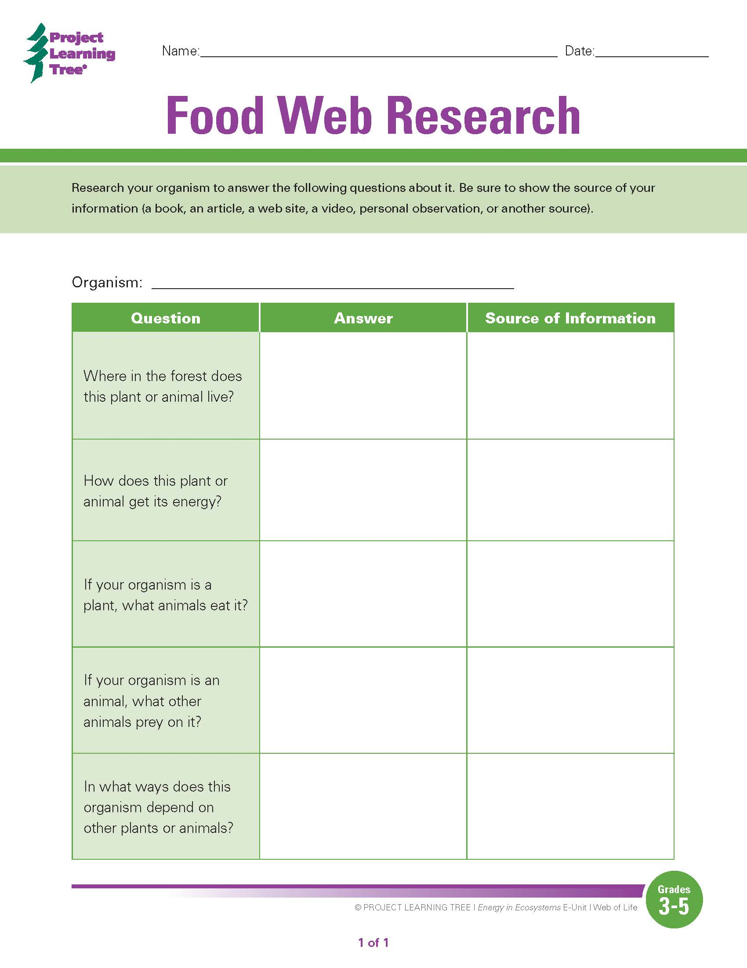
Notes:
Example student page
One of the exciting features of the e-units are that student pages are both printable and fillable. These pages can also be downloaded and saved to your computer.

Slide 20
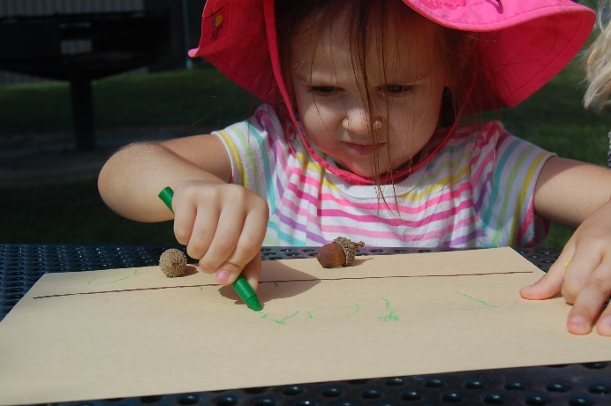
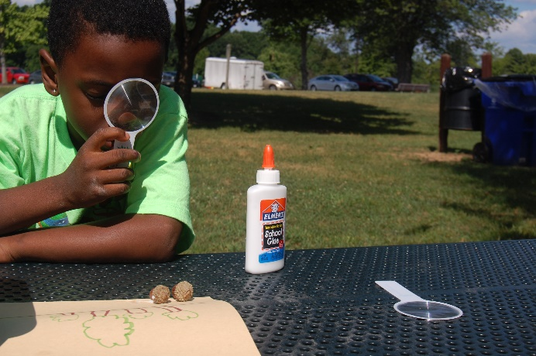
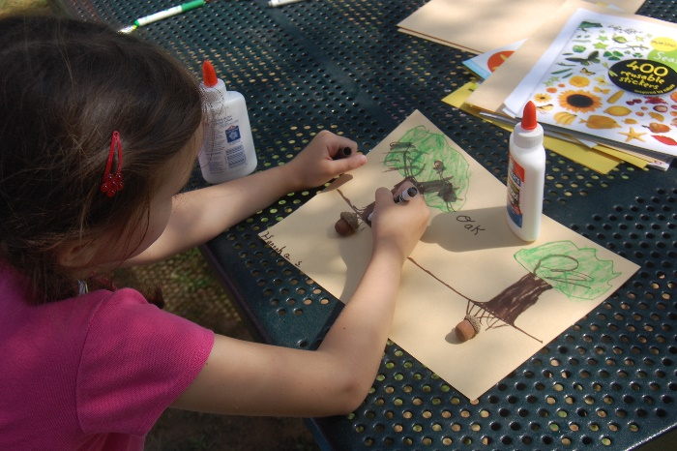
Tremendous Science!
Level B
Level C
(Kindergarten)
(First Grade)
(Second Grade)
Notes:
Use this slide to explain that Treemendous Science! is organized around three levels – Level A corresponding to approximately Kindergarten, Level B to 1st Grade and Level C to 2nd Grade.
Each level has a set of activities tailored to its target grade level. An activity may occur in all levels, but with slight variations to accommodate different levels of learners (as in Adopt a Tree), or it may occur in only one level.
PLT recognizes that the K-2 grade band represents a time of great adjustment, knowledge gain, and personal growth, with different children developing at different paces. To accommodate this variability, teachers can choose activities from one level, or select activities from multiple levels to meet the specific needs of their students.

Slide 21
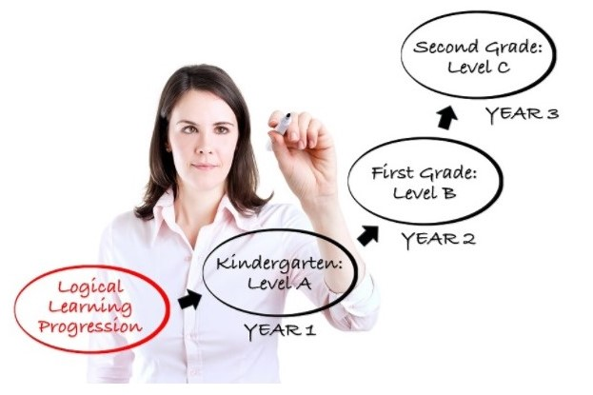
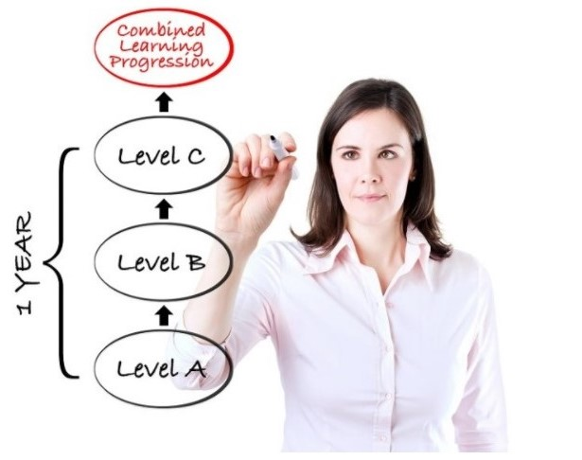
Team Teaching Progressions
Notes:
Use this slide to share different ways that teachers might use the three levels in the Treemendous Science! e-unit – either working alone or as part of a teaching team.
In one option, they could take parts from each of the Levels to individualize instruction for their students.
In a second option, they could work with other teachers in the team to teach Level A in kindergarten, Level B in first grade and Level C in second grade, thus enabling the same cohort of students to build on and refine their content knowledge over time.
In yet a third option, they could teach the three level consecutively within the same year, allowing students to gain an in-depth understanding of the unit content.

Slide 22
Notes:
Use this slide (and/or the others) to highlight relevant appendices for your audience; they include:
Standards Connections
Books and Other Resources (or Additional Resources)
PLT Conceptual Framework
Acknowledgements
Technical Support
Standards Connections in the appendices is a listing of all of the connections for the entire unit that are identified by the pop-up feature.

Slide 23
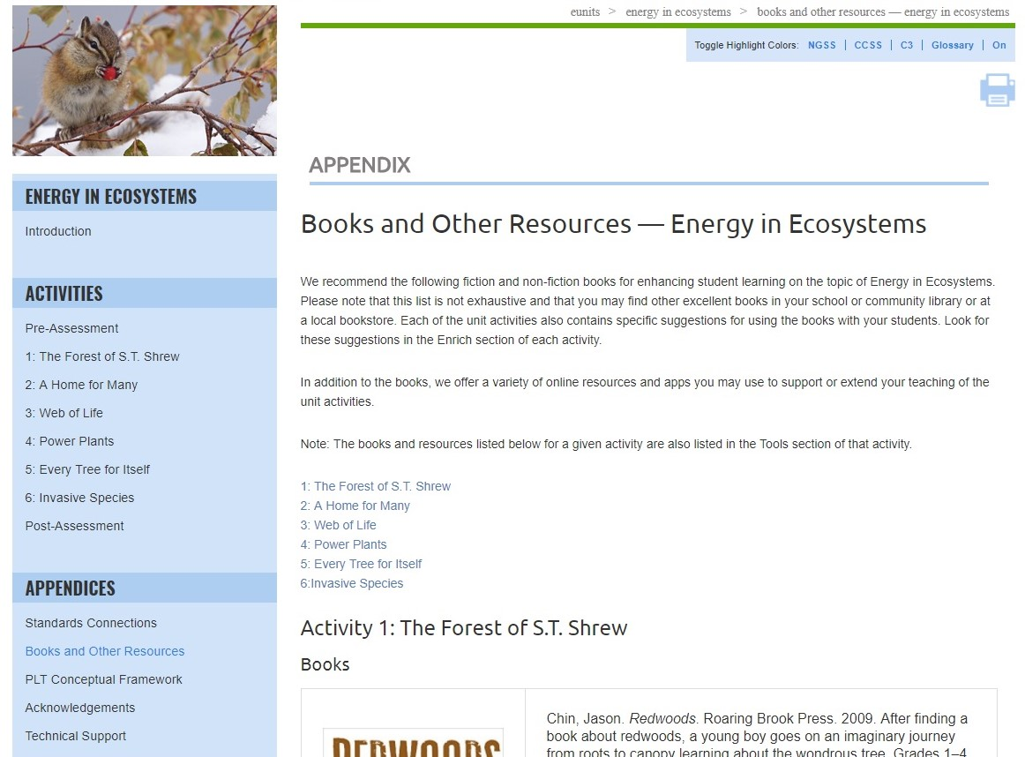
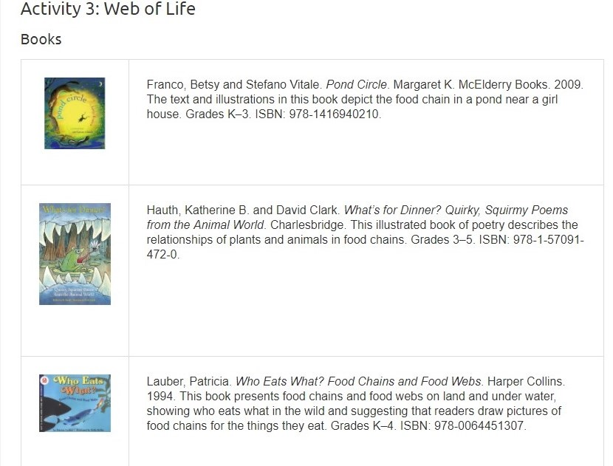
Notes:
Use this slide (and/or the others) to highlight relevant appendices for your audience; they include:
Standards Connections
Books and Other Resources (or Additional Resources)
PLT Conceptual Framework
Acknowledgements
Technical Support
Books and Other Resources in the appendices is a listing of all websites, books, and other resources for the unit as a whole as well as activity-by-activity resources to support teaching of the unit.
Note that for Carbon & Climate, the appendix is called Additional Resources.
Also note that for Treemendous Science! relevant Literature Connections are contained in the Enrich tab

Slide 24
Notes:
Use this slide (and/or the others) to highlight relevant appendices for your audience; they include:
Standards Connections
Books and Other Resources (or Additional Resources)
PLT Conceptual Framework
Acknowledgements
Technical Support
The PLT Conceptual Framework serves as a foundation for all of PLT’s curriculum materials.

Slide 25
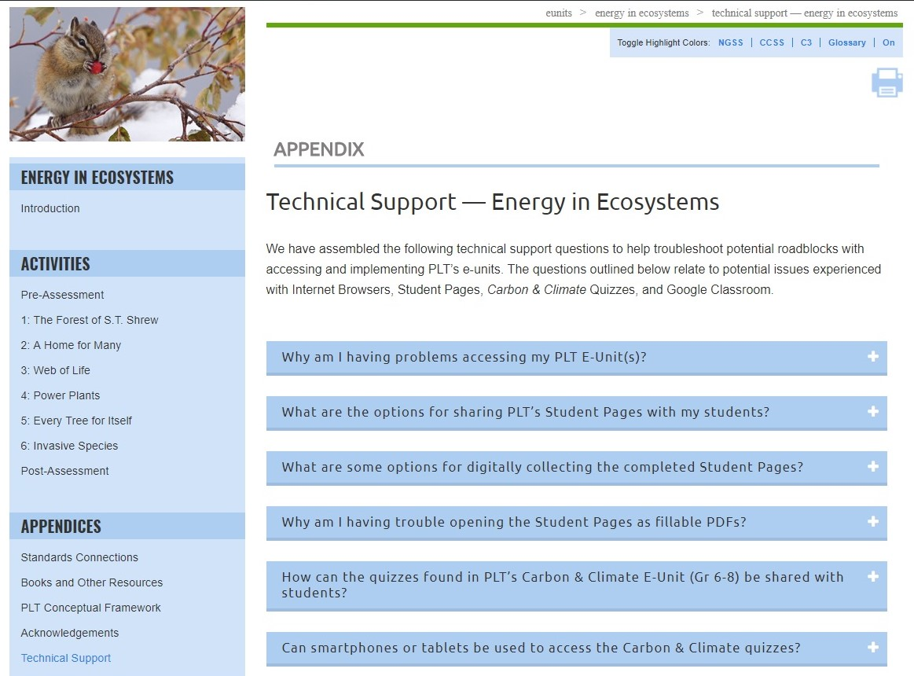
Notes:
Use this slide (and/or the others) to highlight relevant appendices for your audience; they include:
Standards Connections
Books and Other Resources (or Additional Resources)
PLT Conceptual Framework
Acknowledgements
Technical Support
Technical Support answers common technical questions to help troubleshoot potential problems with accessing and using the e-units. Questions relate to potential issues experienced with internet browsers, student pages, quizzes and Google Classroom.

Slide 26
Supports for Teaching Activities
Step-by-step instructions
Extensive background sections
Vocabulary exercises
Suggested book, websites, and other resources
Assessment rubrics
Printable and fillable student pages
Notes:
The Energy in Ecosystems e-unit contains lots of resources and materials to support teaching the activities.

Slide 27
Obtaining PLT E-Units
In-Person Professional Development
Contact your PLT State Coordinator
www.plt.org/your-state-project-learning-tree-program
Online Professional Development
Self-paced online workshop included with e-unit
$40 per e-unit at shop.plt.org
Notes:
If desired, insert your state specific contact information or upcoming workshop details.

Slide 28
Questions, Comments?
Presenter 1 Name
Presenter 1 Title, State
Presenter1email@xxxx.org
Presenter 2 Name
Presenter 2 Title, State
Presenter2email@xxxx.org
Thank you!
Notes:
Remember to update the red text with your workshop-specific information.
Distribute any evaluation forms at this time, tying survey questions to the intended workshop outcome, as appropriate.

Slide 29
Project Learning Tree Montana
These workshops are funded in part from a federal award of the U.S. Forest Service, Department of Agriculture, subawarded by the Montana Department of Natural Resources and Conservation, Forestry Division to Montana State University Extension.
The Montana State University Extension Service is an ADA/EO/AA/ Veteran’s Preference Employer and Provider of Educational Outreach.

